Slide 1
Visual Design Elements and Principles
CSE/ISE 334 Spring 2011
Tony Scarlatos

Slide 2
“Consensus” Visual Design Process
Elements
Principles
Product
Space
Color
Contrast
Line
Shape
Texture
Balance
Emphasis
Pattern
Variety
Movement
Proportion

Slide 3
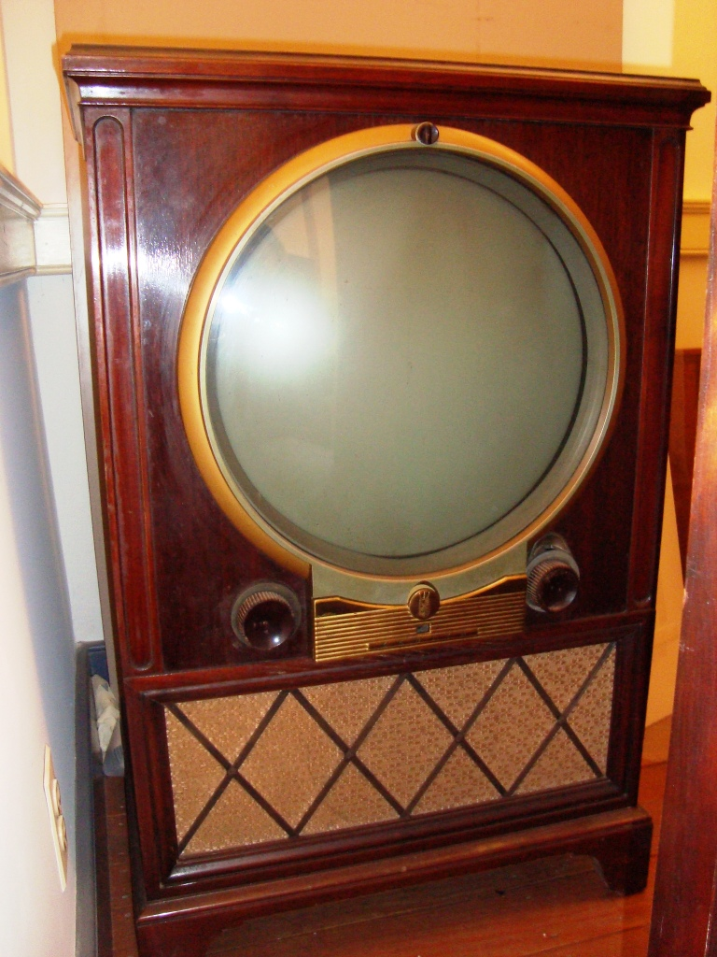
Elements: Space
Space is the dimension and the shape of the:
Window or Frame
Canvas, Support, or Ground
It has an aspect ratio and resolution
It has an orientation
It has a point of view

Slide 4
Composing a space

Slide 5
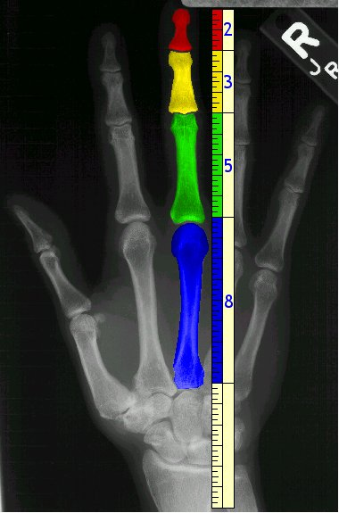
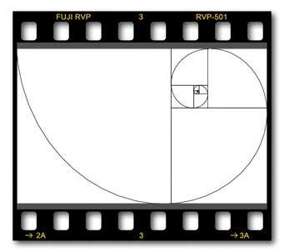
The Fibonacci Series, Phi, & the Golden Mean
0, 1, 1, 2, 3, 5, 8, 13…
Values increase at a ratio of 1 to 1.61 (Phi)
Like the ratio of 3.14 (Pi) this ratio is common in natural forms
This ratio yields a shape called the Golden Rectangle
Notes:
Pi is the ratio of circumference to diameter in a circle

Slide 6
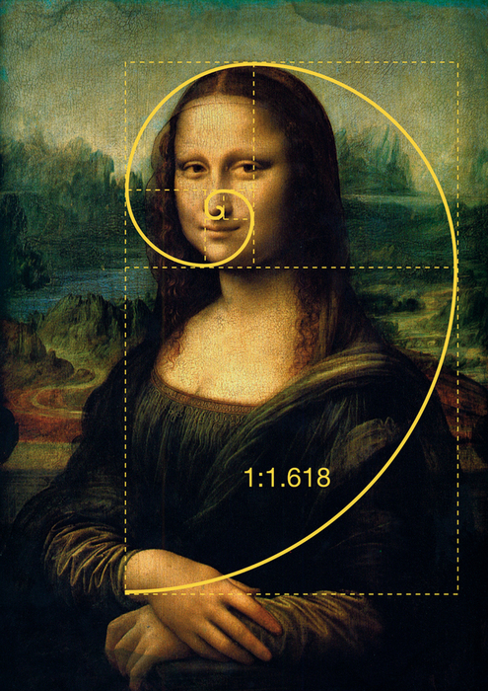
The Golden Rectangle
Notes:
2 X 3 aspect ratio

Slide 7
The 3 X 4 Aspect Ratio (1:1.33)
Common with magazines and computer
monitors.

Slide 8
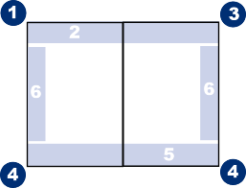
Screen Prominence
The standard 4 X 3 screen
aspect ratio is actually a
2 page spread of 2 X 3 pages.
For Western cultures that read left to right, the upper left corner of the screen is the
most prominent part of the screen, followed by the upper right, and the two lower corners.
The center of the screen actually has the least prominence (it’s the gutter of the book).

Slide 9
The Rule Of Thirds
Four points of interest in a rectangle.
Typically the ratio is:
1 : 1.5 - close to the golden mean.
(3 X 2 is the ratio of 35mm film.)
The rule of thirds helps
designers provide focus
and balance to their
compositions

Slide 10
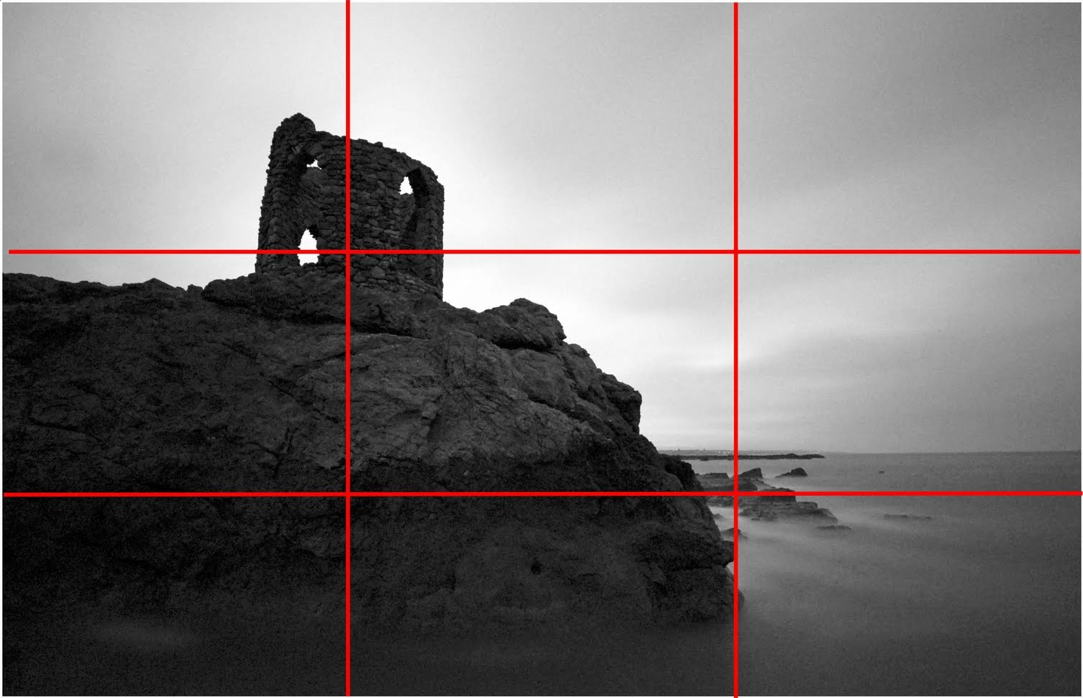
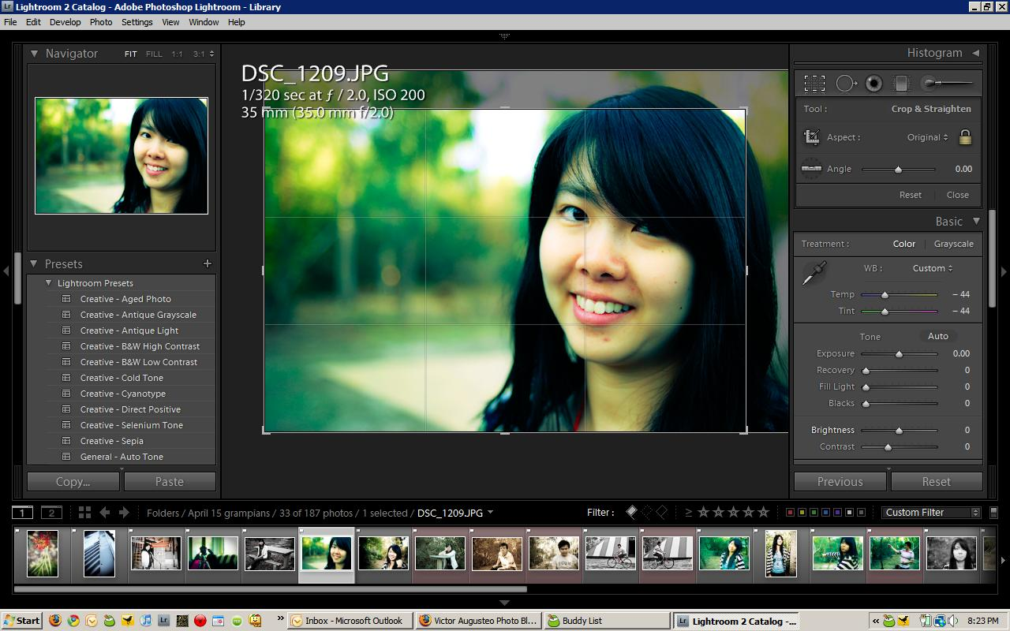
Examples of the rule of thirds
Above, Adobe Lightroom now has an option to crop photos based on the rule of thirds.

Slide 11
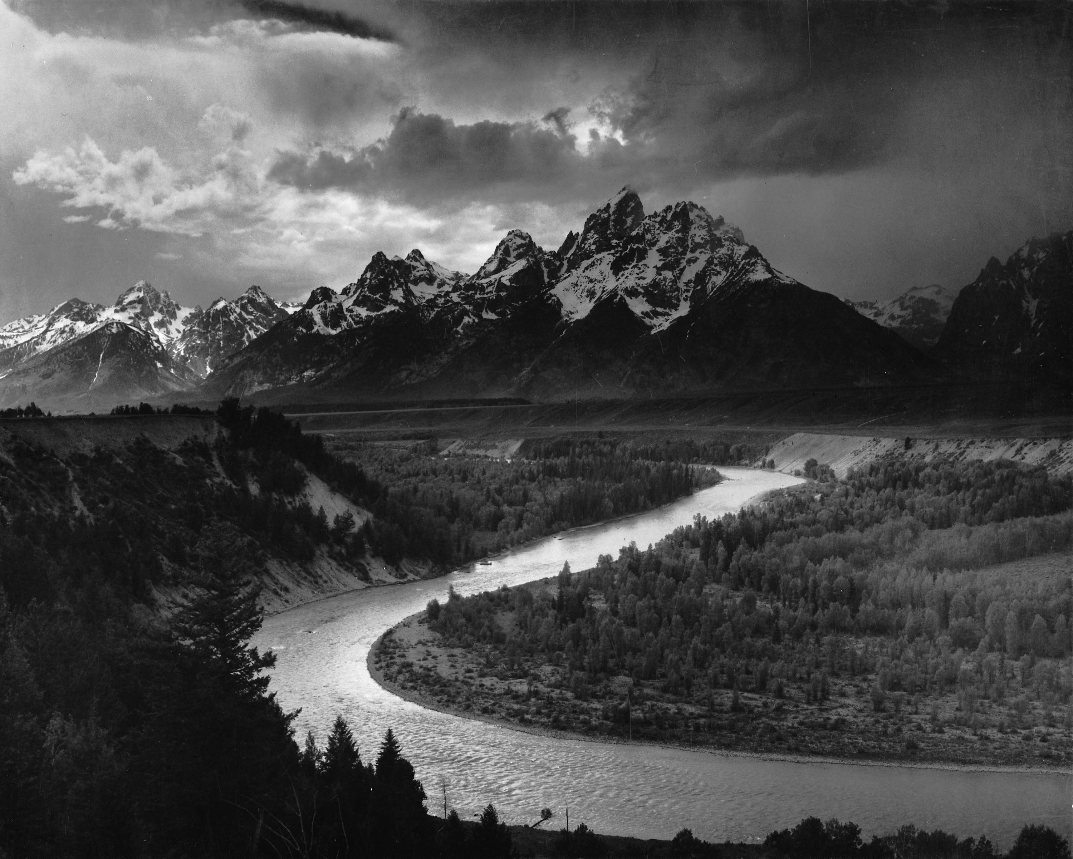
Portrait & Landscape Orientation
Landscape:
Horizontal, Calm, Pastoral, Contemplative
Portrait:
Vertical, Arresting, Alerting, Commanding Attention

Slide 12
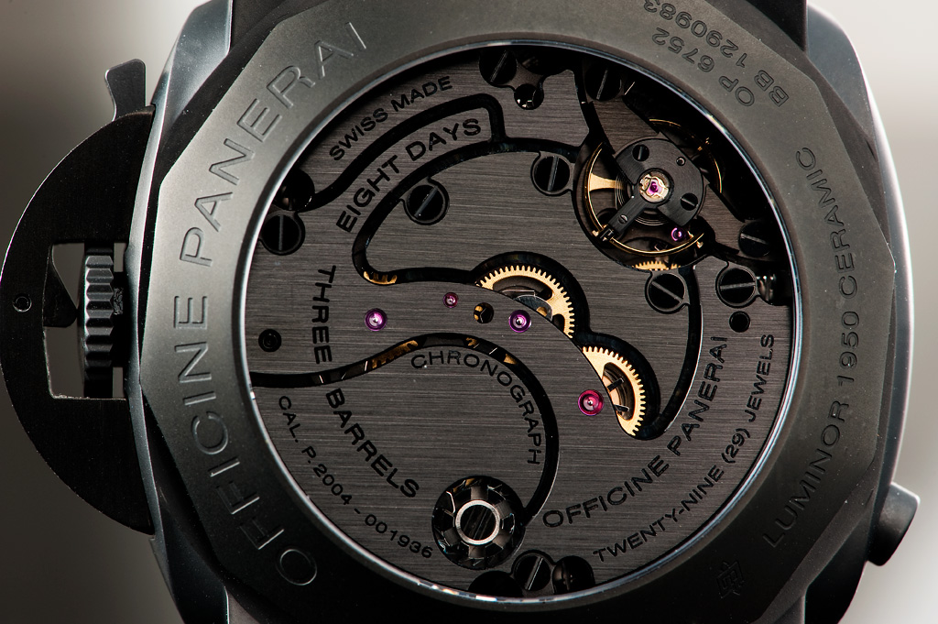
Viewpoint
The position of the viewer is a
crucial aspect of how a visual
story is told.

Slide 13
Figure/Ground – Positive/Negative Space
M.C. Escher’s “Sky and Water” provides a good illustration of Tufte’s “1 + 1 = 3” rule

Slide 14
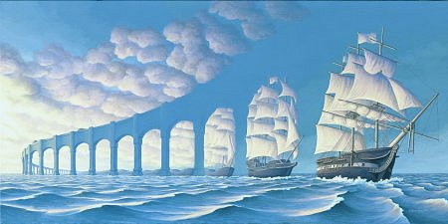
Examples of Figure/Ground Relationships

Slide 15
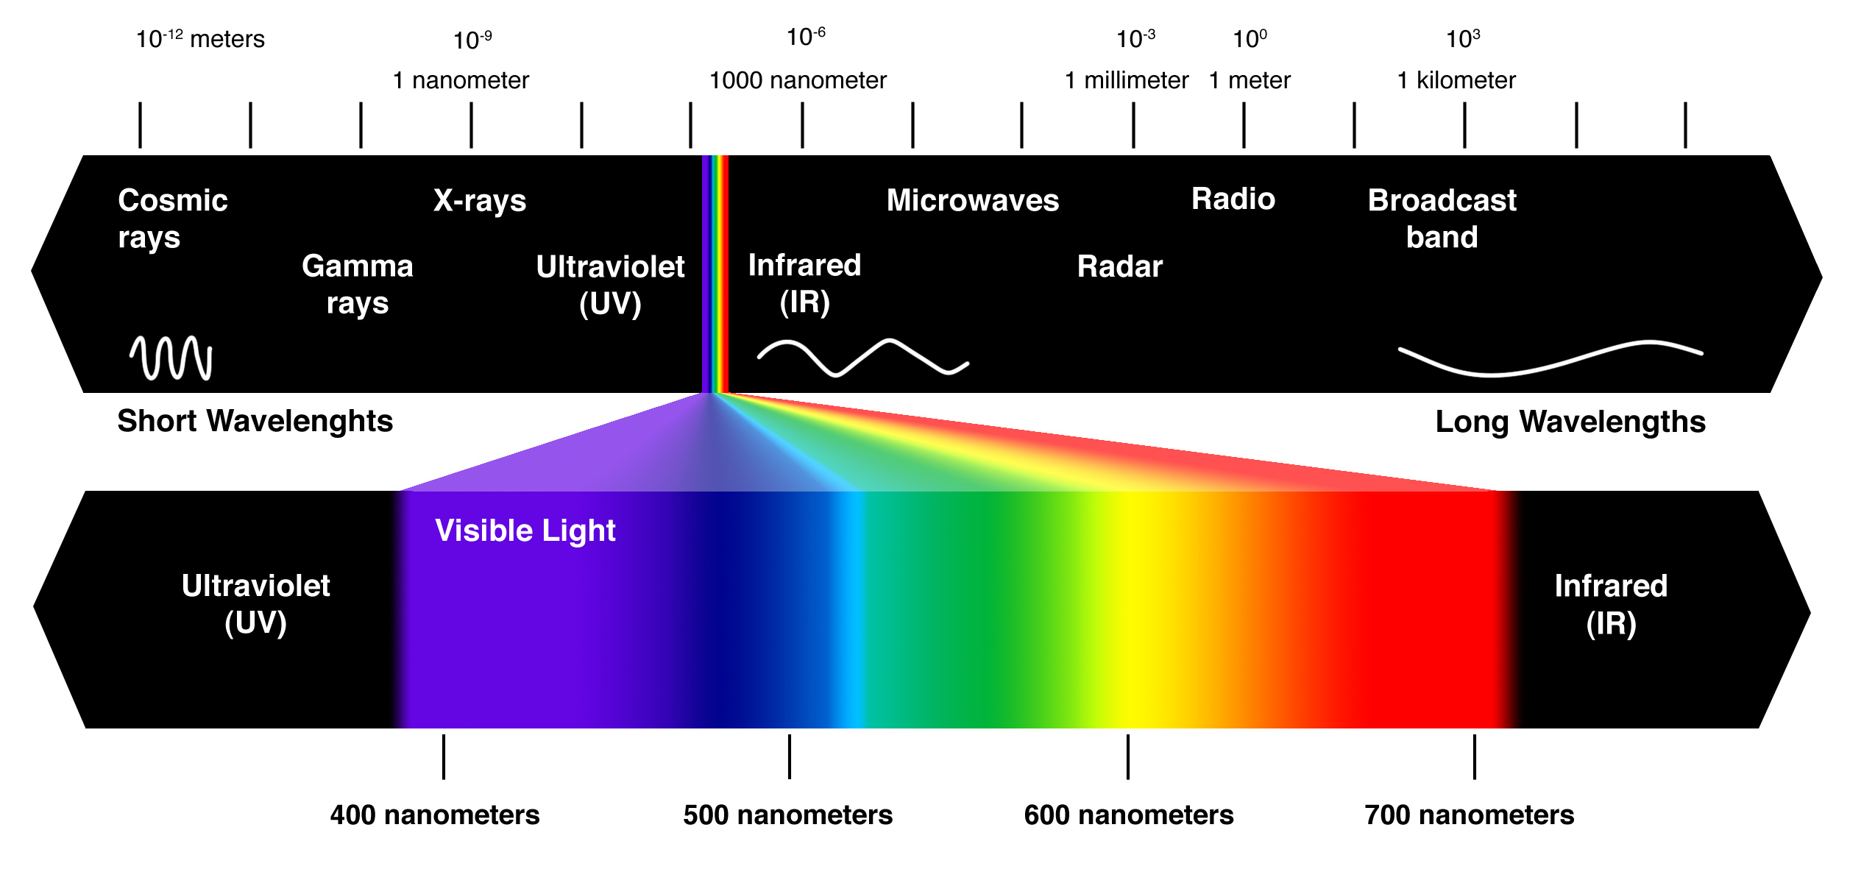
Elements: Color & The Visible Spectrum
Cool colors have a higher frequency and a shorter wavelength.
Warm colors have a lower frequency and a longer wavelength.

Slide 16
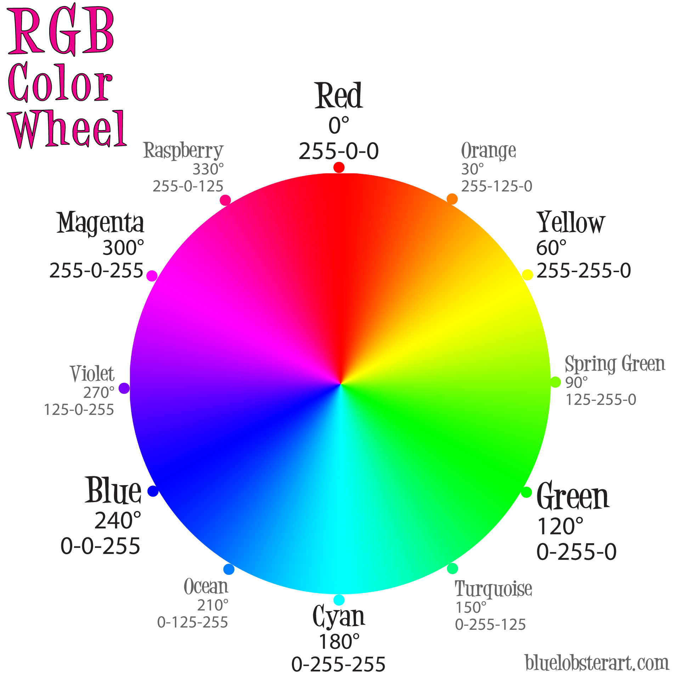
Color models
Additive:
Emitted Light
Light Primaries
The primaries at full strength = white light
Subtractive:
Reflected Light
Pigment Primaries
(Black is added in 4 color printing)

Slide 17
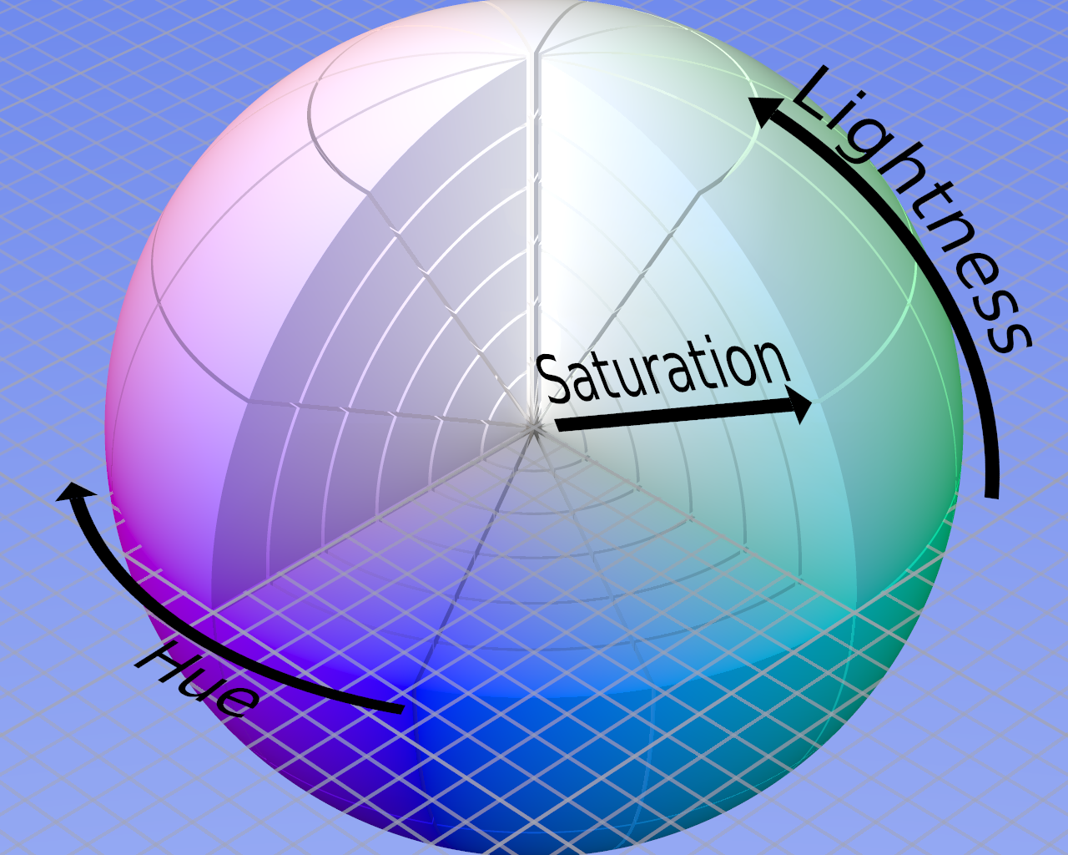
Color Properties
Colors have three properties
Hue: simply what the color is, related to the primary, secondary, and tertiary colors
Saturation: the difference between the color and neutral gray (greater difference = greater saturation)
Lightness (sometimes also called Brightness or Value): the level of illumination, or how bright the color is

Slide 18
Complementary Colors
The complementary color of any hue is the mix of the two other primary or secondary colors.

Slide 19
Color Perception
Color is never seen in isolation.

Slide 20
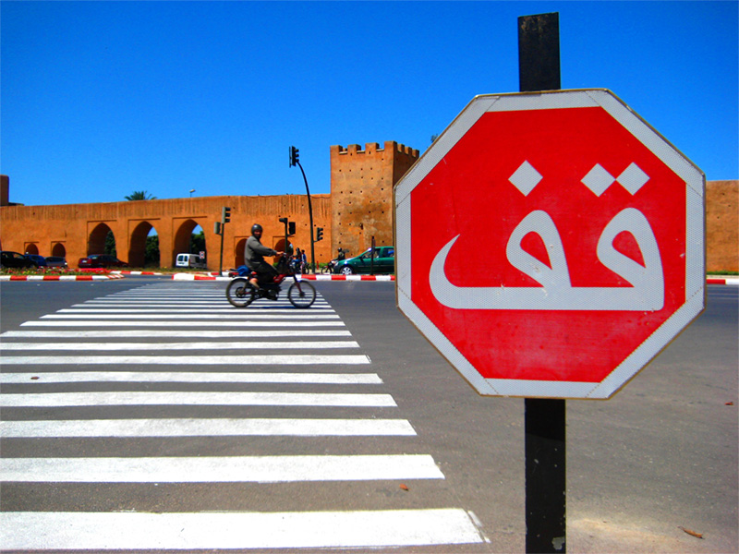
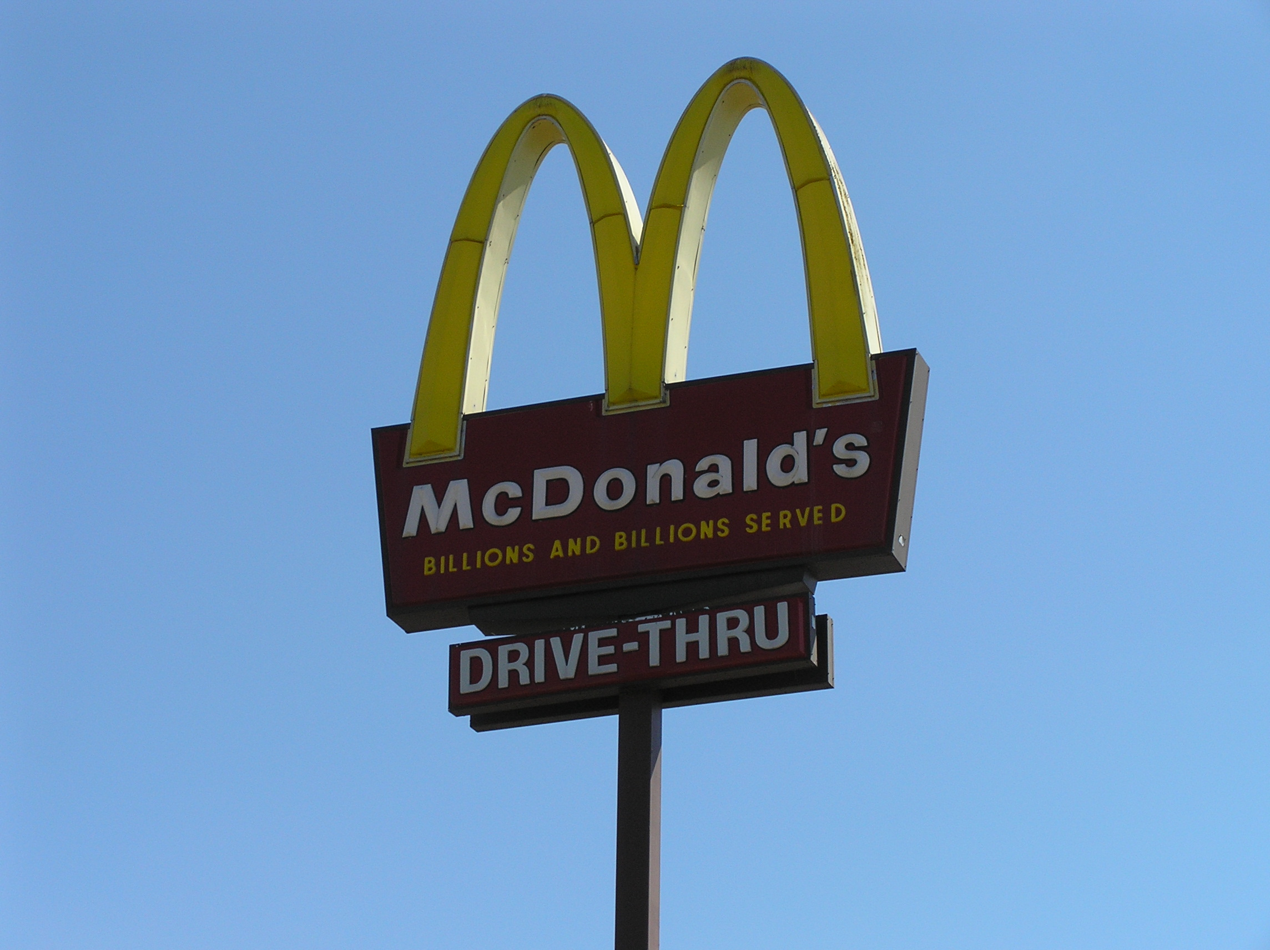
Color Psychology: Warmer Colors
Red
Rare in the natural world
Associated with fire, blood, danger
Commands attention
Orange and Yellow
Color of the sun
Motivator, makes people happy and decide rapidly
Green
Pastoral
Puts people at ease

Slide 21
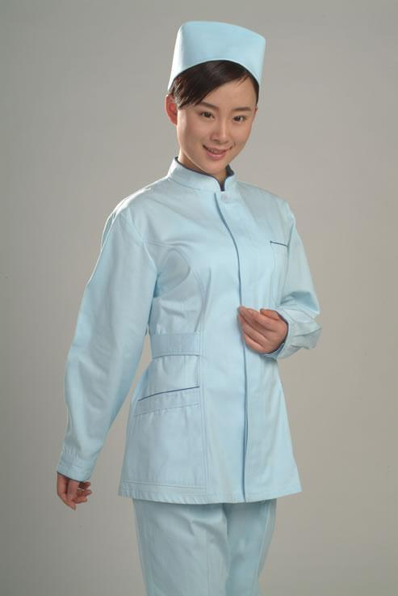
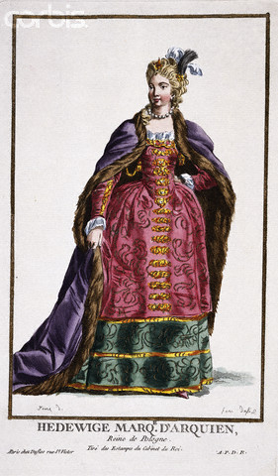
Color Psychology: Cooler Colors
Blue
Most common color in the natural world
Color of the sky and the ocean
Light blue conveys access and assistance
Dark blue conveys authority
Violet
Infrequent color in nature
It’s unusual and exceptional
The color of royalty, intrigue and mystery

Slide 22
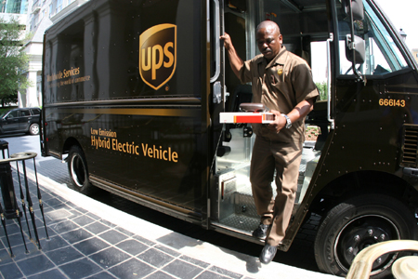
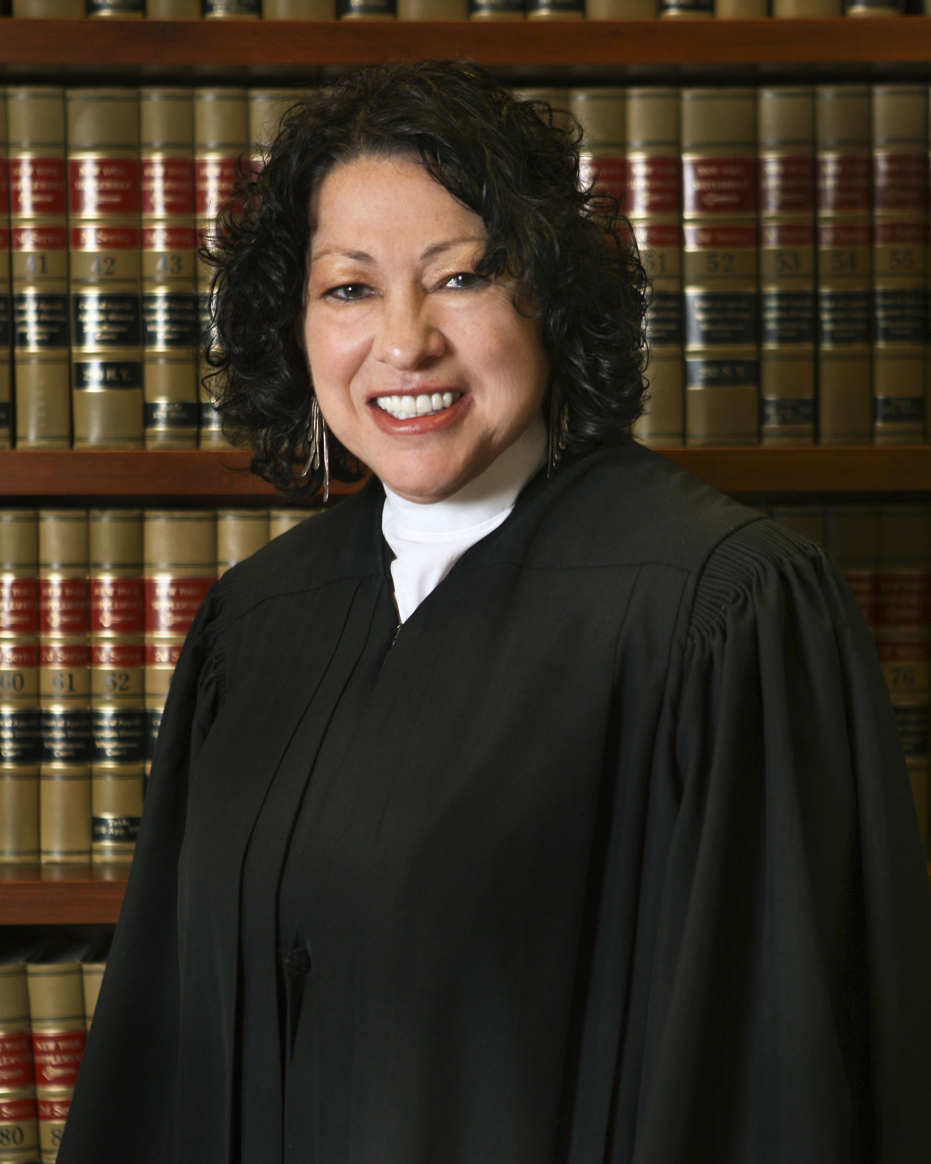
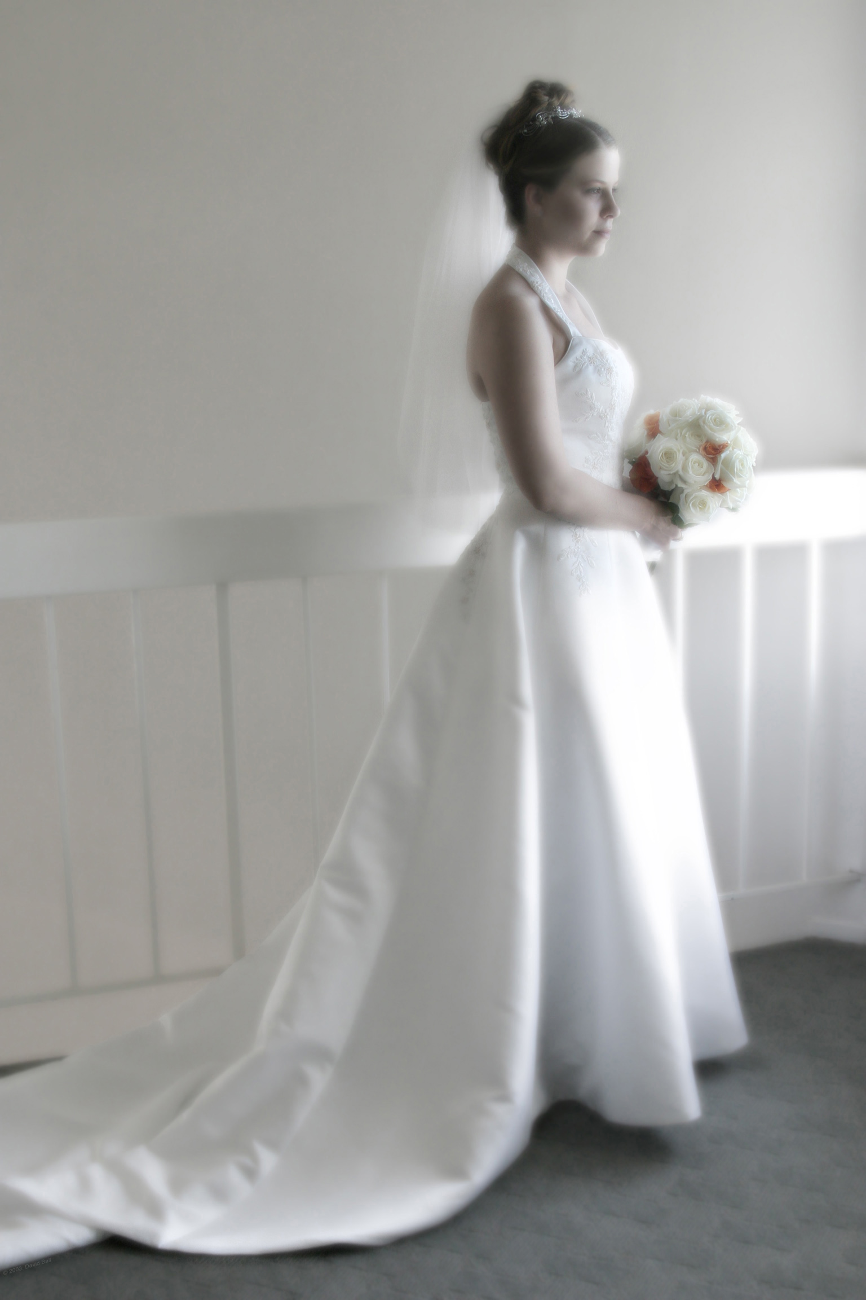
Color Psychology: Neutral Colors
Brown
Color of the earth
Dependable and full of promise
Black
Color of night
Formality (and fear)
Judicial
Funerals in western cultures
White
Color of clouds
Purity
Weddings in western cultures

Slide 23
Atmospheric Distortion & The Blue Shift
Warmer, more saturated colors move forward; and cooler, less saturated colors recede

Slide 24
Elements: Contrast
Value contrast
Color contrast

Slide 25
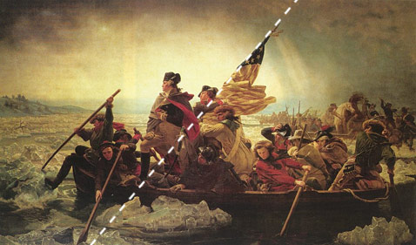
Elements: Diagonal Lines
Diagonal lines are very powerful
compositional elements. They
provide drama and a feeling of
motion, space, and time.

Slide 26
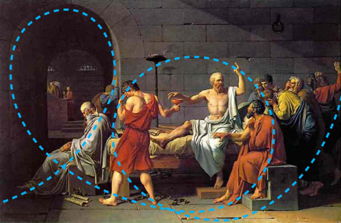
Curved Lines
The use of curves in compositions
is vital for conveying movement.
Notes:
David

Slide 27
Principles: Balance
Notes:
Vermeer

Slide 28
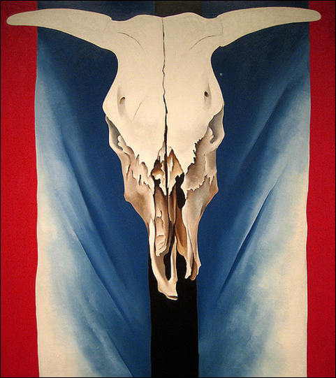
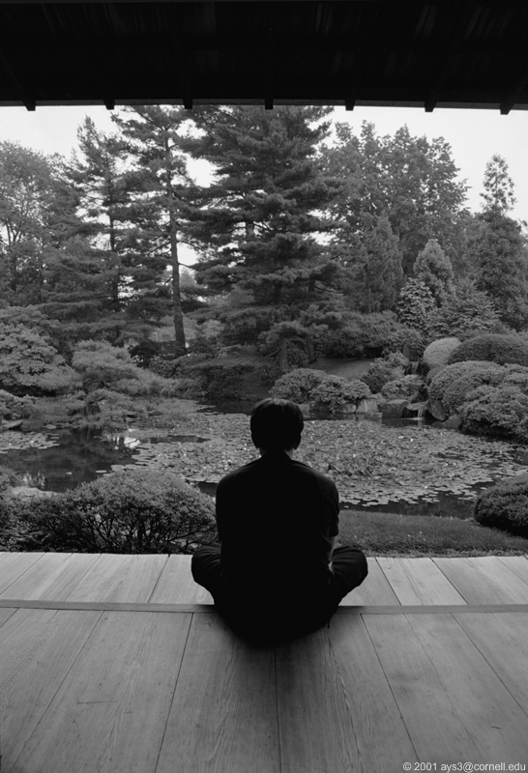
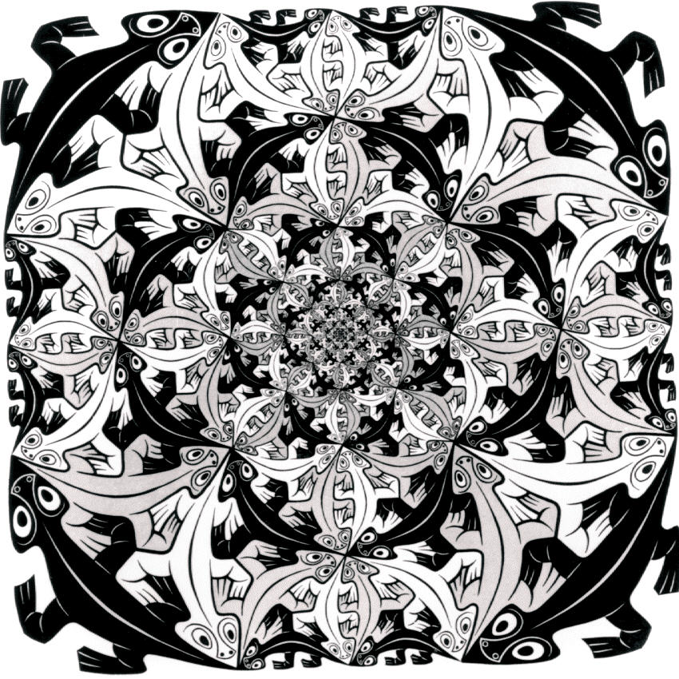
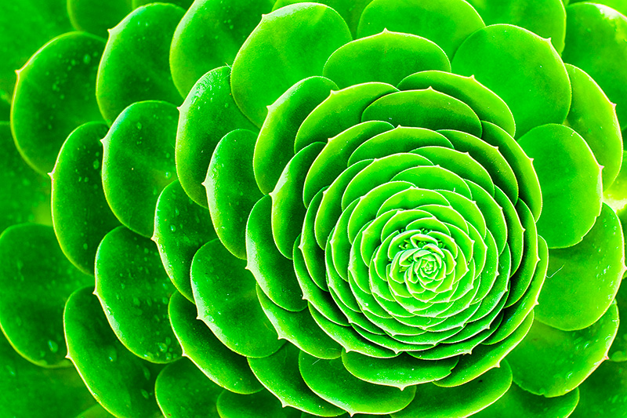
Symmetrical Balance
Symmetry evokes stasis.
It suggests timelessness;
it’s iconic and monumental.
Radial symmetry is a special
instance. Iterative patterns
suggest infinity.
Notes:
Georgia O’Keefe and M.C. Escher

Slide 29
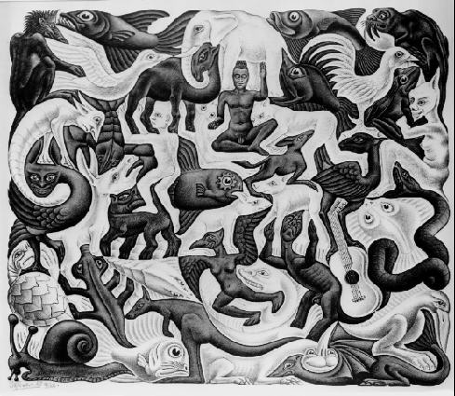
Asymmetrical Balance
In asymmetric balance the relationships seem
more temporal, which creates more tension
and interest.
Notes:
Escher

Slide 30
Principles: Emphasis

Slide 31
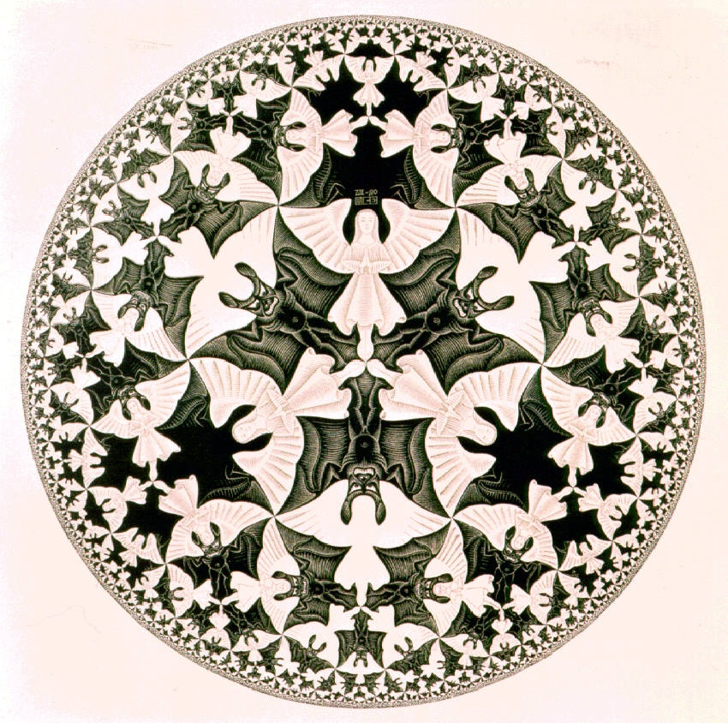
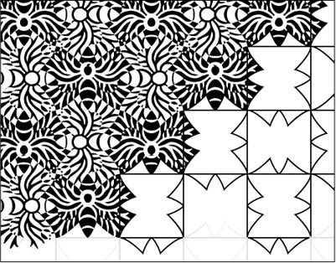
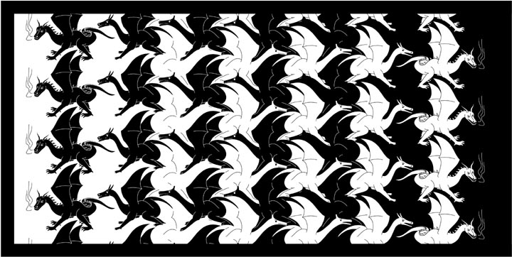
Principles: Pattern
Notes:
Warhol and Escher

Slide 32
Principles: Variety
Notes:
Andy Warhol

Slide 33
Principles: Movement
Note the strong “S” curve that unifies the composition and sets the elements in motion.
Notes:
Salvador Dali

Slide 34
Principles: Proportion
Notes:
Piet Mondrian at the MoMA

