Slide 1
Game Mechanics
EST310/ISE340
Fall 2011
Tony Scarlatos

Slide 2
Player Life Cycle
How do you maintain player engagement over the long term?

Slide 3
Level Difficulty S-Curve
High
Level Off - Victory Lap
DIFFICULTY
Ramp Up Challenges Gradually
Tutorial Levels
Low
Low
TIME ON TASK (player skill)
High

Slide 4
Player Flow Experience

Slide 5
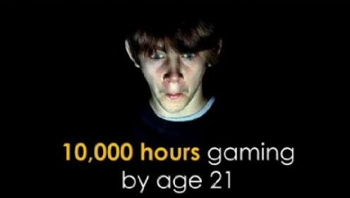
Jane McGonigal’s Motivators
Blissful Productivity
Happy working hard doing what is perceived to be meaningful work.
Social Fabric
Community that supports and relies on the player, and rewards with status.
Urgent Optimism
The desire to act immediately to tackle an obstacle combined with the reasonable hope of success.
Epic Meaning
Achievement that goes beyond the player’s personal success, an achievement that is perceived to be significant globally.

Slide 6
Intrinsic Motivators

Slide 7
Collecting and Completing a Set

Slide 8
Customization (self expression)

Slide 9
Epic Meaning (altruism)

Slide 10
Loss Aversion
In psychological studies, subjects consistently avoided loss more than gains were sought

Slide 11
Extrinsic Motivators: Appointment Dynamics
“Feed Me, Seymore!”

Slide 12
Extrinsic Motivators: Timed Interactions
“For a limited time only…” or “You have 10 seconds before the bomb blows up!”

Slide 13
Rewards: Badges

Slide 14
Rewards: System Points

Slide 15
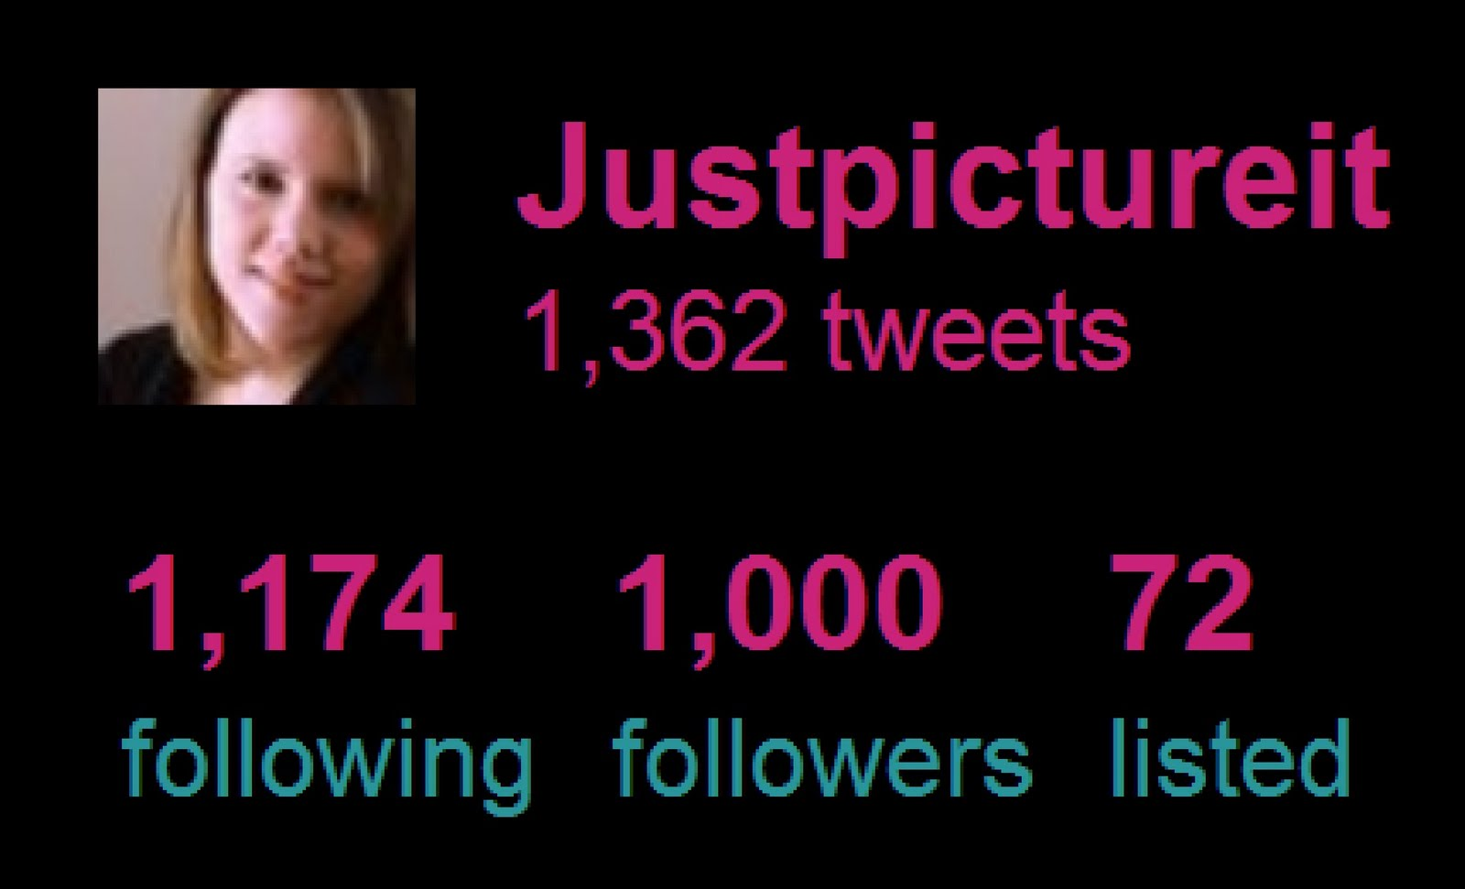
Rewards: Social Points

Slide 16
Rewards: Leaderboard

Slide 17
Rewards: Virtual Goods

Slide 18
Reward Reinforcement Schedules
Variable Reward, Variable Interval
(Slot-Machine)
Fixed Reward,
No Time Interval
(activity- based)
Variable Interval,
Fixed Reward
Fixed Interval, Fixed Reward
“How often?” is usually more important than “How much?”

