Slide 1
Mobile Application Architectures
CSE 390 Fall 2010

Slide 2
Client-Server Layers (software)
Layers describe the “division of labor” within the application code.
The “thinnest” clients have 0 layers.
Fat clients have as many as 3 layers.
Servers have from 1 to 3 layers.
The layers are:
Presentation (UI)
Business (Logic)
Data Access

Slide 3
Thin clients
Less dependent on mobile OS or platform type.
Typically use the widely available Wireless Application Protocol (WAP) browser to display web pages (HTML, XML) or WAP pages (WML).
0 Layers of application code. UI, logic, and data access layers are minimal and merged.
Easier to maintain and support than fat clients, but need a persistent server connection.

Slide 4
Fat clients
Can operate independent of a server connection. Most often use a store and forward approach to data.
More dependent on the platform and OS, and not as portable.
Often use a 3 layer design to facilitate code reuse and portability.
2 layer designs merge the Presentation and the Business layers.

Slide 5
Client-Server Tiers (hardware)
Tiers describe the “division of labor” on multiple servers.
Presentation
Many servers (low end)
Application
Fewer servers (midrange)
Database
Two servers (expensive, high-end)
More distributed architectures enhance scalability and security.
Adding more low-end servers is called horizontal scaling.
Adding more expensive servers is called vertical scaling.

Slide 6
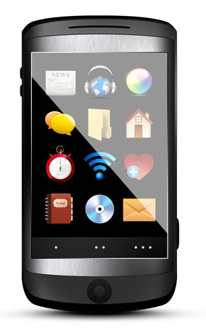
Security and durability
A three tier architecture providing maximum durability, security, and scalability.
Presentation
Server(s)
Application
Server(s)
Database
Server(s)
Store and Forward
DB
Mobile
Firewall
Firewall
DB
DMZ
Intranet Zone

Slide 7
Tier architectures - pros and cons
1 tier
Pros: convenient, quick to develop and deploy, cheaper
Cons: less scalable, hard to secure (you have to place the server in the DMZ which exposes the DB to high risk)
2 tier (merges the presentation and application servers)
Pros: still convenient, but allows for DB specialization
Cons: less scalable, still hard to secure, and more expensive
3 tier
DB, application, and presentation servers are split off from each other
Pros: scalable, secure behind firewalls, allows for DB specialization
Cons: overkill, more difficult to develop and manage, most expensive

Slide 8
Client connection types
Always connected (browser-type).
Partially connected (app-type). Store and Forward model.
Never connected (not applicable).
Synchronous communication – all data received and stored before server confirms and acknowledges receipt.
Asynchronous communication – stores data locally on mobile device. Allows for periodic connection to server to upload/download.

