Slide 1
Dependency Parsing
Niranjan Balasubramanian
March 24th 2016
Credits:
Many slides from:
Michael Collins, Mausam, Chris Manning,
COLNG 2014 Dependency Parsing Tutorial,
Ryan McDonald, Joakim Nivre

Slide 2
Before we start with dependency …

Slide 3
Dealing with independence issues
Lexical dependence
Lexicalize the rules – add words to the rules.
Structural dependence
Add sub-categories e.g., VB use VB_{t}, VB_{i}, VB_{d} etc.
Add parent and sibling information e.g., Pr(NP → NN | Parent(NP) = S)

Slide 4
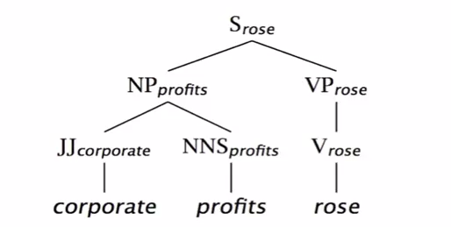
Lexicalized Charniak Parser
Identify heads of constituents and use them to condition probabilities.
There are a handful of rules that specify how to identify heads.
Probability of lexicalized parse tree is computed using these two quantities.
Pr(cur_head = profits, rule=r_{i} | cur_category = NP)
= Pr(rule = r_{i} | cur_head = profits, cur_category = NP)
x Pr(cur_head = profits | cur_category = NP)

Slide 5
Constituency Parser Evaluations
Use the gold tree (GT) annotations in Penn Tree Bank.
For each test check if the predicted constituency tree (PT) matches the GT.
Parsers almost always make mistakes.
Allow for partial credit.

Slide 6
Constituency Parser Evaluations
Break GT and PT into a set of constituents and their token spans.
Compute precision and recall of the predicted constituents.

Slide 7
Evaluation Measures
Labeled Precision (LP) = # of correctly labeled constituents in PT / |PT|
Labeled Recall (LR) = # of correctly labeled constituents in PT / |GT|
Labeled F1 = 2 LP x LR / (LP + LR)

Slide 8
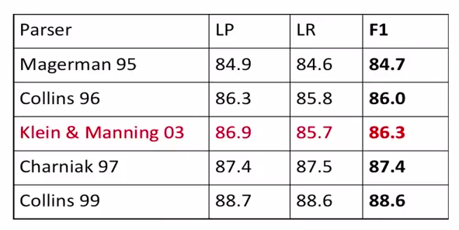
Constituency Parser Evaluations
Magerman 95 and Collins 96
-- Early lexicalized parsers
Klein & Manning 03
-- PCFG + Various ways to encode structural and categorical preferences.
Charniak 97
-- Lexicalized PCFG + State splitting
Collins 99
-- Lexicalized parsing using heads
Unlexicalized basic PCFG ~ 73.0 F1
From: Klein and Manning (2003)

Slide 9
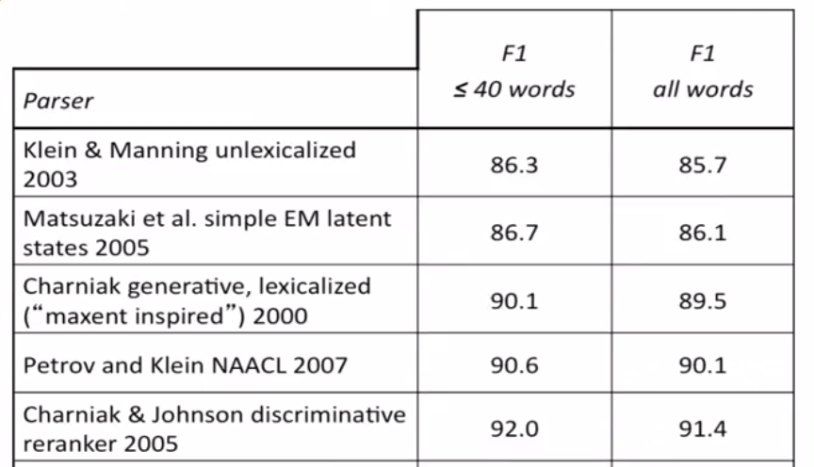
Constituency Parser State-of-the-art

Slide 10
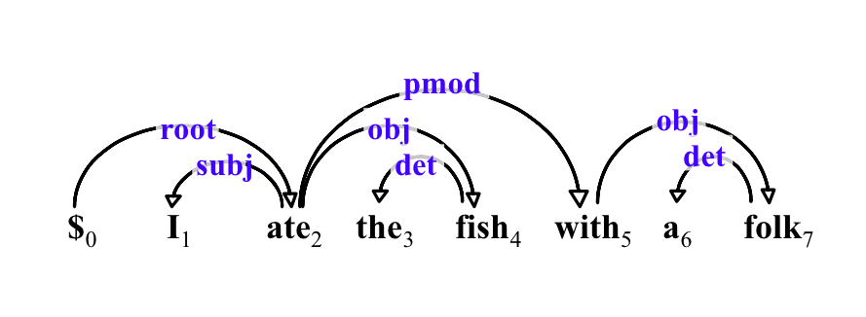
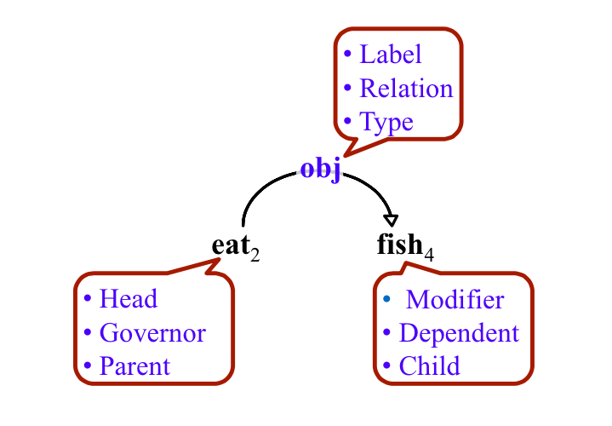
Dependency Parsing
Dependency tree – A tree composed of the input words, which meets a few constraints:
Single-head 
Connected
Acyclic
Projective Parse:
Arcs don’t cross each other.
Mostly true for English.
Non-projective Parse:
Common in lang. w/ more flexible word order.
German, Dutch, Czech etc.

Slide 11
Dependency Parsing
Given an input sentence, draw edges between pairs of words, and label them.
Result should be a tree.
The edge-labels between word pairs should convey the correct syntactic relation.
Convert PCFG parse to a dependency parse.
Phrase structure can be deterministically transformed into dependency relations.
Could construct a tree one edge at a time.
Transition parsing.
Could construct a fully connected tree, and prune it.
Graph-based methods.

Slide 12
Transition Based Parsing
Imagine a machine that has a stack and a buffer.
It makes arc decisions about entries in the top of the stack and buffer.
Keeps shifting words from the buffer until all words are consumed.

Slide 13
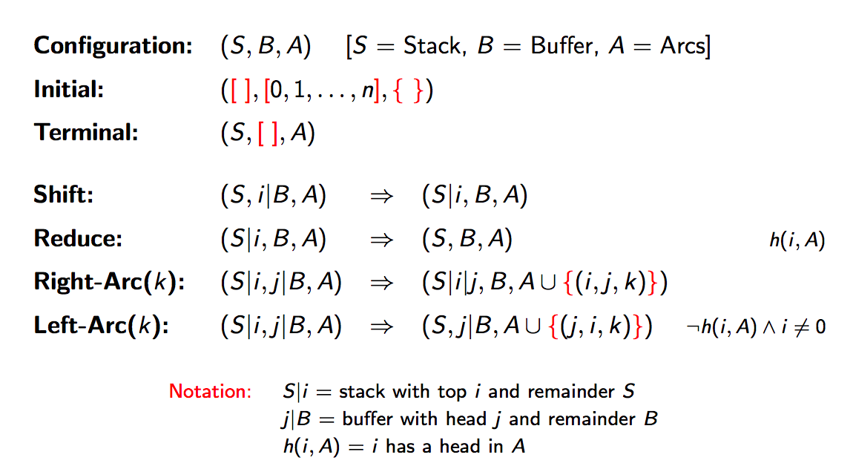
Transition-based Parsing Arc-Eager [Nivre 2003]
Rules of the game!
-- Keep moving items from buffer to stack.
-- If the top item on stack is a dependent of the top buffer item
output dependency relation and drop the item from stack.
-- If the top buffer item is a dependent of any item in stack, move
buffer item to stack, but keep the head in stack.

Slide 14
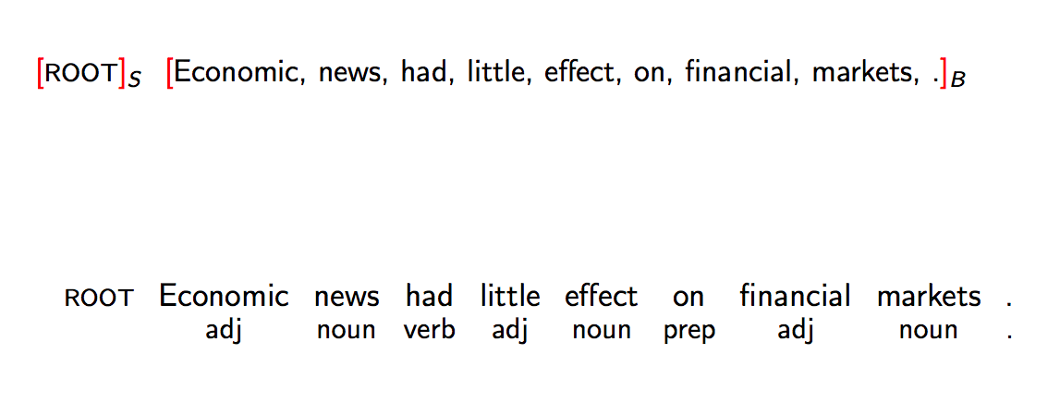
Example Transition Sequence
Assume we have some black-box that takes two words and magically gives you the
dependency relation between them if one exists.

Slide 15
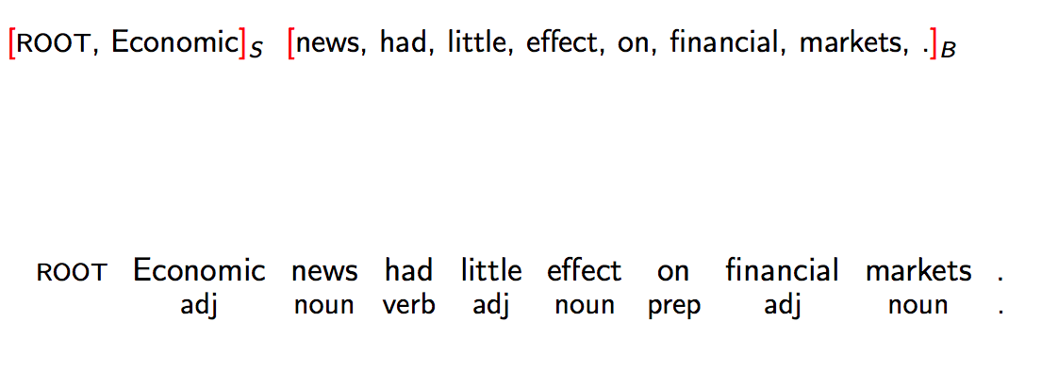
Example Transition Sequence
Shift:
Move Economic to stack.

Slide 16
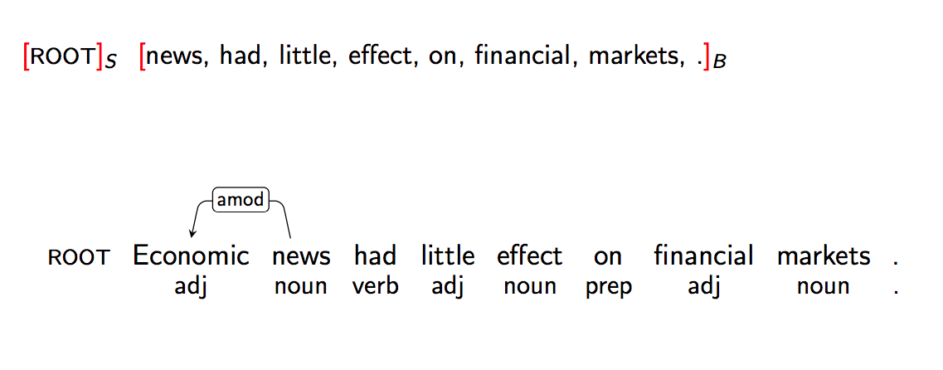
Example Transition Sequence
Left Arc:
Add left-arc amod(news, Economic) to A.
Remove Economic from stack since it now has head in A.
NOTE: Left-arc was possible only as Economic did not previously have a head in A.

Slide 17
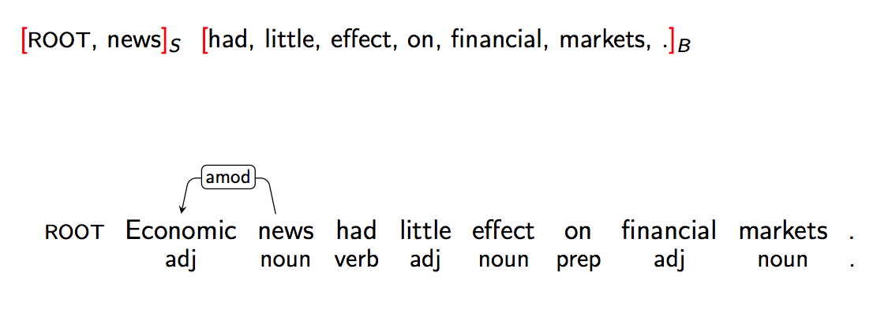
Example Transition Sequence
Shift
Move news to stack.

Slide 18
Example Transition Sequence
Left Arc:
Add left-arc nsubj(had, news) to A.
Remove news from stack since it now has head in A.

Slide 19
Example Transition Sequence
Right Arc:
Add right-arc root(ROOT, had) to A.
Keep had in stack.
NOTE: We are keeping had because it can have other dependents on the left.

Slide 20
Example Transition Sequence
Shift:
Black-box did not find any dependence relation for had and little.

Slide 21
Example Transition Sequence
Left-arc:
Add amod(effect, little) to A.
Remove little from stack.

Slide 22
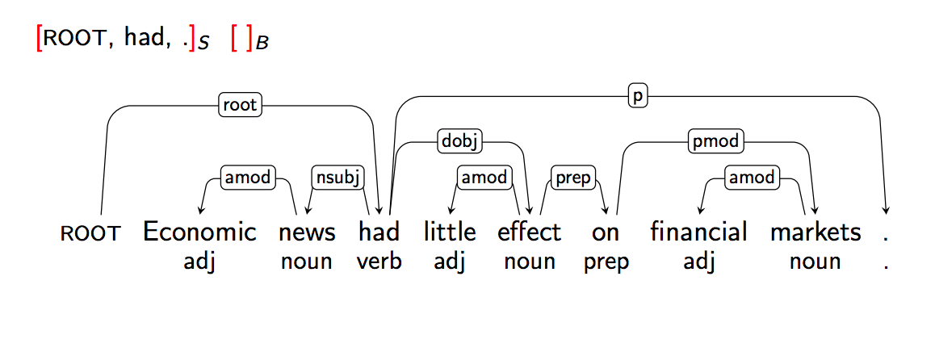
And on it goes until …

Slide 23
As a supervised classification task.
Given the current state (i.e., stack, buffer and A) predict the next action.
Can be viewed as a supervised learning problem.
Four way classification (if un-typed dependencies)
m-way classification, where m = 2 x number of types + 2
Features
Compute features of the current configuration of the stack, buffer and A.
Word in stack, POS of word, Word in buffer and POS of Word in buffer.
Other features: Length of dependency arc
Greedy classifier (no search involved)
At each stage ask the classifier to predict the next transition.
Select the best legal transition and apply it.
Works quite well, close to PCFG.
Quite fast!
O(N) in length of sentence.

Slide 24
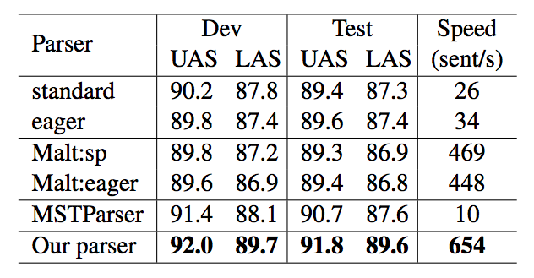
State-of-the-art Results
From Chen and Manning (2014)
Our parser – Neural network based transition parser.
UAS – Unlabeled attachment scores
LAS -- Labeled attachment scores

Slide 25
Summary
Syntactic parsing aims to find phrase-structure in sentences and word-word relations.
Constituency
Group of words that behave as a unit.
Context-free Grammar (CFG) to represent structure.
Key Issue:
Ambiguities, which lead to many many parses.
Solution:
Probabilistic CFG – Score trees using probabilities on rules.
Has lexical and structural dependence issues.
Add fine-grained categories, include parents, lexicalize rules.
Dependency
Word-word relations e.g., nsubj(ate, Elephant).
Parsing generates dependency trees by predicting edges or pruning edges.
Transition-based parsing formulates edge prediction as a classification task.
Predict one of four actions to take next.
Parsing is a widely used step in constructing deeper, semantic representations.

