Slide 1

  PeckVis
A Visual Analytics Tool to Analyze Dominance Hierarchies in Small Groups
Darius Coelho, Ivan Chase, and Klaus Mueller

Slide 2
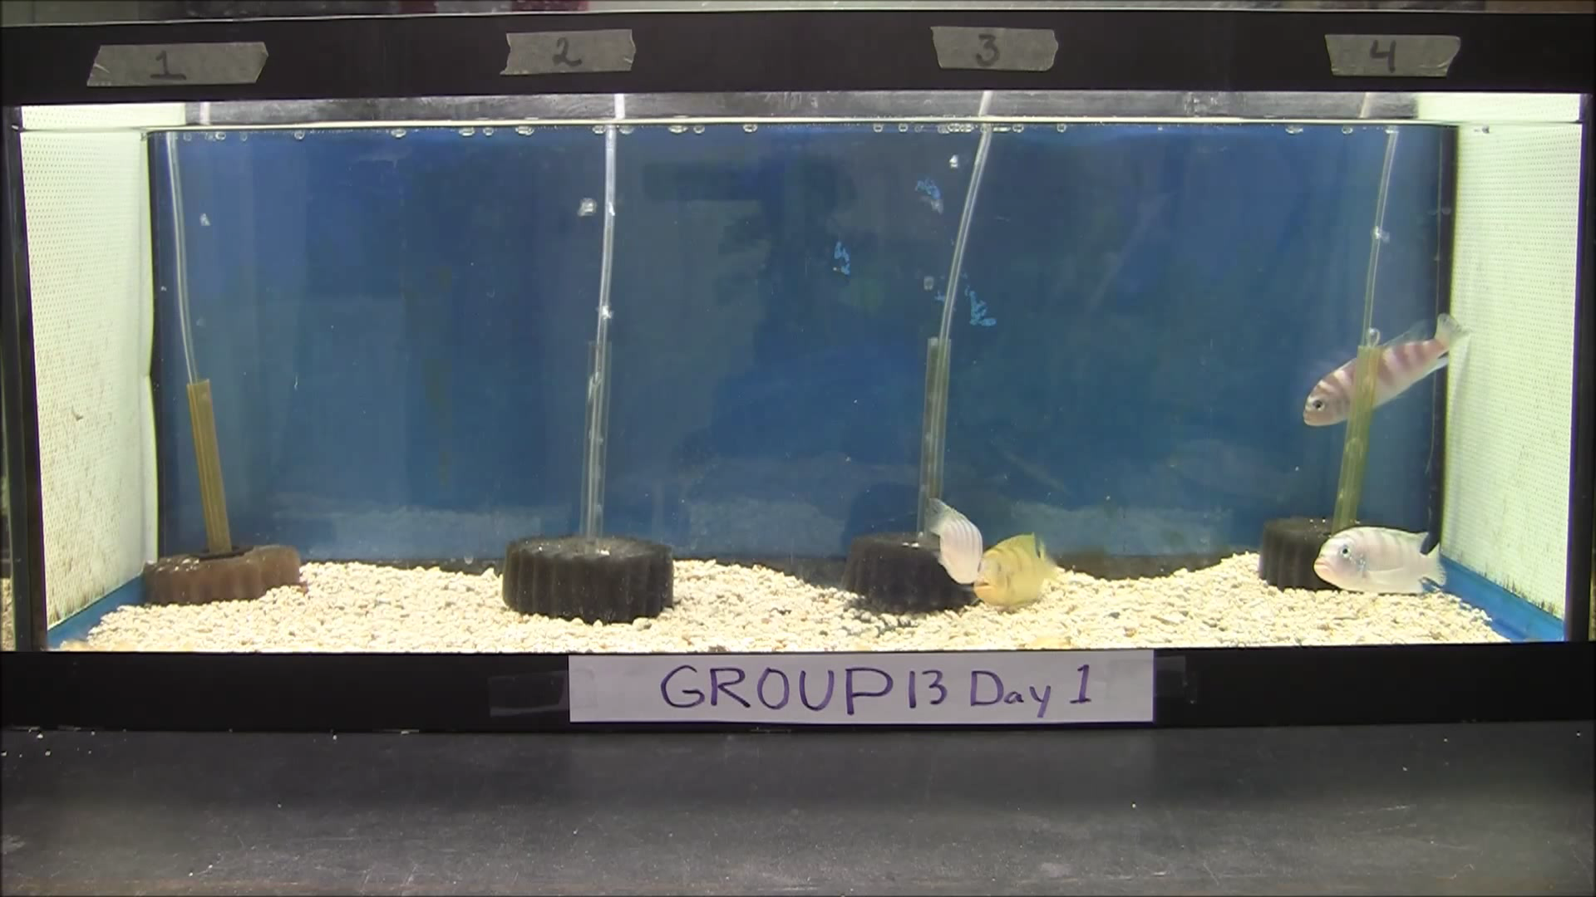
Dominance Hierarchies
Collection of all dominance relationships.
They inform us of group dynamics.
Notes:
So what are dominance hierarchies?
Let’s take look at this example.
Here you see a group of four fish.
Initially two fish were biting at each other then the more dominant one starts chasing the other.
It also chases a third fish trying to get involved while the fourth fish is submissive and just stays in a corner.
By observing these dominant interactions such as the biting and chasing behaviors, we can infer the dominance relationships between two individuals.
The collection of these dominance relationships are dominance hierarchies.
Scientists are interested in studying these hierarchies as they are informative of a groups dynamics. For example, they can inform us of food distribution, reproduction and more

Slide 3
Goals
Learn how hierarchies are formed, evolve, and maintained.
Compare groups based on interactions and hierarchies.
Notes:
There are multiple algorithms such as David’s score or the elo rating algorithms that can analyze a set of interactions and tell us which hierarchy was formed.
However, the experts we worked with were interested in understanding how these hierarchies are formed and evolve as relationships change over time.
They also wanted to compare groups within and across species to learn about commonalities and differences in the evolution of hierarchies.
To enable such analyses, we proposed a visual analytics tool that centered around two main visualizations. One to study the interactions in a group and the other to understand the intermediate hierarchies.

Slide 4
Visualizing Interactions
Time | Attacker | Victim
0 | A | B
100 | A | B
200 | A | B
300 | C | D
550 | C | D
650 | B | C
710 | B | C
770 | C | B
970 | B | C
1060 | B | C
1250 | A | C
1350 | A | C
1450 | A | C
1550 | A | D
Notes:
We will first discuss how interactions are visualized.
Data such as this is extracted from videos similar to the one of the fish.
Every entry is an aggressive interaction and consists of a time stamp, an attacker id and a victim id. Some datasets also include the type of interaction e.g. biting and chasing

Slide 5




Visualizing Interactions
Time | Attacker | Victim
0 | A | B
100 | A | B
200 | A | B
300 | C | D
550 | C | D
650 | B | C
710 | B | C
770 | C | B
970 | B | C
1060 | B | C
1250 | A | C
1350 | A | C
1450 | A | C
1550 | A | D
A
B
C
D
Notes:
In this group we have four subjects, A, B, C, D.
We assign a color and create horizontal axes for each subject.
Also, the subjects are ordered from top to bottom based on their eventual rank.
Now, every time a subject attacks another we draw a vertical arrow from the attacker’s axis to the victim’s axis.

Slide 6
Visualizing Interactions
Time | Attacker | Victim
0 | A | B
100 | A | B
200 | A | B
300 | C | D
550 | C | D
650 | B | C
710 | B | C
770 | C | B
970 | B | C
1060 | B | C
1250 | A | C
1350 | A | C
1450 | A | C
1550 | A | D
A
B
C
D
Notes:
For example, the first three entries in the dataset indicate that A attacked B so we draw three arrows from A’s axis to B’s axis.

Slide 7
Visualizing Interactions
Time | Attacker | Victim
0 | A | B
100 | A | B
200 | A | B
300 | C | D
550 | C | D
650 | B | C
710 | B | C
770 | C | B
970 | B | C
1060 | B | C
1250 | A | C
1350 | A | C
1450 | A | C
1550 | A | D
A
B
C
D
Notes:
Similarly, we draw arrows for the remaining interactions and color them based on the identity of the attacker.

Slide 8
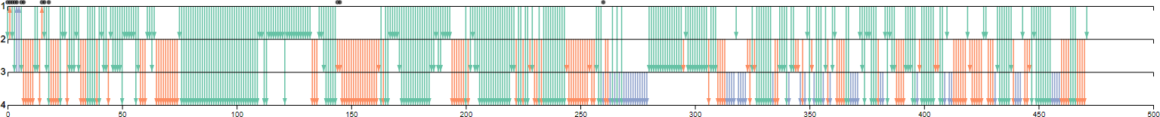
Visualizing Interactions
Music Notation:
Notes:
This is an example of a real set of about 480 interactions.
The music notation allows us to quickly see who attacks whom and how frequent these attacks are.
For example, the top individual commits the most attacks as indicated by the green arrows. It also seems to attack all other individuals in the group.

Slide 9
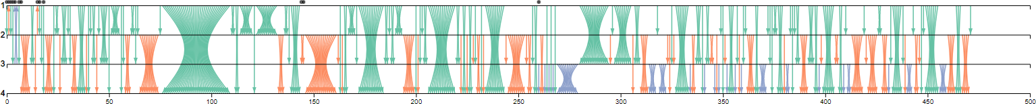
Visualizing Interactions
Music Notation:
Bundling for burst detection:
Notes:
By bundling the arrows, the music notation highlights bursts of interactions between two individuals.
It creates these hour glass shapes where wider hourglasses indicate bigger bursts.

Slide 10
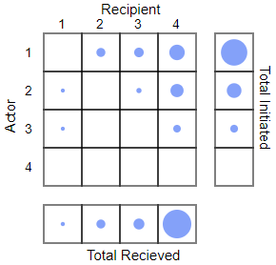
Visualizing Interactions
Music Notation:
Balloon Plot Summary:
Notes:
To provide an overall summary of these interactions, we make use of a balloon chart.
Here rows represent attackers and columns represent victims, with circle size representing the number of attacks.

Slide 11
Aggregating Interactions
Notes:
Next, to learn about the formation and evolution of dominance hierarchies, we aggregate interactions into intermediate dominance hierarchies
We visualize these hierarchies as a dominance network.
Let us consider the four fish again.

Slide 12
Aggregating Interactions
Notes:
Each fish is represented as a node in a dominance network.

Slide 13
Aggregating Interactions
Notes:
The nodes are placed based on the eventual rank of the subject.
Rank decreases from left to right and from top to bottom.

Slide 14
Aggregating Interactions
Notes:
Now when we observe an interaction, we draw an arrow between two nodes.

Slide 15
Aggregating Interactions
Notes:
We also color nodes based on the instantaneous ranks of the subjects.

Slide 16
Aggregating Interactions
Notes:
If the same interaction occurs again, we do not change anything in the network as the interactions belong to the same dominance relationship.

Slide 17
Aggregating Interactions
Notes:
If a new relationship is observer we add it to the network creating a new intermediate hierarchy.
Here new relationships are indicated by dashed lines

Slide 18
Aggregating Interactions
Notes:
And if an existing relationship is reversed we replace it in the network
Again creating a new intermediate hierarchy.
Here we add a double slash marker to a dashed line to indicate a reversed relationship

Slide 19
Aggregating Interactions
Notes:
Doing this for an entire sequence of interactions reduces it to a sequence of dominance hierarchies.

Slide 20
Aggregating Hierarchies
Notes:
In practice, these hierarchy sequence can be quite long, so we further aggregate them based only the structure of the network while ignoring the identities of the nodes.

Slide 21
Aggregating Hierarchies
Notes:
For example, these three hierarchies have the same structure, two nodes with directed edges to two other nodes.

Slide 22
Aggregating Hierarchies
Notes:
We do this for entire sequences

Slide 23
Aggregating Hierarchies
State Variants:
Notes:
and we call the dominance hierarchies - state variants

Slide 24
Aggregating Hierarchies
State Variants:
States:
Notes:
and the hierarchy structures - states

Slide 25
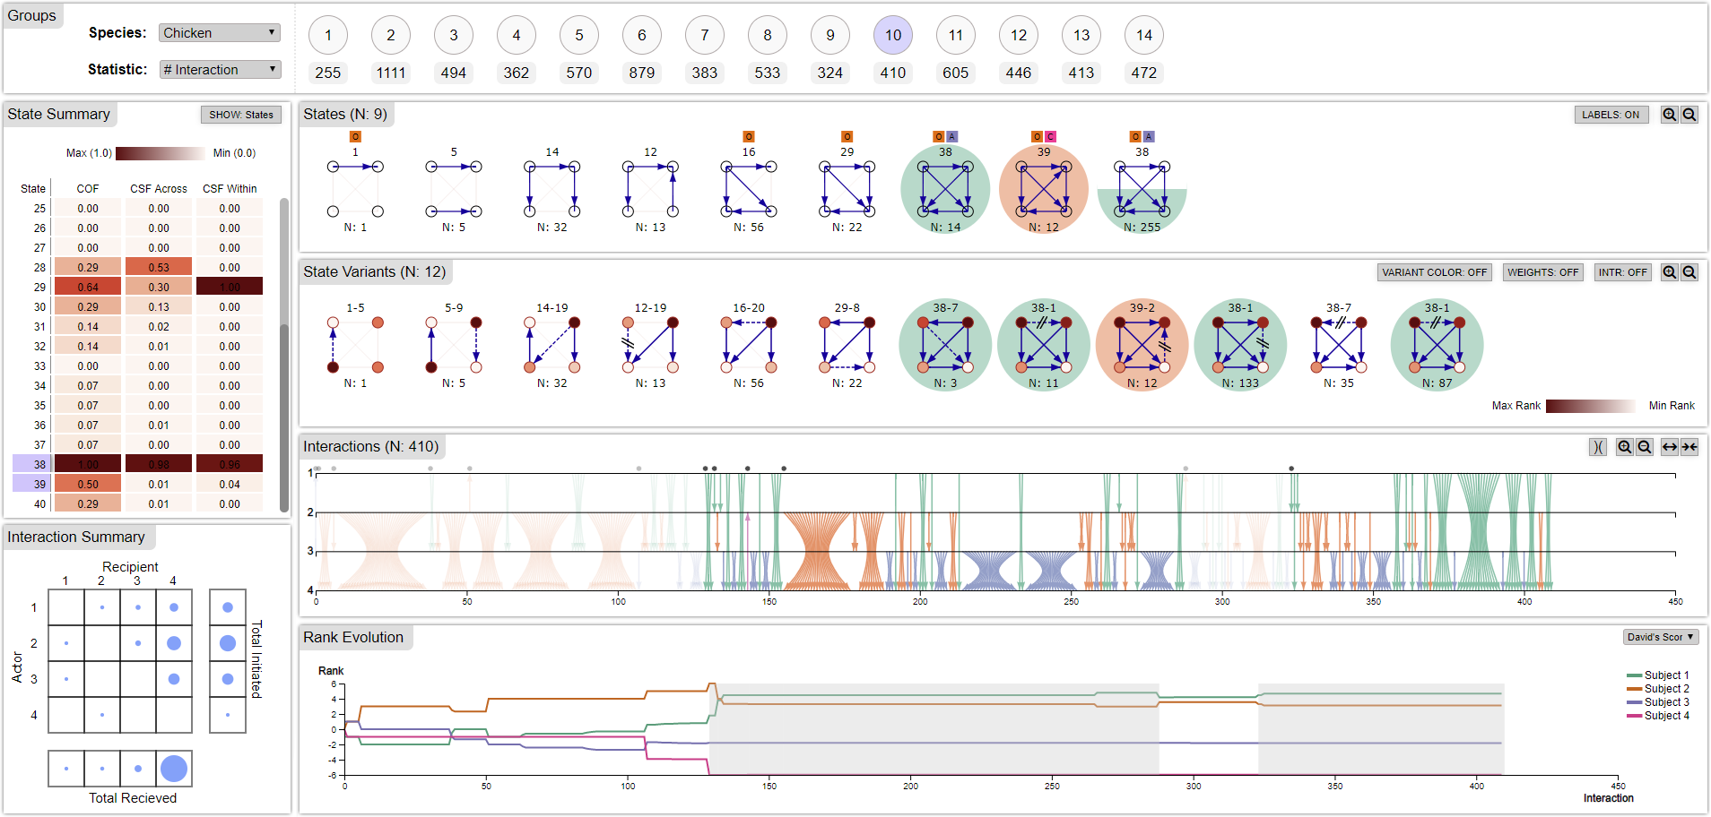
Notes:
The state sequence, state variant sequence, and music notation are brought together in our PeckVis interface.
And when laying out the visualization in the interface, we follow an overview to detail approach.

Slide 26
Notes:
We start off at the top.
Here we list all the groups for a particular species along with some metrics.

Slide 27
Notes:
Next we have the state sequence

Slide 28
Notes:
Which expands to the state variant sequence

Slide 29
Notes:
Which in turn expands to the sequence of interactions.

Slide 30
Notes:
Note that we add markers at the top of the music notation to indicate positions where a new state begins. This helps the user to easily connect the state variant sequence to the music notation.

Slide 31
Notes:
We also show the instantaneous rank of each subject after an interaction with this multi line chart.

Slide 32
Notes:
Additionally on the left we have a summary table that shows state statistics such as occurrence frequency and stability

Slide 33
Notes:
And below it the summary of interactions.

Slide 34
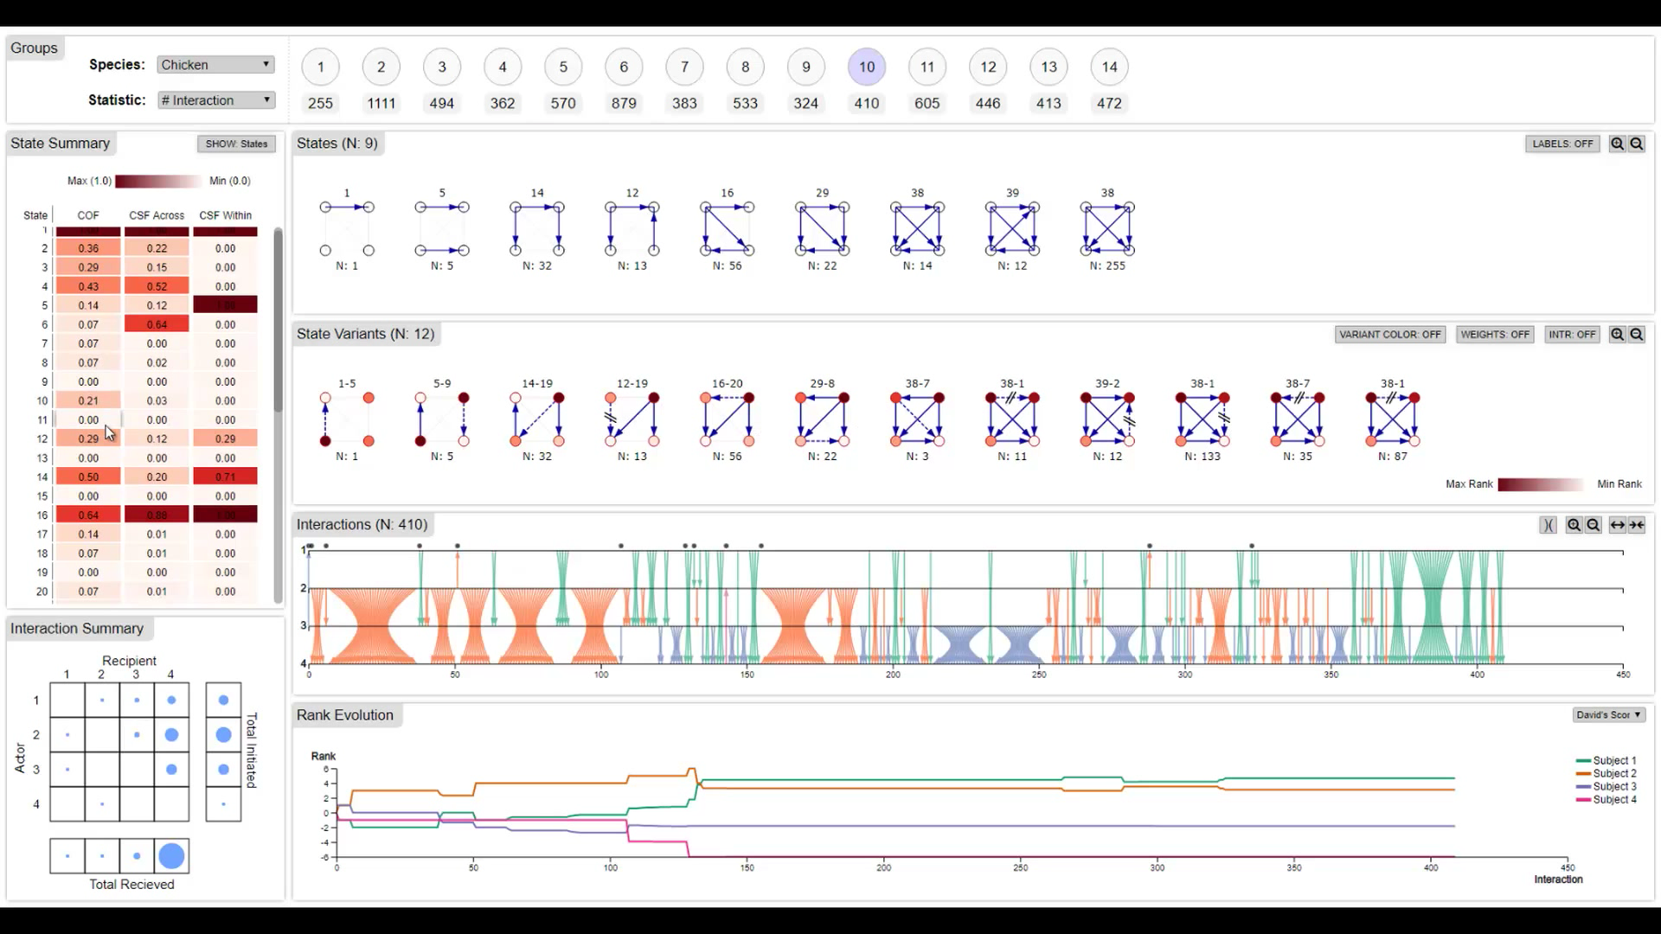
Notes:
Users can select a set of states for inspection.

Slide 35
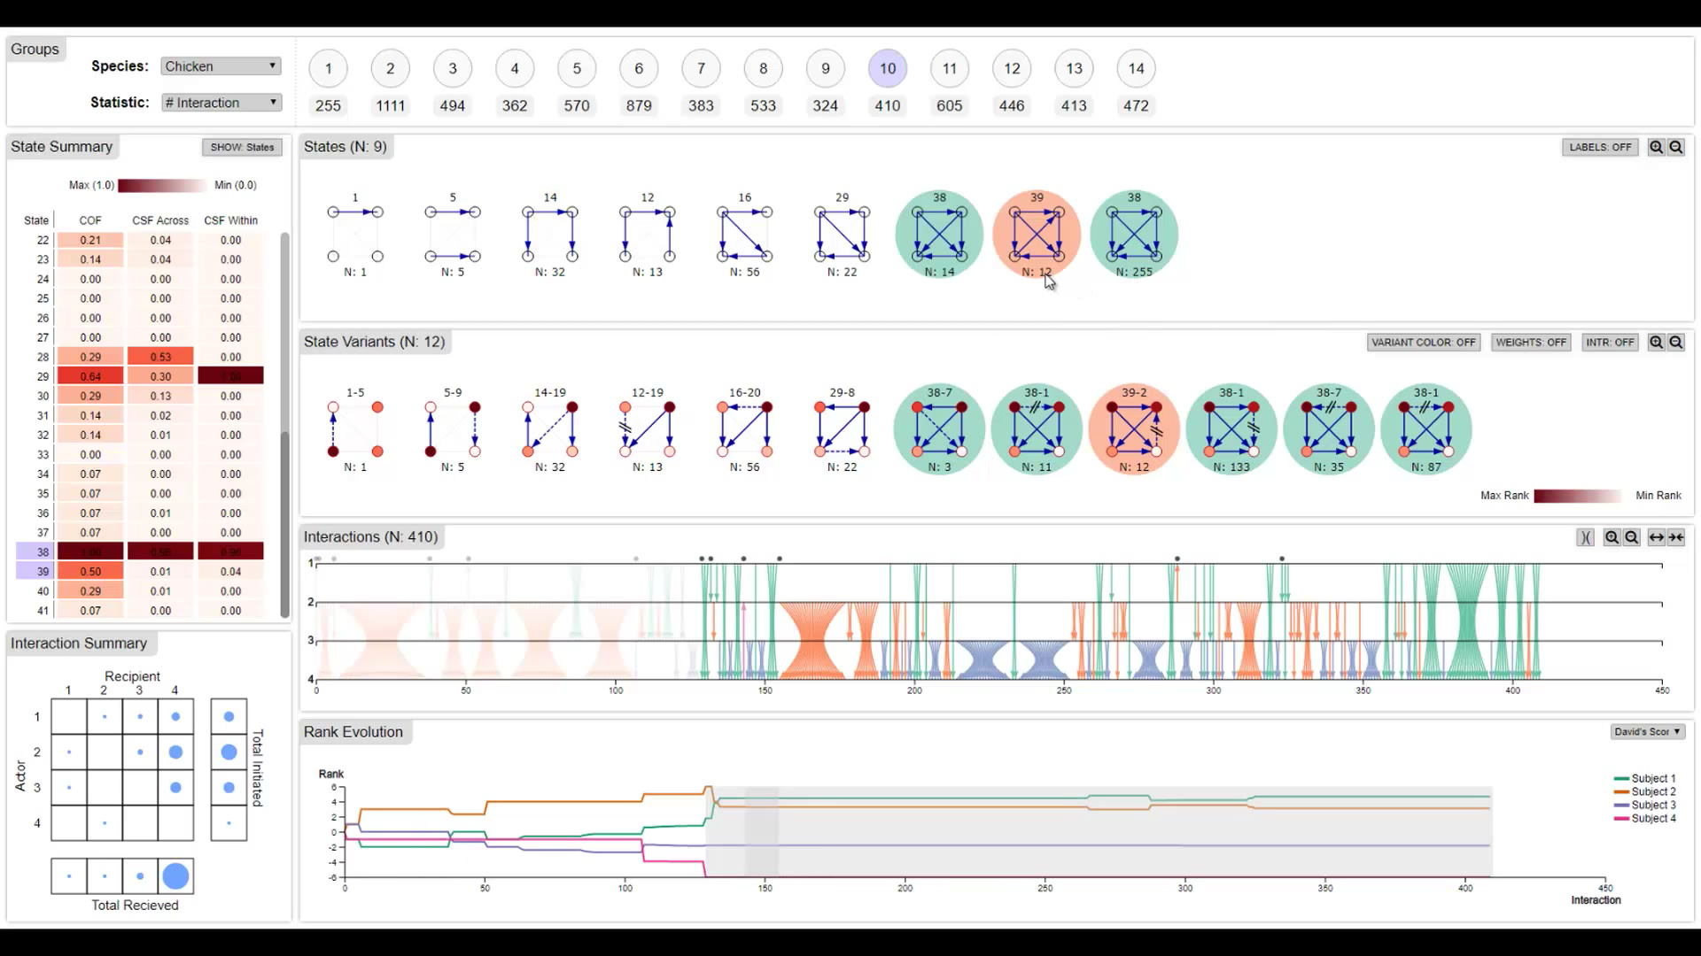
Notes:
Then from the state sequence they can refine the selection, here the user was only interested in states labeled 38 so he deselected state 39.

Slide 36
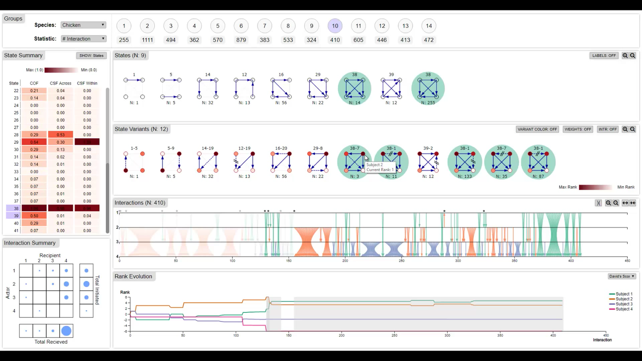
Notes:
Next, he closely inspected the state sequence while selecting a particular dominance relationship.
Using this interactive interface, experts were able to learn of patterns of behavior among the differently ranked individuals in different groups and how these different behaviors ended up in similar hierarchy structures.

Slide 37
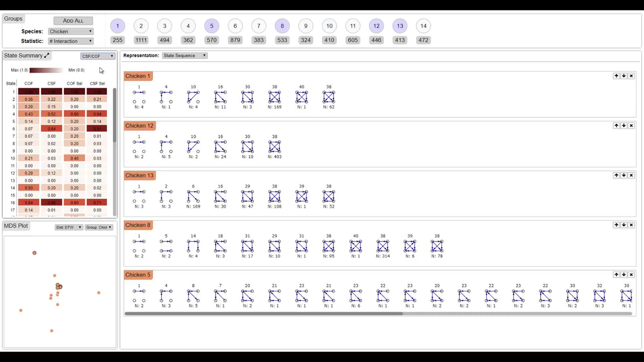
Notes:
We also provide users with an interface to compare groups using a small multiples display of visualizations supported by an MDS plot to show similarity among groups.

Slide 38
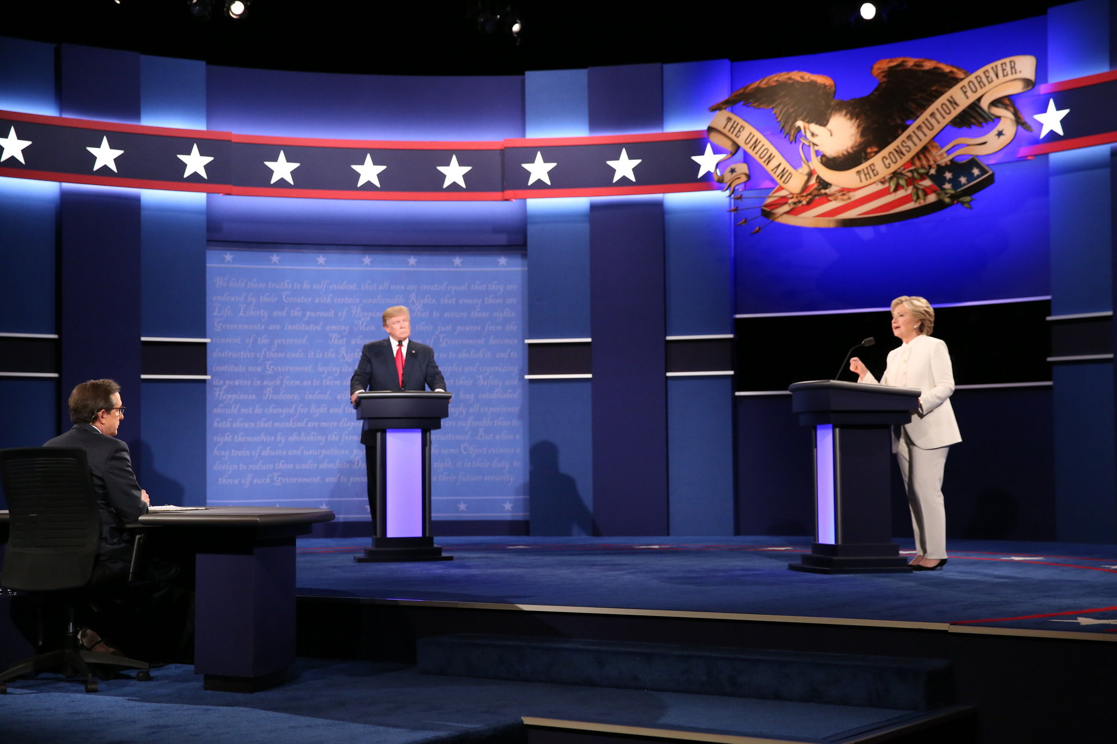
Case Study: Debates
Four subjects - two debaters, the moderator and audience
Interruptions were considered as aggressive interactions
Notes:
To demonstrate the generalizability of our tool, we applied it data from the 2016 US presidential debates.
The also had 4 members, a Democratic candidate, a Republican candidate, a moderator and the audience.
We only considered interruptions to be aggressive interactions.

Slide 39
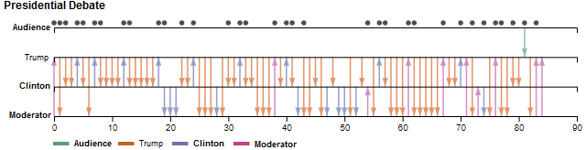
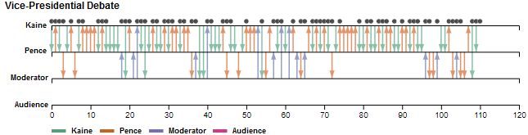
Case Study: Debates
Notes:
So these are the music notation for both the presidential and vice presidential debates.

Slide 40
Case Study: Debates
Notes:
From the markers you at the top, can see that there were a lot more states variants in the vice presidential debates, almost at every interaction, indicating that there was no stable hierarchy.

Slide 41
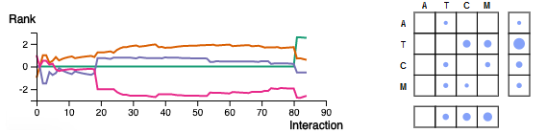
Case Study: Debates
Notes:
Looking at the presidential debates, you can see that Trump, indicated by the orange arrows and line, is at the top for most of the debate.
And he often interrupts in bursts.
However, at the very end, the audience who was never interrupted, interrupted trump who was the most dominant to that point. This caused the audience to be recognized as the most dominant of all members of the group.

Slide 42
Conclusion
Overall the experts found the system useful and engaging.
Explicitly encoding the instantaneous rank and reversals was useful.
Bursts were better detected with bundling
The MDS plot was only helpful for finding similarities in state and state variant sequences, not interaction sequences and summary statistics.
Only two users tested the tool.

Slide 43
  PeckVis
Darius Coelho
Ivan Chase
Klaus Mueller
Notes:
Thank you.

Slide 44
Representing Dominance Networks
Notes:
Now the experts we worked with, found this coloring of nodes and edges to be overwhelming and unnecessary for networks of this size.

Slide 45
Encoding Additional Details
Notes:
Thus we went back to the most basic representation and encoded other important information into it.

Slide 46
Encoding Instantaneous Rank
Highest Rank
Value
Lowest Rank
Value
Notes:
First we used node color to represent instantaneous rank. That is the rank of a subject in an intermediate hierarchy.
This enabled the experts to observer the rank of a subject changing while having the context of it eventual rank based on the node position.

Slide 47
Encoding New Relationships
Latest Relationship
Reversed Relationship
Notes:
In addition to encoding rank, we represented new relationships that lead to the formation of a hierarchy with a dashed arrow and if that relationship is a reversal of a prior relationship, we add a double slash marker to the dashed arrow.
This encoding helped the experts to quickly see which relationships were creating hierarchies and which ones were being reversed very often.

