Slide 1
On Re-engineering the X.509 PKI with Executable Specification for Better Implementation Guarantees
Joyanta Debnath¹, Sze Yiu Chau², and Omar Chowdhury¹
¹ The University of Iowa
² The Chinese University of Hong Kong

Slide 2
TLS and X.509 PKI
TLS
Client
Server
Confidentiality & Data Integrity
Public Key Distribution
Authentication

Slide 3
TLS and X.509 PKI
Client
Server

Slide 4
Certificate Chain Validation
Parsing
Client
Server
Validation
Trusted Issuer
So on …
Not Expired
Valid Signatures

Slide 5
Open-source X.509 Implementations
GnuTLS
MatrixSSL
BoringSSL

Slide 6
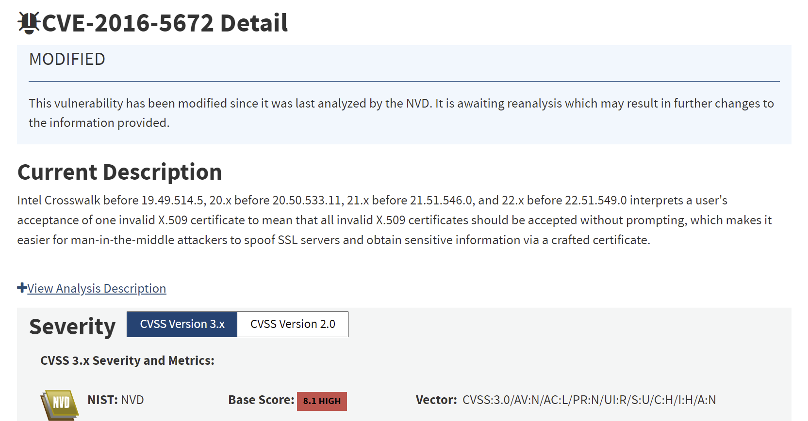
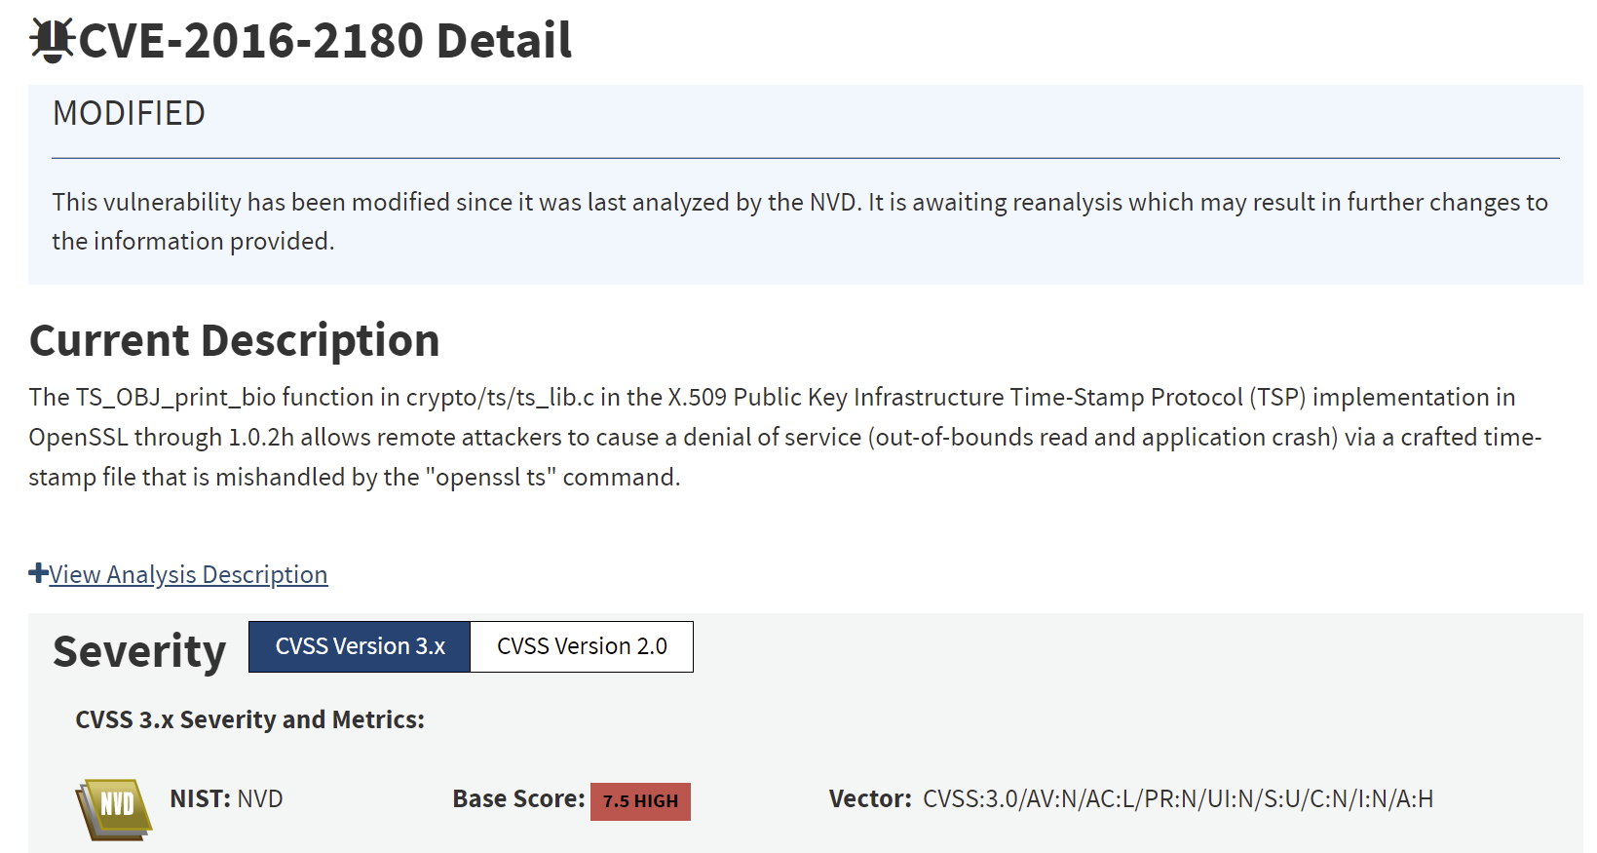
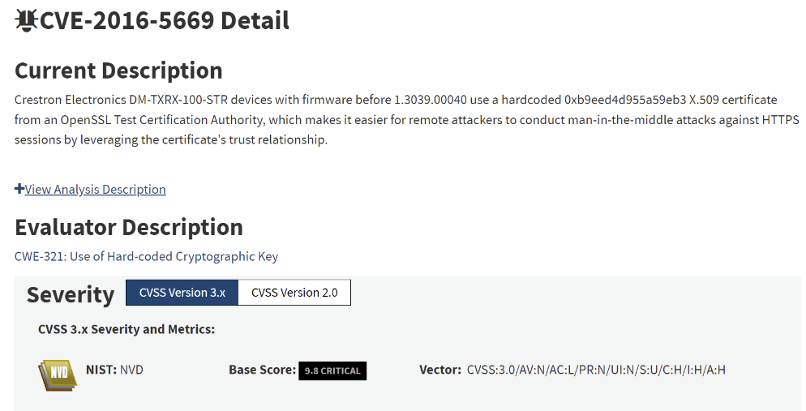
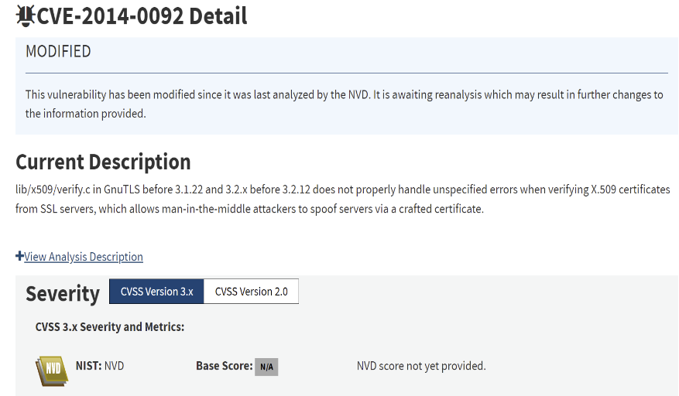
Developers make mistakes!
Incorrect Implementations
≈
Implementations are non-compliant
against X.509 PKI specification

Slide 7
Implications of Non-compliant Implementations

Slide 8
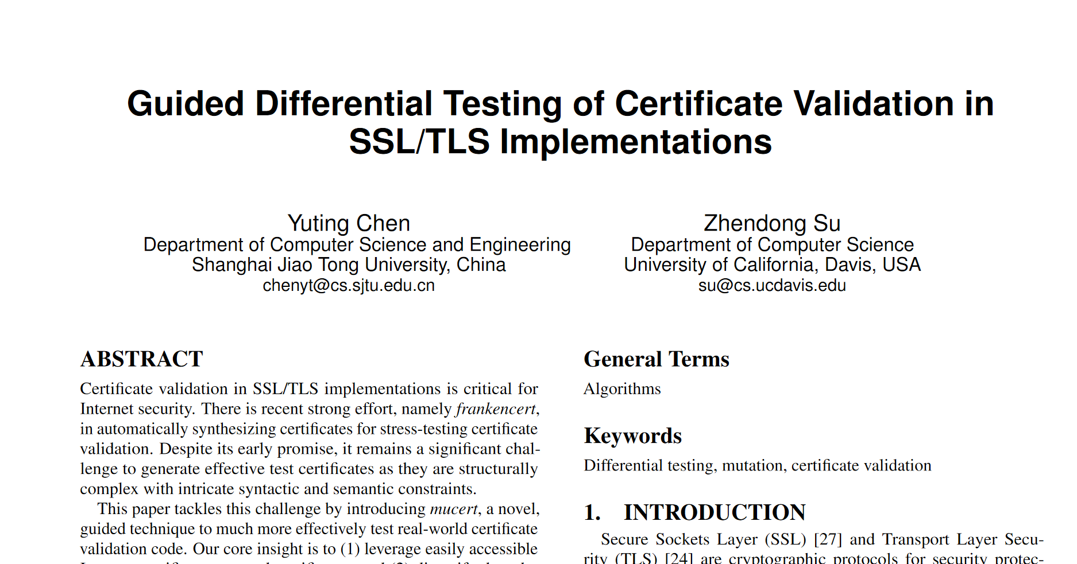
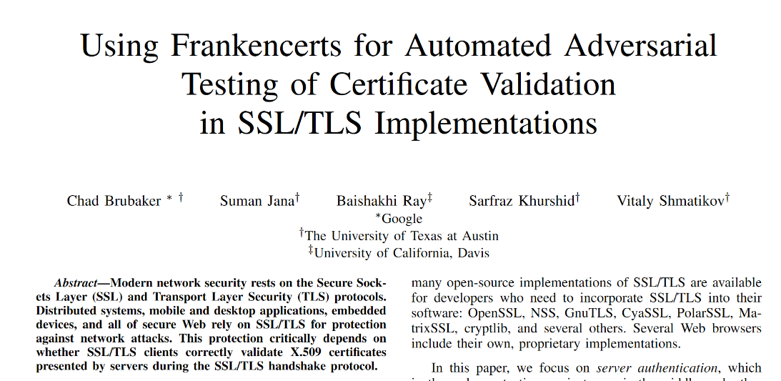
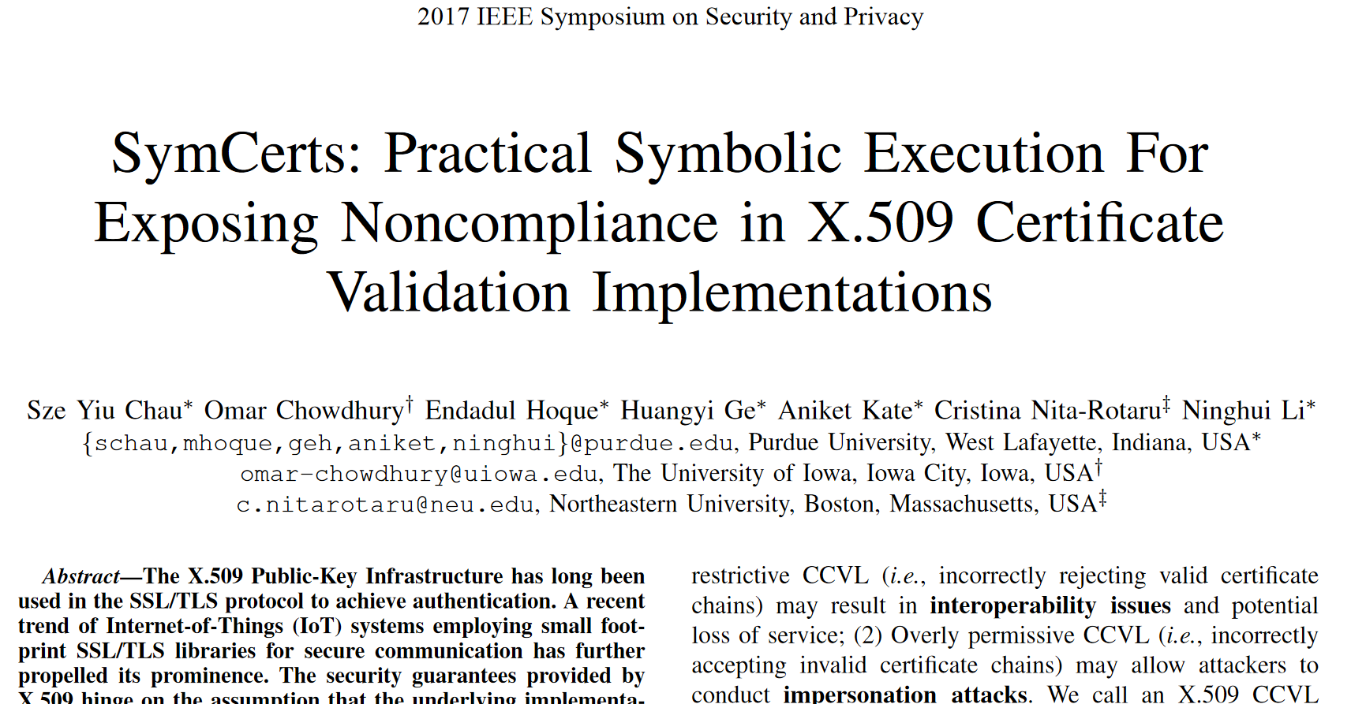
Existing Solutions
Differential Testing
Fuzzing
Dynamic Symbolic Execution
No formalized specification
No reference implementation
No oracle for non-compliance test

Slide 9
Objective
Development of a high-assurance implementation
for X.509 certificate chain validation

Slide 10
Challenges
Natural language specification
Ambiguity /
Inconsistency

Slide 11
Challenges
ASN.1
< T, L, V >
Complex certificate structure
Type
Length
20 bytes
Bytes[20]
Context-sensitive
Grammar
DER
Encoding

Slide 12
Re-engineering of Specification
Modularity in specification
Possibility of two different formalisms
Syntactic Restrictions
However, where is the boundary?
Semantic Restrictions

Slide 13
𝑎^{𝑛}𝑏^{𝑛}
where 𝑎, 𝑏 are terminals and 𝑛 ∈ Z⁺
Syntactic Restrictions
a⁺b⁺
a^{n}b^{n}
Sweet Spot !
Semantic Restrictions
#(a) == #(b)

Slide 14
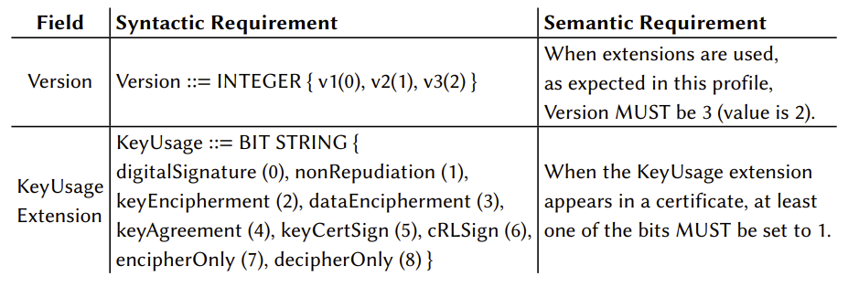
Re-engineering of Specification
DER
Syntactic Restrictions
Semantic Restrictions
Rest …

Slide 15
Formalization of Syntactic Restrictions
Attribute Grammar
Limited Context
Synthesized Attributes
Inherited
Attributes
Unambiguous LL(1) Context-free Grammar
Domain-Specific Language for
X.509 Grammar

Slide 16
Re-engineering of Specification
Semantic Restrictions
Executable Specification!

Slide 17
Executable Specification
Specification
Goal ?
Goal ?
+
How ?
Non-operational
Executable
Find maximum between
two numbers

Slide 18
Formalization of Semantic Restrictions
Semantic
Restrictions
(Version = 0 ∨ Version = 1 ∨ Version = 2)
∧
(KUE_isPresent → Version = 2)
Assertion 1
Assertion 2
…….
Assertion n
Quantifier-Free First Order Logical Formula
Consistency of Specification ?
SMT Solver
Yes / No

Slide 19
Enforcement of Both Restrictions
Semantic
Restrictions
Syntactic
Restrictions
Quantifier-Free First Order Logical Formula
Certificate parser
Certificate Chain Validation
Concrete Values
Version = 2
∧
KUE_isPresent
SMT Solver
UNSAT-core
Yes / No

Slide 20
Implementation
Driver
Module
Parser
Module
Chain-builder
Module
Semantic-checker
Module
CERES

Slide 21
Use Cases
Oracle for checking non-compliance of a given library implementation
Validate a chain to be used for configuring a TLS-enabled webserver

Slide 22
Evaluation
Certificate Chain Dataset
2 millions from Censys
2 millions from Frankencert
All are unique
GnuTLS
CERES

Slide 23
Some Non-compliance Issues
Critical
Extension
GnuTLS

Slide 24
Some Non-compliance Issues
Version
Extension
GnuTLS

Slide 25
Responsible Disclosure
Reported findings to 3 library vendors
Findings acknowledged by GnuTLS
Rejected by OpenSSL and mbedTLS
This reflects the reluctance of the library developers
on developing RFC compliant X.509 implementations

Slide 26
Limitations
Slower due to usage of SMT solver
Supports only RSA Signature verification
No revocation status check
No hostname matching
No completeness guarantee

Slide 27
Summary
X.509 Specification
Syntactic
Restrictions
Semantic
Restrictions
Re-engineer the Specification
Formalized
Restrictions
Formalize the Restrictions
High-assurance Implementation
Non-compliance Testing
Report the findings
GnuTLS

Slide 28
CERES is publicly available
https://github.com/joyantaDebnath/CERES

Slide 29
THANK YOU

