Slide 1
From Cardiac Cells to
Genetic Regulatory Networks
Radu Grosu SUNY at Stony Brook
Joint work with
Ezio Bartocci, Gregory Batt, Flavio H. Fenton,
James Glimm, Colas Le Guernic, and Scott A. Smolka

Slide 2
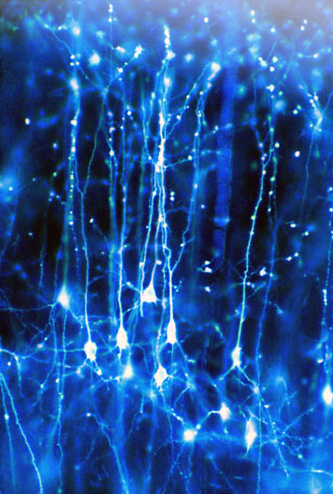
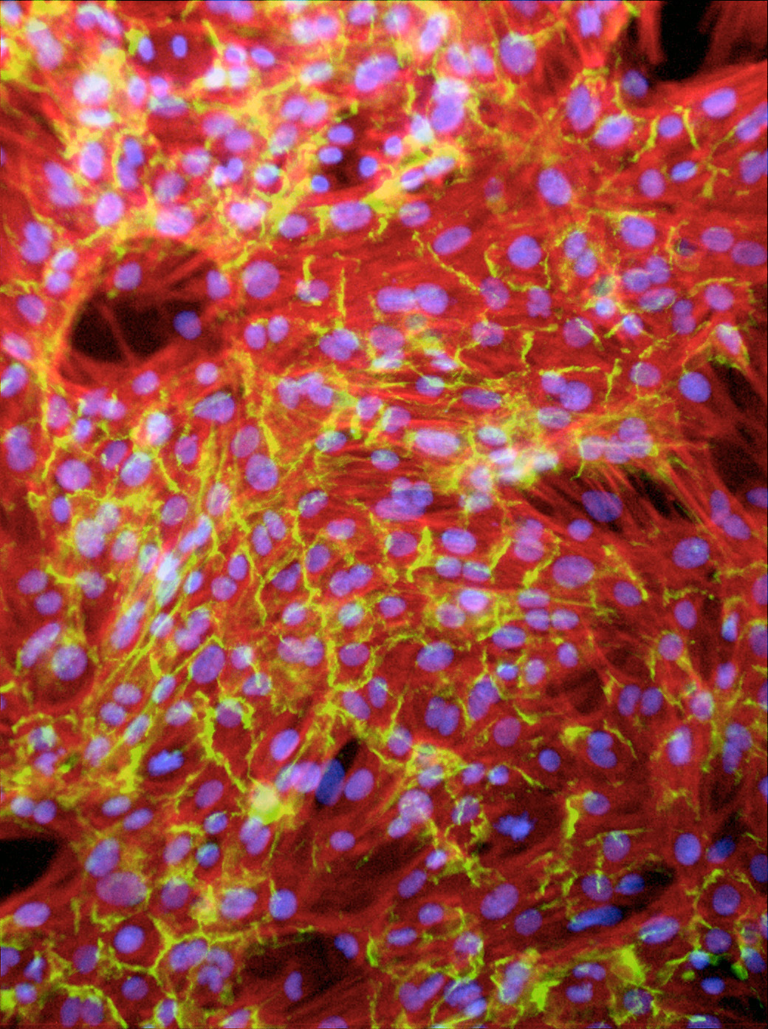
Excitable Cells
Generate action potentials (AP), electrical pulses in response to electric stimulation
Examples: neurons, cardiac cells, etc.
Local regeneration allows electric signal propagation without damping
Building block for electrical signaling in brain, heart, and muscles
Neurons of a squirrel
University College London
Artificial cardiac tissue
University of Washington
Notes:
Excitable cells are cells that generate electrical pulses,
called Action Potentials in response to electrical stimulation.
- Examples are neurons, cardiac muscle cells.
It's currently possible to grow cardiac cells in the laboratory, but the result is random and disordered. To be useful, the cells must be organized so they can work together as functioning tissue.
This photograph shows the neurons of a ground squirrel. The specimen was prepared by Professor Brian Boycott using the Golgi technique and was photographed by Dr Jonathan Clarke of UCL Anatomy and Developmental Biology. The department uses sophisticated imaging techniques and molecular genetics to study the development of the brain in vertebrate embryos.

Slide 3
Single Cell Reaction: Action Potential
Membrane’s AP depends on:
Stimulus (voltage or current):
External / Neighboring cells
Cell itself (excitable or not):
State / Parameters value
Schematic Action Potential
nonlinear
voltage
Tissue: Reaction / diffusion
Threshold
Stimulus
failed initiation
Resting potential
Behavior
In time
Reaction
Diffusion
time

Slide 4
Lack of Excitability: Implications
Stimulus: bottom row, every 300ms
No Obstacle
Obstacle of UT

Slide 5
Problem to Solve
What circumstances lead to a loss of excitability?
What parameter ranges reproduce loss of excitability?
Experimental
Data
Minimal
Resistor Model
Minimal Conductor Model
RoverGene
Analysis Tool
Minimal
Multi-Affine Model
Notes:
Excitable cells are cells that generate electrical pulses,
called Action Potentials in response to electrical stimulation.
- Examples are neurons, cardiac muscle cells.
It's currently possible to grow cardiac cells in the laboratory, but the result is random and disordered. To be useful, the cells must be organized so they can work together as functioning tissue.
This photograph shows the neurons of a ground squirrel. The specimen was prepared by Professor Brian Boycott using the Golgi technique and was photographed by Dr Jonathan Clarke of UCL Anatomy and Developmental Biology. The department uses sophisticated imaging techniques and molecular genetics to study the development of the brain in vertebrate embryos.

Slide 6
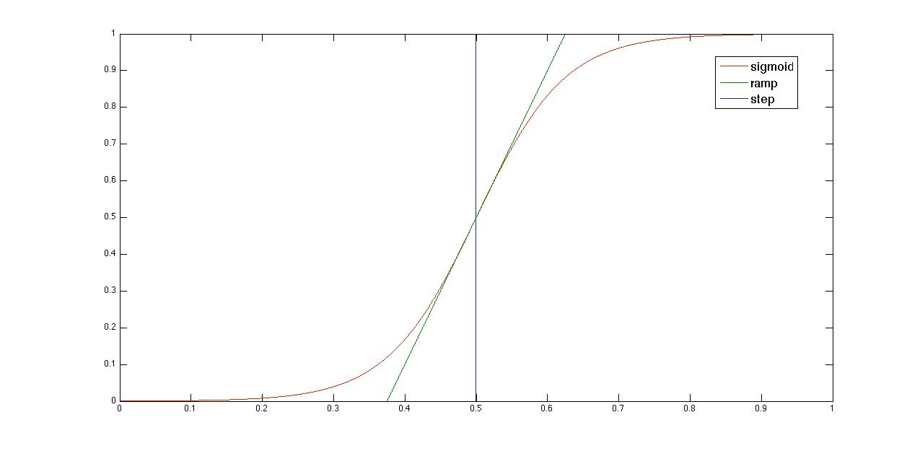
Biological Switching

Slide 7
Minimal Resistor Model: Voltage ODE
Voltage
Rate
Diffusion
Laplacian
Fast input
current
Slow input
current
Slow output
current

Slide 8
Minimal Resistor Model: Voltage ODE

Slide 9
MRM: Currents Equations
Heaviside
(step)
Constant
Resistance
Piecewise
Nonlinear
Piecewise
Bilinear
Piecewise
Resistance
Sigmoidal
Resistance
Piecewise
Nonlinear

Slide 10
MRM: Gates ODEs
Piecewise
Resistance
Sigmoidal
Resistance
Sigmoid
Piecewise
Resistance

Slide 11
MRM: Voltage-Controlled Resistances/SSV
Piecewise
Constant
Sigmoidal
Piecewise
Constant
Piecewise
Linear

Slide 12
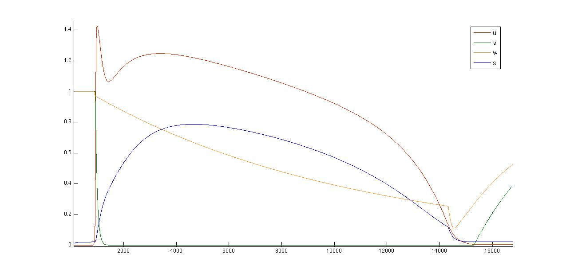
Minimal Resistance Model (MRM)

Slide 13
Sigmoid Closure Property
Theorem: For ab > 0, scaled sigmoids are closed
under the reciprocal operation:
Proof:
b
b-a
a

Slide 14
Sigmoid Reciprocal Closure
Theorem: For ab > 0, scaled sigmoids are closed
under the reciprocal operation:
Proof:

Slide 15
Minimal Conductance Model (MCM)

Slide 16
Gene Regulatory Networks (GRN)
GRN canonical sigmoidal form:
where:
Note: steps and ramps are sigmoid approximations

Slide 17
Optimal Polygonal Approximation
Given: One nonlinear curve and desired # segments
Find: Optimal polygonal approximation
Example: What is the optimal polygonal approxima-
tion of the blue curve with 3 segments ?
Dynamic Programming Algorithm
Complexity: O(P²)
P: # points of the curve
M. Salotti, Pattern Recognition Letters 22 (2001), Pag 215-221

Slide 18
Globally-Optimal Polygonal Approximation
Given: Set of nonlinear curves and desired # of segments
Find: Globally optimal polygonal approximation
Example: What is the optimal polygonal approxima-
tion of the curves below with 5 segments ?
Combining the two we obtain 8 segments and not 5 segments
Solution: modify the OPAA to minimize the maximum
error of a set of curves simultaneously.

Slide 19
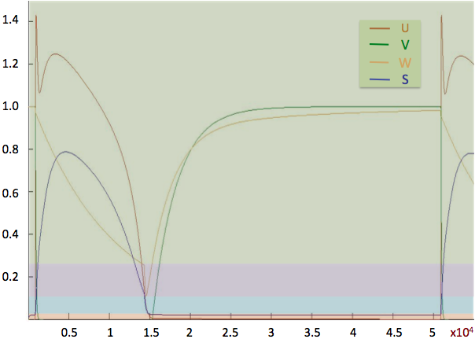
Deriving the Piecewise Multi-Affine Model

Slide 20
Deriving the Piecewise Multi-Affine Model

Slide 21
Deriving the Piecewise Multi-Affine Model

Slide 22
Deriving the Piecewise Multi-Affine Model

Slide 23
Deriving the Piecewise Multi-Affine Model

Slide 24
Deriving the Piecewise Multi-Affine Model

Slide 25
2D Comparison

Slide 26
Analysis Problem
Find parameter ranges reproducing un-excitability:
Restated as an LTL formula:
Initial region:
Uncertain parameter ranges:
Stimulus:
Notes:
Excitable cells are cells that generate electrical pulses,
called Action Potentials in response to electrical stimulation.
- Examples are neurons, cardiac muscle cells.
It's currently possible to grow cardiac cells in the laboratory, but the result is random and disordered. To be useful, the cells must be organized so they can work together as functioning tissue.
This photograph shows the neurons of a ground squirrel. The specimen was prepared by Professor Brian Boycott using the Golgi technique and was photographed by Dr Jonathan Clarke of UCL Anatomy and Developmental Biology. The department uses sophisticated imaging techniques and molecular genetics to study the development of the brain in vertebrate embryos.

Slide 27
State Space Partition
Hyperrectangles: 4 dimensional (uv-projection)
Arrows: indicate the vector field
Notes:
Excitable cells are cells that generate electrical pulses,
called Action Potentials in response to electrical stimulation.
- Examples are neurons, cardiac muscle cells.
It's currently possible to grow cardiac cells in the laboratory, but the result is random and disordered. To be useful, the cells must be organized so they can work together as functioning tissue.
This photograph shows the neurons of a ground squirrel. The specimen was prepared by Professor Brian Boycott using the Golgi technique and was photographed by Dr Jonathan Clarke of UCL Anatomy and Developmental Biology. The department uses sophisticated imaging techniques and molecular genetics to study the development of the brain in vertebrate embryos.

Slide 28
Embedding Transition System T_{X}(p)
Notes:
Excitable cells are cells that generate electrical pulses,
called Action Potentials in response to electrical stimulation.
- Examples are neurons, cardiac muscle cells.
It's currently possible to grow cardiac cells in the laboratory, but the result is random and disordered. To be useful, the cells must be organized so they can work together as functioning tissue.
This photograph shows the neurons of a ground squirrel. The specimen was prepared by Professor Brian Boycott using the Golgi technique and was photographed by Dr Jonathan Clarke of UCL Anatomy and Developmental Biology. The department uses sophisticated imaging techniques and molecular genetics to study the development of the brain in vertebrate embryos.

Slide 29
The Discrete Abstraction T_{R}(p)
Notes:
Excitable cells are cells that generate electrical pulses,
called Action Potentials in response to electrical stimulation.
- Examples are neurons, cardiac muscle cells.
It's currently possible to grow cardiac cells in the laboratory, but the result is random and disordered. To be useful, the cells must be organized so they can work together as functioning tissue.
This photograph shows the neurons of a ground squirrel. The specimen was prepared by Professor Brian Boycott using the Golgi technique and was photographed by Dr Jonathan Clarke of UCL Anatomy and Developmental Biology. The department uses sophisticated imaging techniques and molecular genetics to study the development of the brain in vertebrate embryos.

Slide 30
Computing T_{R}(p)
Theorem: If f is multi-affine then
Corollary:

Slide 31
Partitioning the Parameter Space
In each vertex: affine equation in the parameters
Parameter space: 4 dimensional (g_{o1}/g_{o2} projection)
Each rectangle: a different transition system

Slide 32
Results
Rovergene: intelligently explores the PS rectangles
independent
linearly dependent
simulation

Slide 33
Conclusions and Outlook
First automatic parameter-range identification for CC
Validated both in MCM and MRM
Can be validated experimentally as for ischemia
Moving towards 2D/3D parameter-range identification
Use PS partitioning, simulation and curvature analysis

Slide 34
From Resistances to Conductances
Removing Divisions using Sigmoid Reciprocal:
Removing Divisions using Step Reciprocal:

