Slide 1
Cse 416
Software Engineering
Introduction

Slide 2
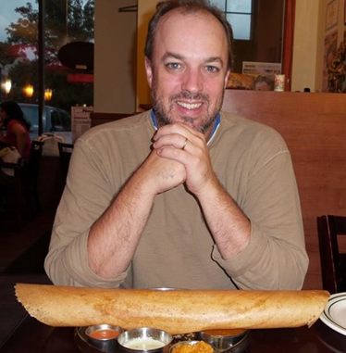
Who am I?
Richard McKenna
richard@cs.stonybrook.edu
New CS 216
  Tu 2:00pm-3:30pm
  Th 2:00pm-3:30pm
http://www.cs.stonybrook.edu/~richard

Slide 3
ALL
PAST
PROGRAMMING
SINS
ARE
FORGIVEN

Slide 4
Welcome
We want to set you up for success
  make sure now is the right semester for 416
  clear policies
Make sure you read the entire course syllabus
  Next Tuesday we have Quiz #1 (on the syllabus and Chapter 1)

Slide 5
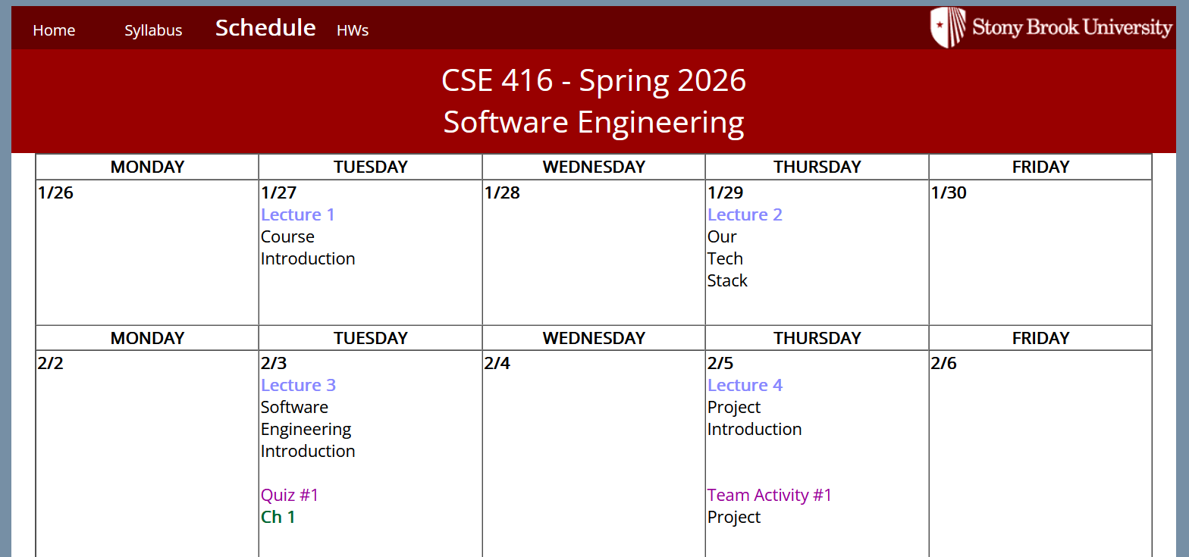
Course homepage
http://www.cs.stonybrook.edu/~cse416/Sections02and03
  syllabus
  schedule (lecture slides, hw, etc …)
  etc.
  https://it.stonybrook.edu/services/brightspace
    grades

Slide 6
Course description
Introduces the basic concepts and modern tools and techniques of software engineering. Emphasizes the development of reliable and maintainable software via system requirements and specifications, software design methodologies including object-oriented design, implementation, integration, and testing; software project management; life-cycle documentation; software maintenance; and consideration of human factor issues.
NOTE: C or higher in CSE 316; and CSE major; and U4 standing.

Slide 7
Course topics
Approaches to software engineering
The UML (Universal Modeling Language)
Requirements Analysis and Use Case Modeling
Object Modeling and/or Functional Modeling
Dynamic Modeling using appropriate diagrammatic approaches
Specification Documents
Design Documents
Testing
Project Planning
Software Engineering tools
Oral and Written Communication

Slide 8
Abstract Software Engineering

Slide 9

Our Course Textbook
Ch. 1 – Introduction
Ch. 2 – Processes
Ch. 3 – Requirements
Ch. 4 – Models
Ch. 5 – Design Principles
Ch. 6 – Design Patterns
Ch. 7 – Architecture
Ch. 8 – Testing
Ch. 9 – Refactoring
Ch. 10 – DevOps

Slide 10
How are grades computed?
10 Quizzes 7.5 %
10 Team Activities 7.5 %
Exam #1 20 %
Exam #2 20 %
Group Project – Product Sketch 5 %
Group Project – Design Sketch 5 %
Group Project – Minimum Viable Product Presentation 5 %
Group Project – Sprints (and a Code Review) 5 %
Group Project – Finished Product & Presentation 20 %
100 %
Note CEAS Policy: The Pass/No Credit (P/NC) option is not available for this course.

Slide 11
Sprints/Progress Reviews
Meetings with Professor/TAs
Demonstrations of Implementation & Formal Testing
Update Task Status

Slide 12

What tech are we using?
The MERN stack plus other stuff (NextJS)
Mongo
Express
React
Node
Why? We use this in 316
  everyone here has been trained in these technologies

Slide 13
What about AI?
You may use it but you must document all usages
You must still know all of your project’s code
No one else may make contrubutions
Don’t let AI take you to a dead end
Be sure to read the syllabus

Slide 14





App Deployment
Throughout your development lifecycle your app will be deployed live. Where? That’s up to you.

Slide 15
Teams
Let's start by making teams of 4
  pick a named color that your UI will use
Rules to start:
  teammates must always be respectful to one another
  teammates must always answer each others' emails/texts
  teammate should learn and know each others' schedules

Slide 16
Team Rules
Can a teammate be traded?
  yes, but only before the first exam
  i.e. the Software Engineer to be named later clause
Can a teammate be fired?
  yes, but only if the instructor approves
Obvious advice:
  team members’ commitment to the project is a commitment to each other
  team members help each other succeed
  team members communicate concerns and progress

Slide 17
What happens during a meeting?
Agenda is prepared and sent out before the meeting
  Preparation is always key
  Go to the meeting knowing what needs to be decided
Take attendance
Make decisions leaving the meeting knowing the who what when where how and why of each decision
Don’t waste your teammates’ time

Slide 18
Document all team meetings
Date
Attendees
Agenda (again, best if decided ahead of time)
Meeting Minutes (follows the discussion)
Action Items

Slide 19
What’s an action item?
An assigned task
All tasks should have:
  owner
  completion date
  dependencies
Task assignments must be reviewed/followed up
  even those with distant horizons
  Is it on track?
  Does the owner need help?
  Is the owner overloaded?

Slide 20




So what’s the project?

Slide 21
But More
You will make a pay-for-license/pay-to-use API
So, you will make multiple things:
  API
  Example use of API
  3rd Party Web & Mobile Apps that Use API

Slide 22
Your first Task
Find a Team
Pick a Color
Ref: S26_416_Teams

