Slide 1
CSE 591: Energy-Efficient Computing
Lecture 6
SHARING: distributed vs. local
Anshul Gandhi
347, CS building
anshul@cs.stonybrook.edu

Slide 2
energy_routing paper

Slide 3
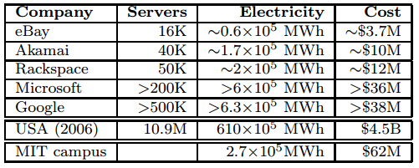
# servers

Slide 4
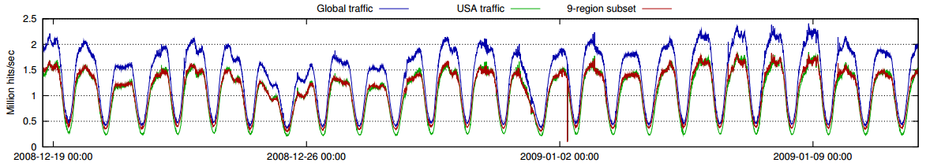
workload
Notes:
Predictable

Slide 5
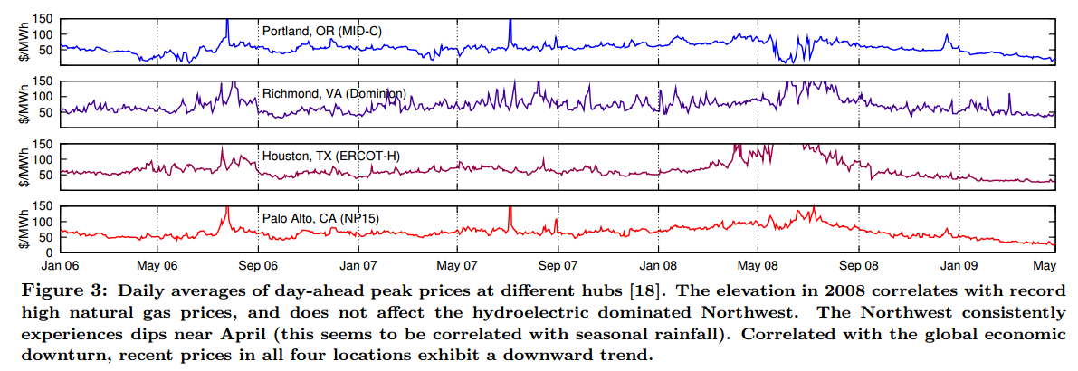
electricity prices
Notes:
Convert 70 $/MWh to 7 c/KWh

Slide 6
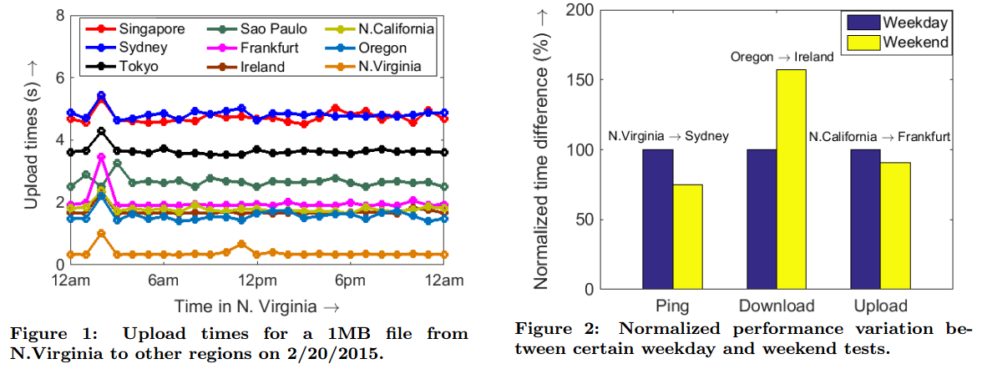
network variations
Notes:
DCC paper

Slide 7
softscale paper

Slide 8
Goals of a data center
Performance
Power
Low response times
Goal: T₉₅ ≤ 500 ms
70% is wasted
Goal: Minimize waste
Intel Xeon server
Load
BUSY: 200 W
IDLE: 140 W
OFF: 0 W
Time

Slide 9
Scalable data centers
Performance
Power
Only if load changes slowly
Setup cost
300 s
200 W
(+more)
Intel Xeon server
Load
BUSY: 200 W
IDLE: 140 W
OFF: 0 W
Time
Reactive: [Leite’10;Horvath’08;Wang’08]
Predictive: [Krioukov’10;Chen’08;Bobroff’07]

Slide 10
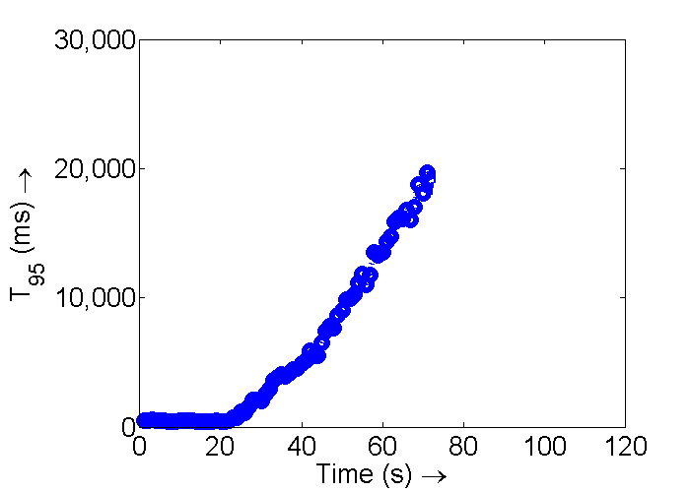
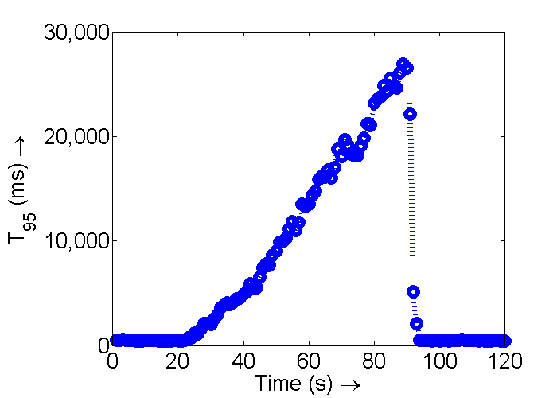
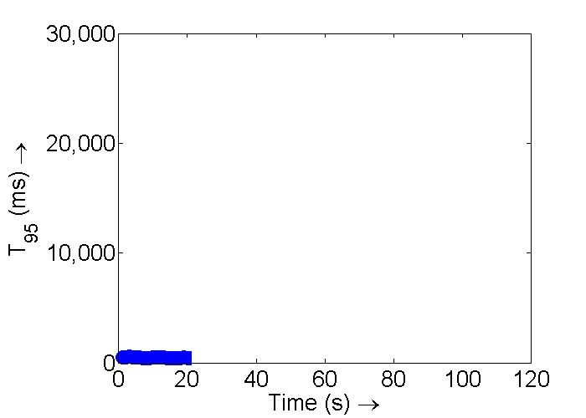
Problem: Load spikes
2x
Load
x
Time

Slide 11
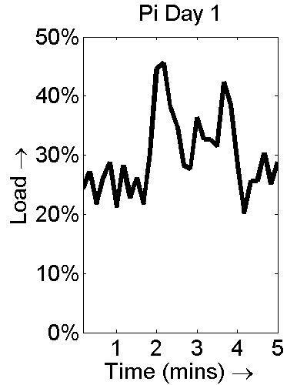
Prior work
2x
Dealing with load spikes
Spare servers [Shen’11;Chandra’03]
  Over provisioning can be expensive
Forecasting [Krioukov’10;Padala’09;Lasettre03]
  Spikes are often unpredictable
Compromise on performance [Urgaonkar’08;Adya’04;Cherkasova’02]
  Admission control, request prioritization
Load
x
Time

Slide 12
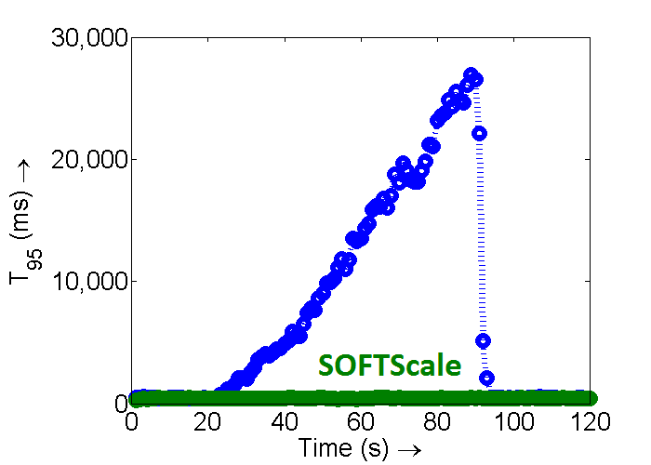
Our approach: SOFTScale
No spare servers
No forecasting
Does not compromise on performance (in most cases)
2x
Load
x
Time
Can be used in conjunction with prior approaches

Slide 13
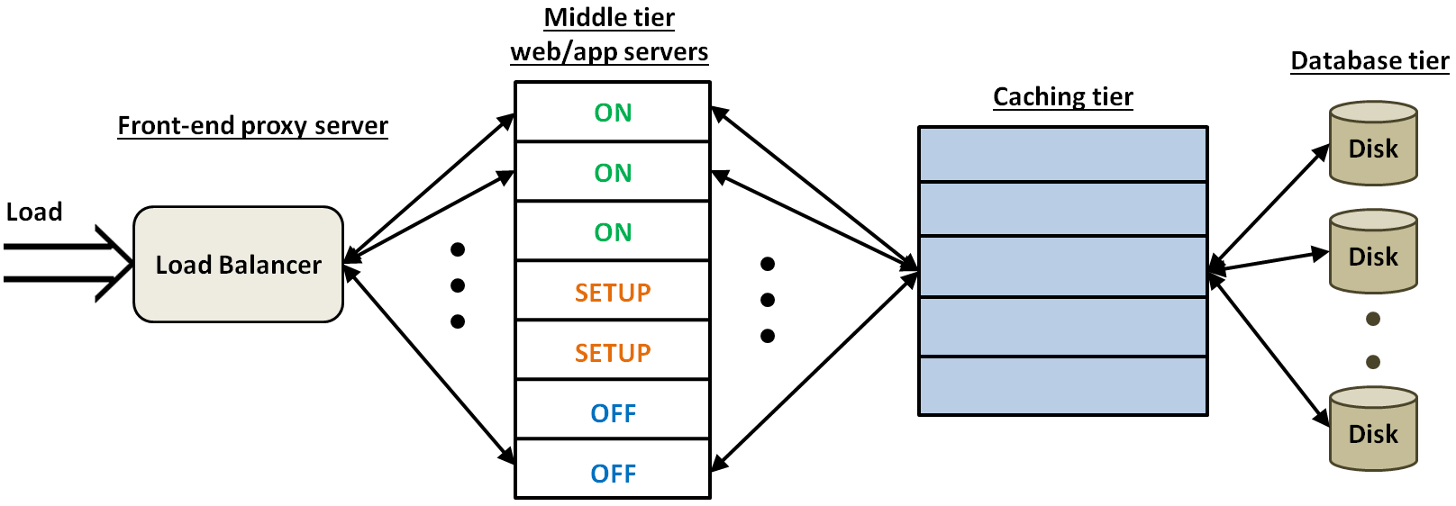
Closer look at data centers
Scalable
Always on
Use caching tier to “pick up the slack”

Slide 14
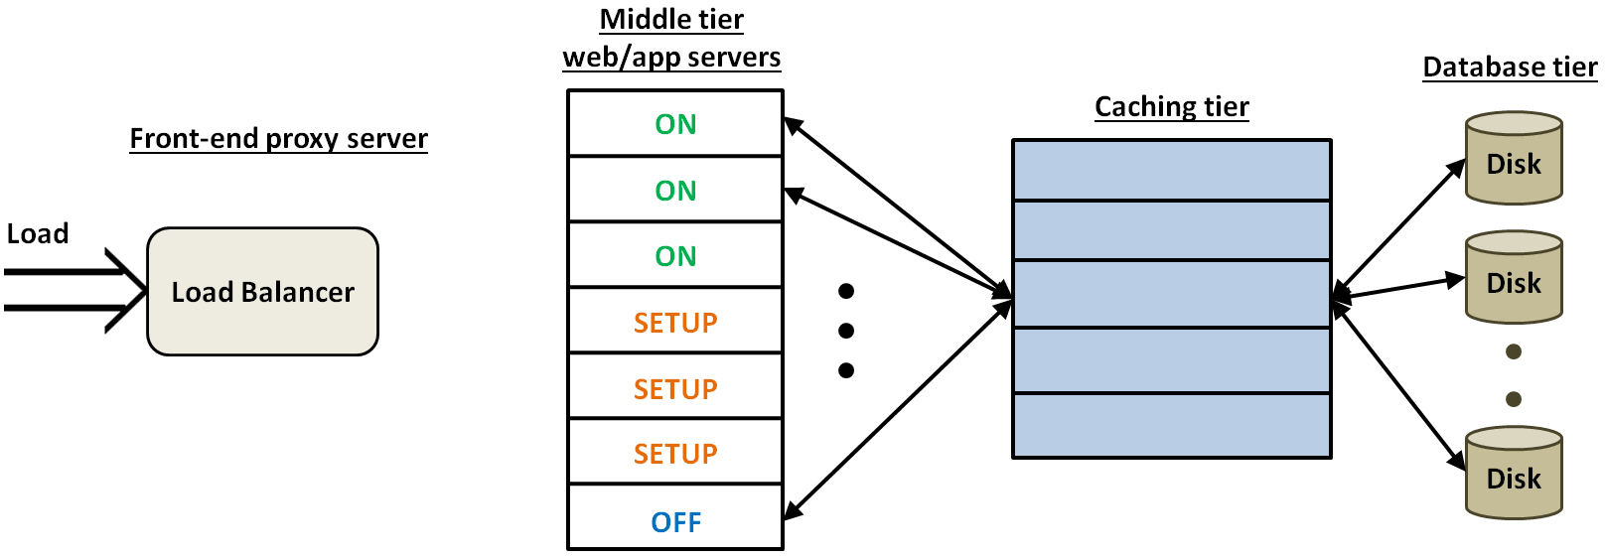
High-level idea
SETUP
ON
OFF
ON
OFF
SETUP
OFF
SETUP
ON
Dual purpose
2x
Load
x
Leverage spare capacity
Time

Slide 15


Experimental setup
Apache
Memcached
(memory-bound)
PHP
(CPU-bound)
Response time: Time for entry to exit
Average response time: 200ms (with 20X variability)
Goal: T₉₅ ≤ 500ms

Slide 16
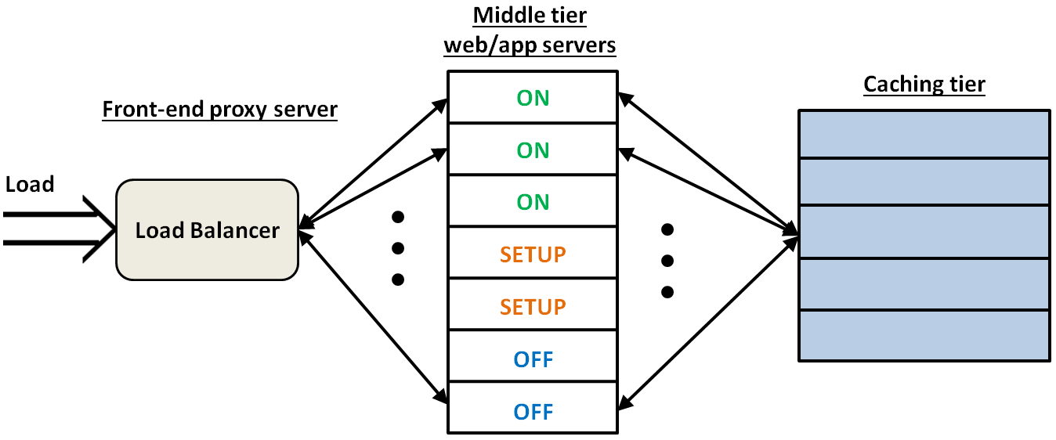
Experimental setup
Apache
Memcached
(memory-bound)
PHP
(CPU-bound)
8-core CPU
4 GB memory
4-core CPU
48 GB memory

Slide 17
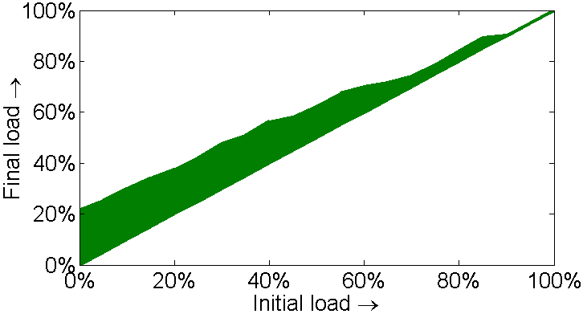
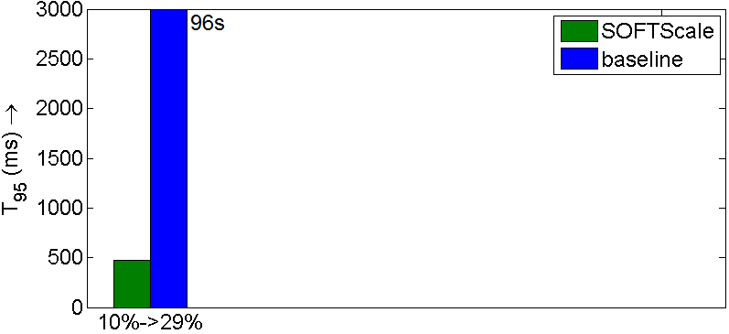
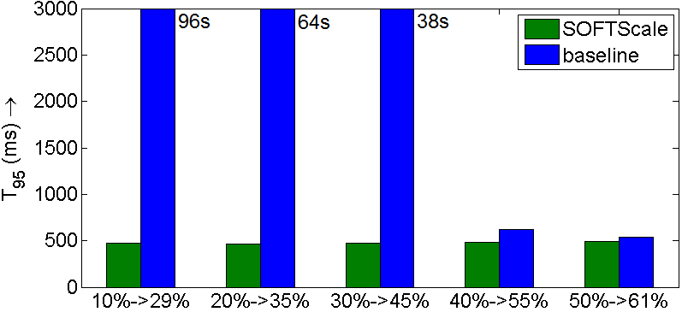
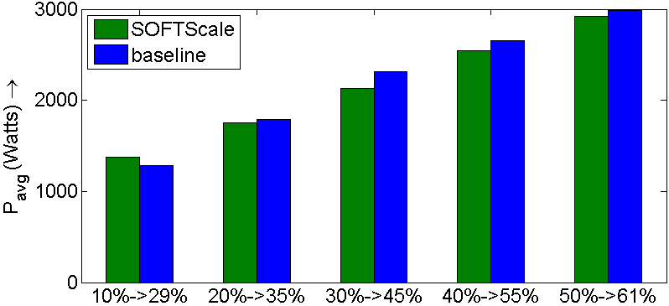
Results: Instantaneous load jumps
61%
Load
50%
10% → 29%
Time
baseline = provisioned for initial load
T₉₅ (ms)
averaged over 5 mins

Slide 18
Conclusion
Problem: How to deal with load spikes?
Prior work: Over provision, predict, compromise on performance
Our (orthogonal) approach: SOFTScale
  Leverages spare capacity in
  “always on” data tiers
  Look at the whole system
  Can handle a range of load spikes

