Slide 1

Statistics in Medicine November 2025
Sneha Shrivastava MD, MSEd
Visting Associate Professor of Clinical Medicine
Associate Program Director, Internal Medicine Residency Program

Slide 2
Learning Objectives
Identify areas where statistics can be used in medicine.
Exploring statistical methods in diagnosing a patient.
Define sensitivity, specificity, positive predictive value and negative predictive value

Slide 3

Use of Statistics in Medicine

Slide 4

Why do we need statistics?
Primary objective
To make an inference about a population based on a sample from that population
What is the chance of being wrong? (alpha)

Slide 5


What Statistics Will and will NOT do for us?
Clarify our exact question.
Identify fixed and constant variables.
Verify if planned sample size if adequate.
Answer the question asked.
Limit risk of error.
Make uncertainty disappear.
Provide credible conclusion from poor data.
Give answers without thought and effort.

Slide 6
Statistics is fundamental to modern medicine, providing the essential framework for evidence-based decision-making in research, clinical practice, and public health.
It allows healthcare professionals to make sound decisions in the presence of uncertainty by providing methods to design studies, analyze data, and interpret results objectively.

Slide 7
Key areas
Clinical Trials
Epidemiology and public health
Clinical decision making and diagnosis
Medical research
Precision and personalized medicine

Slide 8
Clinical Trials
Statistics are crucial for designing, conducting, and analyzing clinical trials, the gold standard for evaluating new treatments and drugs.
Study Design
Efficacy and Safety Assessment
Interim Monitoring

Slide 9
Epidemiology and public health
Disease Tracking
Policy Making
Statistics are vital for understanding disease patterns, identifying risk factors, and evaluating public health interventions.

Slide 10
Clinical Decision Making and Diagnosis
Reference Ranges and Scoring Systems
Prognosis and Risk Assessment
Statistical tools are integrated into daily clinical activities.

Slide 11
Medical Research
Statistics provide an objective framework for all stages of medical research, from planning an investigation to interpreting results.
Medical education research!

Slide 12
Precision and Personalized Medicine
In this emerging field, statistics helps analyze large amounts of genetic and molecular data to develop predictive models and tailor treatment approaches to a patient's individual characteristics.
In essence, statistics ensures the reliability, validity, and integrity of medical research and practice, enabling continuous improvement in patient care and health outcomes

Slide 13
Planning Studies: From design to publication
Stages of scientific knowledge
Phase I
Increase knowledge, is this drug safe? design next steps.
Phase II
Is this drug more effective than other drugs?
Phase III
Large scale verification of early findings. Will this drug work on > 10,000 patients?
Phase IV
Are there any long-term effects?

Slide 14
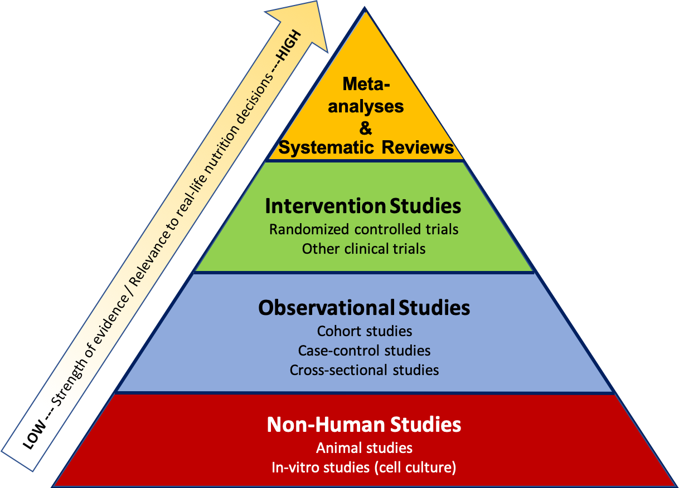
Types of studies

Slide 15
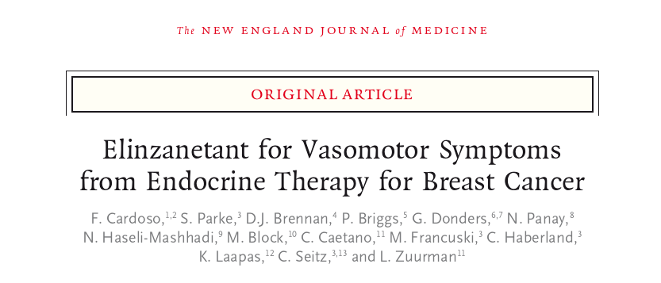

Slide 16

P: Population
474
Key Inclusion Criteria
•
Women aged 18-70 years.
•
Receiving endocrine therapy (tamoxifen or aromatase inhibitor) for HR+ breast cancer.
Total Women Randomized
•
Experiencing moderate-to-severe VMS (≥35 episodes per week).
~11.5
Baseline Characteristics
Mean age was ~51 years. Groups were well-balanced for demographics and endocrine therapy type (55% Tamoxifen, 45% AI).
Mean Daily VMS at Baseline

Slide 17
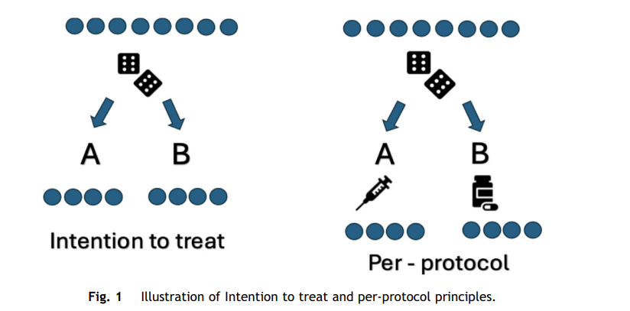

I, C, T: Study Design
Intervention (I)
Elinzanetant 120 mg, taken once daily (N=316).
Comparison (C)
Identical-appearing placebo, taken once daily (N=158).
Time (T)
This was a 52-week trial. The primary efficacy endpoints were measured during the 12-week placebo-controlled period.

Slide 18
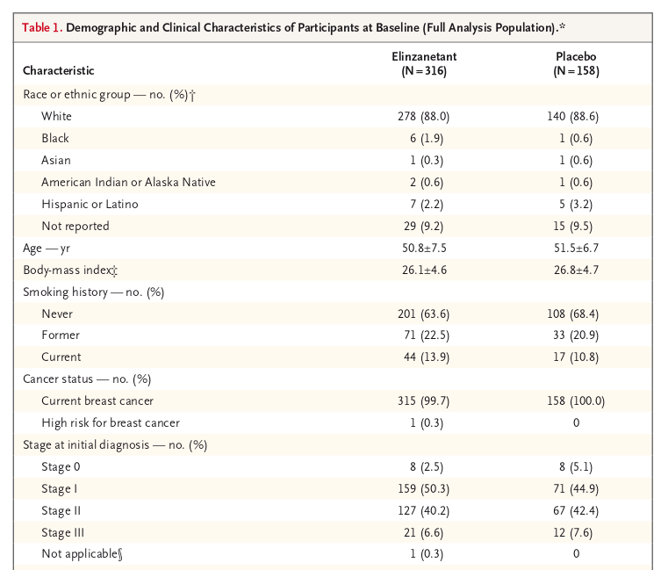

Slide 19
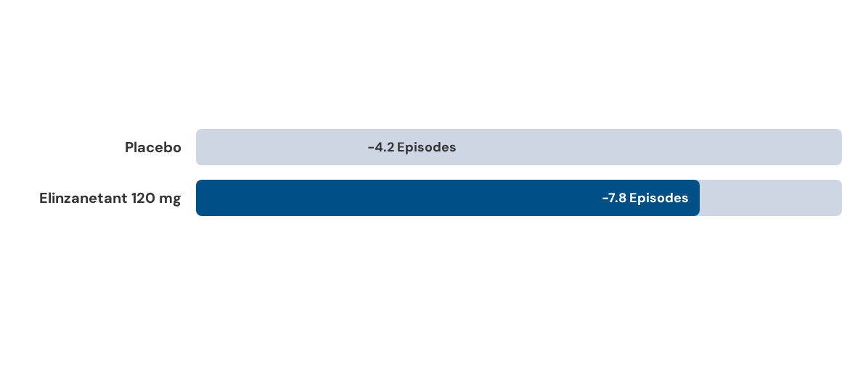
O: Primary Outcome (VMS Frequency)
Mean change in daily moderate-to-severe VMS frequency from baseline to Week 12.
Least-Squares Mean Difference: -3.4 episodes (p < 0.001). The benefit was seen early (at Week 4: -6.5 vs -3.0 episodes).

Slide 20
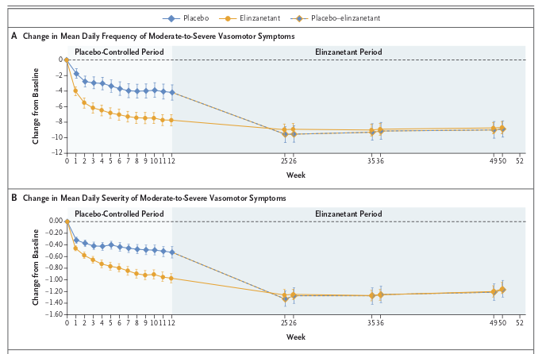

Slide 21


O: Safety Outcomes (Weeks 1-12)
Any Adverse Event (AE): Rates were similar. (69.8% Elinzanetant vs. 62.0% Placebo).
Serious AEs: Low in both groups (2.5% Elinzanetant vs. 0.6% Placebo).
Most Common AEs: Headache, fatigue, and somnolence were reported more frequently with elinzanetant.
Liver Safety: No substantive hepatotoxicity signal was identified by the liver safety monitoring board.

Slide 22
Conclusion
Elinzanetant led to a significantly lower frequency of vasomotor symptoms associated with endocrine therapy than placebo.
"
"
Cardoso F, et al. N Engl J Med 2025.

Slide 23

Can I use this medication for my patient?

Slide 24

Break
5 minutes

Slide 25

Use of Statistics in Diagnosis

Slide 26

“Excessively hungry, thirsty, and urinating a lot”
Habits
Snacks on chips
Soda (not diet)
No exercise
No smoking
Drinks beer
Age: 26
Gender: Female
Allergies: None
Medications: None
HR: 80 (60-100)
BP: 122/78
(100-140/70-90)
BMI: 35 (18-25)
Exam: unremarkable

Slide 27

FAMILY HISTORY
Diabetes
Obesity
Hypertension
Diabetes
Stroke Diabetes
Stroke
Diabetes
CAD
Diabetes

Slide 28
RESULTS
 | NORMAL RANGE | PATIENT’S VALUE
Hemoblobin A1C | Less than 6.5% | 9%
How can we be sure that she has diabetes?
Is this test accurate?
How accurate is this test?

Slide 29
What are the possibilities?
Disease
True Positive | False Positive
False Negative | True Negative
Test

Slide 30
Definitions
 |  | Condition
 |  | + | -
Test | + | TP | FP
 | - | FN | TN
Sensitivity
Mathematically:
TP / (TP + FN)
Conceptually: If the _______ is ________,
What is the chance that the _______ will be ______ ?
patient
positive
test
positive

Slide 31
Definitions
 |  | Condition
 |  | + | -
Test | + | TP | FP
 | - | FN | TN
Specificity
Mathematically:
TN / (TN + FP)
Conceptually: If the _______ is ________,
What is the chance that the _______ will be ______ ?
patient
negative
test
negative

Slide 32
Definitions
 |  | Condition
 |  | + | -
Test | + | TP | FP
 | - | FN | TN
Positive predictive value/
PPV
Mathematically:
TP / (TP + FP)
Conceptually: If the _______ is ________,
What is the chance that the _______ will be ______ ?
test
positive
patient
positive

Slide 33
Definitions
 |  | Condition
 |  | + | -
Test | + | TP | FP
 | - | FN | TN
Negative predictive value/
NPV
Mathematically:
TN / (TN + FN)
Conceptually: If the _______ is ________,
What is the chance that the ______ will be _______ ?
test
negative
patient
negative

Slide 34
When she walked in to your office… What were the probability that she has diabetes? = Pre-test probability After you performed the test and the test was positive… What are the probability that she has diabetes? = Post-test probability
Prevalence
Positive Predictive Value

Slide 35
Prevalence
Diabetes
9.4%

Slide 36
When she walked in to your office… What were the probability that she has diabetes? = Pre-test probability = Prevalence = 9.4% After you performed the test and the test was positive… What are the probability that she has diabetes? = Post-test probability = ?
 |  | Condition
 |  | + | -
Test | + | TP | FP
 | - | FN | TN

Slide 37
Let’s review

Slide 38

Thank you
Sneha.Shrivastava@stonybrookmedicine.edu

