Slide 1
CSE 357, Fall 2024
Statistical Methods for Data Science
Lecture 1: Intro and Logistics
Instructor: Anshul Gandhi
Department of Computer Science

Slide 2
CSE 357, Fall 2024
Statistical Methods for Data Science
What is Data Science?
Analysis of data (using several tools/techniques)
Statistics/Data Analysis + CS

Slide 3
CSE 357, Fall 2024
Statistical Methods for Data Science
Who is a Data Scientist
Statistics/Data Analysis + CS
Someone who is better at stats than the average CS person
and
someone who is better at CS than an average statistician.

Slide 4
Contact Info:
Anshul Gandhi
347, New CS building
anshul@cs.stonybrook.edu
anshul.gandhi@stonybrook.edu (Brightspace, SOLAR)
PLEASE USE PIAZZA FOR ALL COMMUNICATIONS

Slide 5
Outline
Logistics
  Course info
  Lectures
  Office Hours
  Course webpage + resources
Grading
Syllabus
  Tentative schedule

Slide 6
Course Info
  Probability theory
    Probability review (basics, conditional prob, Bayes’ theorem)
    Random variables (mean, variance, Geometric, Normal)
  Statistical inference
    Non-parametric inference (empirical distribution, sample mean, bias, confidence intervals)
    Parametric inference (method of moments, max. likelihood)
    Hypothesis testing (truth table, various tests, p-values)
    Bayesian inference (Bayesian reasoning, conjugate priors)
  DS techniques
    Regression analysis (linear regression, residuals)

Slide 7
Course Info
Prerequisites:
  Probability and Statistics
    Will greatly help!
  Basic CS + programming background
    We will exclusively use Python (no exceptions)
This is NOT a systems course
More of a theory + algorithms course

Slide 8


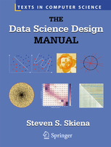

Course Info
Recommended texts:
Software:
  Available from DoIT

Slide 9
Example 1: Simple stats
X is a collection of 99 integers (positive and negative)
Mean(X) > 0
How many elements of X are > 0?
Same question but now Median(X) > 0?

Slide 10
Lectures
Tu Th: 12:30pm – 1:50pm
Javits 101
  Live slides + annotations (+ maybe prepared slides)
    Slides on class website (more on this later today)
    No recordings
  5-min break at the halfway point
  Occasionally some programming (Python)
    Code/scripts will be posted on class website

Slide 11
Lectures
  Interactive (please): useful checkpoints, questions
  Plan to take down notes somewhere (book, tablet)
  Attendance is not mandatory but strongly encouraged
    Will provide several hints in class for exam Qs
  Possible guest lectures: (i) Python, (ii) Stats in medicine.
  May have cancellations due to weather or unavailability
    Will be emailed and updated on website/piazza

Slide 12
Lectures
  All off-class communication (changes in deadlines, class cancelations, etc.) will be via piazza
  Please sign-up and change communication mode to real-time
  Post your lecture doubts or assignment clarifications on piazza, and instructor or TAs will respond

Slide 13
Office hours
Tu Th 2-3pm
NCS 347 (in-person)
TA and TA OH: TBD
1-hour TA OH every week, for assignment help
  Piazza for assignment queries (do not give away answers)

Slide 14
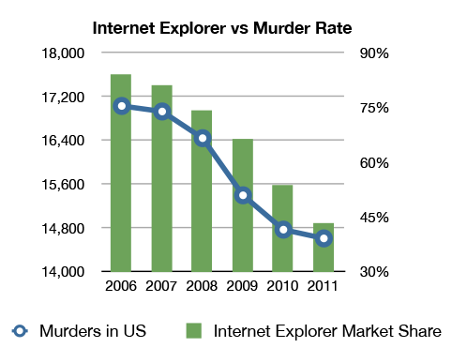
Example 2: Correlation v/s Causation
Q1: Are A and B correlated?
A
B

Slide 15
Example 2: Correlation v/s Causation
Q2: Which of the following is true
(i) A causes B
(ii) B causes A
(iii) Either (i) or (ii)
(iv) None of the above
A
B

Slide 16
Example 2: Correlation v/s Causation
Q2: Which of the following is true
(i) A causes B
(ii) B causes A
(iii) Either (i) or (ii)
(iv) None of the above
A
B

Slide 17
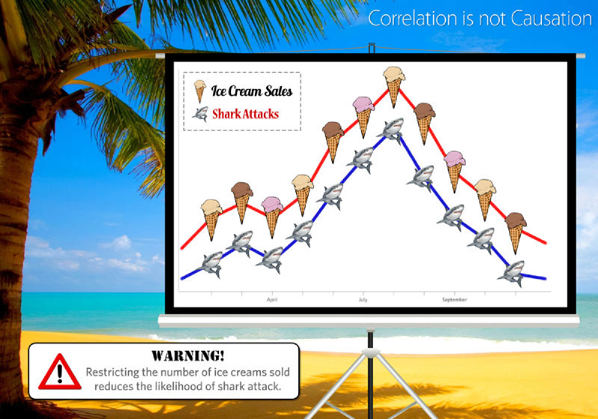
Example 2: Correlation v/s Causation

Slide 18
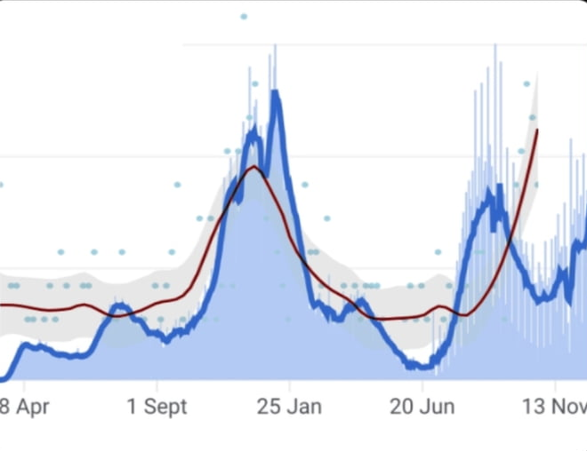
Example 3: Correlation v/s Causation
BLUE: # daily covid cases in US
RED: amazon reviews claiming no scent for Yankee candles
2021

Slide 19
Course webpage
www.cs.stonybrook.edu/~cse357 (will redirect)
Please bookmark this page
This is your best resource!
Will be regularly updated
  Lecture slides
  Assignment and exam dates
  Assignment data files
  Readings
  Python scripts

Slide 20
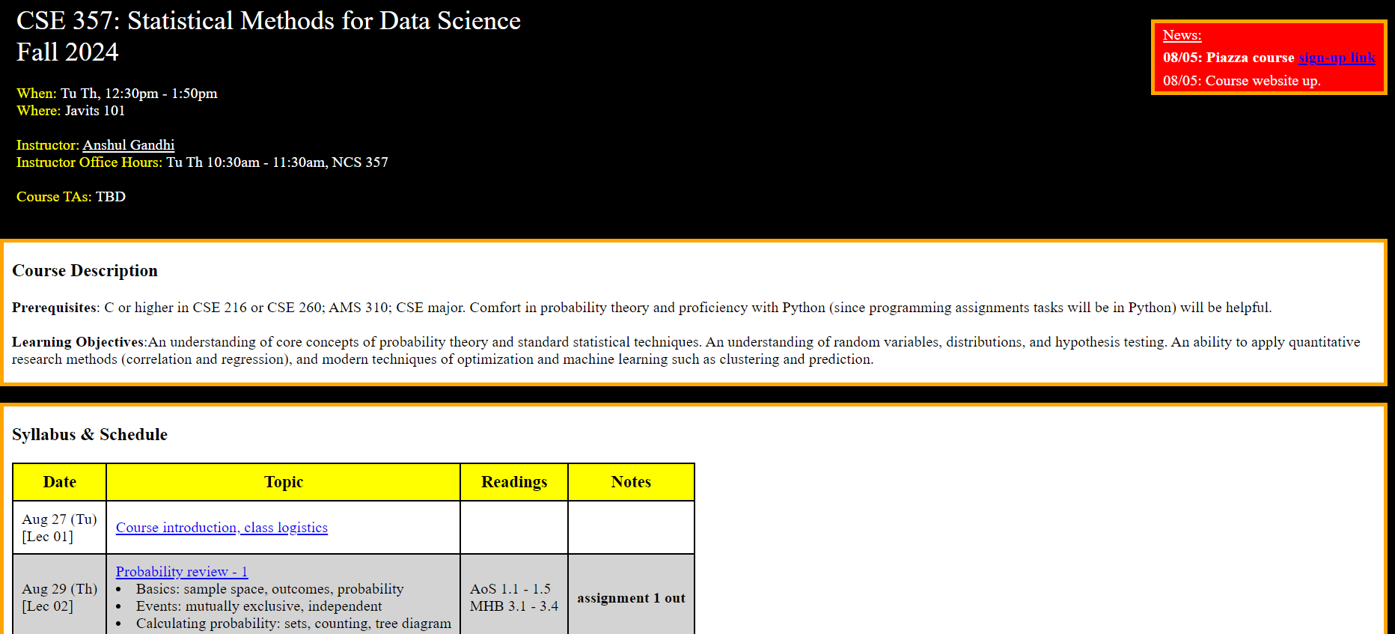
Course webpage

Slide 21
Other resources
Piazza (link on website)
  Primary mode of communication, please sign up!
  Helpful for posting lecture or assignment doubts
  Instructor + TA will respond in a timely manner
  Do NOT wait till the last moment
  Announcements, abundance of caution, etc.
Brightspace for assignments, solutions, and grades
  Assignment submission also via Brightspace
  Upload all files (pdf, graphs, code) as an archive file (zip, tar)

Slide 22
Example 3: Inspection Paradox
Students at BSU complain about large class sizes. In an unbiased sample poll of students, the average reported class size was far beyond 100. However, BSU admin swears that the average class size is less than 50. Who is lying?
10 students
10 students
CSE 999, 180 students
10 students
10 students
Avg class size = (180 + 10 + 10 + 10 + 10)/5 = 220/5 = 44 < 50
Reported average = (180*180 + 4*10*10)/220 = 149 > 100

Slide 23
Grading
40% assignments (submit online)
60% exams (2 in-class, mid-terms)
0% attendance
Grading is on a curve

Slide 24
Grading - assignments
40% assignments
  6 assignments (roughly once every 1.5 weeks)
    5-6 problems per assignment
    Later assignments will have more programming
    Questions will be based on lectures, but tougher on purpose
  Collaboration is allowed (groups of at most 4 students)
    One write-up/upload per group
    Only use techniques taught in class
    Discuss ONLY among group members
    Form groups yourself, use piazza if needed
    If a group member is inactive, let me know asap!
    Group members can change (please check with me first)

Slide 25
Grading - assignments
40% assignments
  Submit all files (scanned pdf, py files, graphs) as one archive
  Solutions can be types of hand-written (legible)
  Only one group member needs to submit, mention all names
  On Brightspace
  Assignments due at 11:59pm on due date
    Due date posted on class website and in assignment pdf
  Example: A1 due on Sept 9th
    Brightspace will mark submissions after 11:59pm on Sept 9th as LATE, will not be graded if late
    Upload ahead of time, updates till 11:59pm allowed
    NO LATE SUBMISSIONS, NO EXCEPTIONS

Slide 26
Grading - exams
60% exams
  Mid-terms 1 and 2
    25% mid-term 1 (probs&stats, basics of inference), early October
    35% mid-term 2 (inference, techniques), early December
    Non-overlapping
  In-class exams (~70mins)
    Easier than assignments, on-par with in-lecture questions
    Entirely based on material covered in class
    Closed-notes, closed-book (index card allowed)
    No programming questions
    No collaborations, obviously
    Will release practice mid-term exam a week prior

Slide 27
Grading – attendance
0%
  Attending class will be beneficial!
    Exam questions centered around lecture material
    Useful hints/questions posed in lectures
    Practice questions in class will aid self-evaluation
    Lectures not recorded to encourage attendance, though slides will be posted on website by end-of-day

Slide 28
Grading recap
40% assignments (6 assignments)
60% exams (two exams)
0% class participation
Grading is on a curve

Slide 29
Schedule
Probability Theory (6-7 lectures, 2 assignments)
  Probability review (events, computing probability, conditional prob., Bayes’ thm.)
  Random variables (Geometric, Exponential, Normal, expectation, moments, etc.)
  Probability inequalities (Markov’s, Chebyshev’s, Central Limit thm., etc.)
MID-TERM 1 (Early October)
Statistical Inference (12-14 lectures , 3 assignments)
  Non-parametric inference (empirical PDF, bias, kernel density, plug-in estimator)
  Confidence intervals (percentiles, Normal-based CIs)
  Parametric inference (method of moments, max likelihood estimator)
  Hypothesis testing (Wald’s test, t-test, KS test, p-values, permutation test)
  Bayesian inference (Bayesian reasoning, inference, etc.)
Data Science Models (2-3 lectures, 1 assignment)
  Regression (simple LR, multiple LR, residuals)
MID-TERM 2 (Early December)

Slide 30
Key Takeaways
Very useful course for data scientist or quantitative analyst positions or ML/DS researchers
Math-heavy course
Exams have high weightage

Slide 31
Syllabus
www.cs.stonybrook.edu/~cse357

Slide 32
Next class
Probability review - 1
  Basics: sample space, outcomes, probability
  Events: mutually exclusive, independent
  Calculating probability: sets, counting, tree diagram

Slide 33
Questions??

