Slide 1
Language Modeling Part II: Smoothing Techniques
Niranjan Balasubramanian
Slide Credits:
Chris Manning, Dan Jurafsky, Mausam

Slide 2
Recap
A language model is something that specifies the following two quantities, for all words in the vocabulary (of a language).
Pr(W) = ? or Pr(W | English) = ?
Pr(w_{k+1} | w₁, …, w_{k}) = ?
Markov Assumption
Direct estimation is not reliable. Don’t have data.
Estimate sequence probability using its parts.
Probability of next word depends on a small # of previous words.
Maximum Likelihood Estimation
Estimate language models by counting and normalizing.
Turns out to be problematic as well.

Slide 3
Main Issues in Language modeling
New words
Rare Events

Slide 4
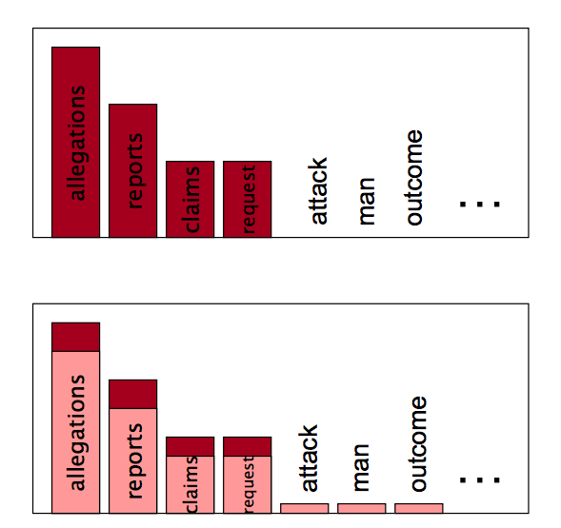
Discounting
Pr(w | denied, the)
MLE
Discounting

Slide 5
Add One / Laplace Smoothing
Assume that there were some additional documents in the corpus, where every possible sequence of words was seen exactly once.
Every bigram sequence was seen one more time.
For bigrams, this means that every possible bi-gram was seen at least once.
Zero probabilities go away.

Slide 6
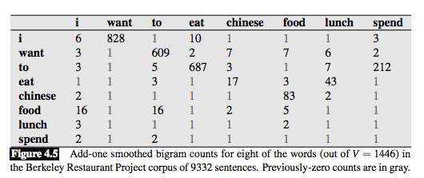
Add One Smoothing
Figures from JM

Slide 7
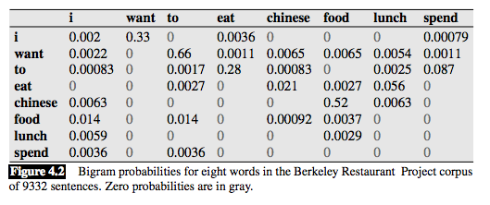
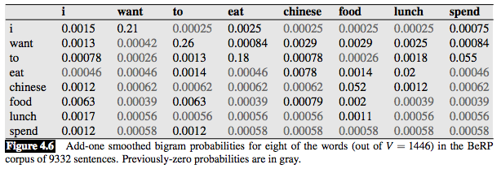
Add One Smoothing
Figures from JM

Slide 8
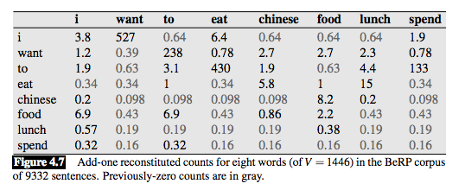
Add One Smoothing
Figures from JM

Slide 9
Add-k smoothing
Adding partial counts could mitigate the huge discounting with Add-1.
How to choose a good k?
Use training/held out data.
While Add-k is better, it still has issues.
Too much mass is stolen from observed counts.
Higher variance.

Slide 10
Good-Turing Discounting
Chance of a seeing a new (unseen) bigram
= Chance of seeing a bigram that has occurred only once (singleton)
Chance of seeing a singleton
= #singletons / # of bigrams
Probabilistic world falls a little ill.
We just gave some non-zero probability to new bigrams.
Need to steal some probability from the seen singletons.
Recursively discount probabilities of higher frequency bins.
Pr_{GT}(w_{i}¹) = (2 . N₂ / N₁) / N
Pr_{GT}(w_{i}²) = (3 . N₃ / N₂) / N
…
Pr_{GT}(w_{i}^{max}) = ((max+1) . N_{max+1} / N_{max}) / N [Hmm. What is N_{max+1}]
Exercise: Can you prove that this forms a valid probability distribution?

Slide 11
Interpolation
Interpolate estimates from various contexts.
Requires a way to combine the estimates.
Use training/dev set.

Slide 12
Back-off
Conditioning on longer context is useful if counts are not sparse.
When counts are sparse, back-off to smaller contexts.
If trigram counts are sparse, use bigram probabilities instead.
If bigram counts are sparse, use unigram probabilities instead.
Use discounting to estimate unigram probabilities.

Slide 13
Discounting in Backoff – Katz Discounting

Slide 14
Kneser-Ney Smoothing

Slide 15
Interpolated Kneser-Ney

Slide 16
Large Scale n-gram models: Estimating on the Web

Slide 17
But, what works in practice?

