Slide 1
Information Retrieval
Niranjan Balasubramanian

Slide 2
Outline
Task Definition
Evaluation
A Typical IR System
Retrieval Models
  Vector Space Models
  Probabilistic Language Models
  LSA and LDA
Web Search and Learning to Rank
  Features
  Learning to Rank Algorithms
    Classification
    Pairwise ranking
    Query Modeling

Slide 3
Information Retrieval
An umbrella term that covers many text retrieval tasks:
Document retrieval
Passage retrieval
Sentence retrieval
XML fragment retrieval
QA retrieval
Tweet retrieval
…

Slide 4

Task Definition
Input:
A piece of text representing user information need.
Typically, a set of keywords user expects to see in a relevant document.
Output:
A (ranked) list of documents that should satisfy the user information need.

Slide 5
Evaluation: What is a good ranking?
What is a good list of documents?
One which ranks relevant documents above non-relevant documents.
A
B
D₁
D₁
D₂
D₄
B better than A
D₃
D₂
D₄
D₃

Slide 6
Evaluation: Relevance
What is a relevant document?
The notion of relevance is:
subjective – You and I might disagree.
task-dependent – You may disagree with yourself.
time-dependent – Collection may get updated.
In practice, most empirical IR research hand-waves:
let’s aggregate ratings from multiple users
and hope for the best!

Slide 7
Evaluation: Ranking Measures
What is a good ranking measure?
Favors relevant documents above non-relevant documents.
Average Precision
Average of precisions at ranks where relevant docs are found.
A
B
C
D₁
(1/1) . 1 = 1.0
(1/2) . 0 = 0.0
(1/3) . 0 = 0.0
(2/4) . 1 = 0.5
AP = 0.75
D₁
(1/1) . 1 = 1.0
(2/2) . 1 = 1.0
(2/3) . 0 = 0.0
(2/4) . 1 = 0.0
AP = 1.0
D₄
D₂
D₄
D₁
D₃
D₂
D₃
D₄
D₃
D₂

Slide 8
Evaluation: Pooling
How can we compare different retrieval systems?
Collect a set of queries.
Run the queries through all systems.
Pool the top K results from the systems
Get humans to annotate the top K pool.
Compare systems using mean of average precision (MAP).

Slide 9
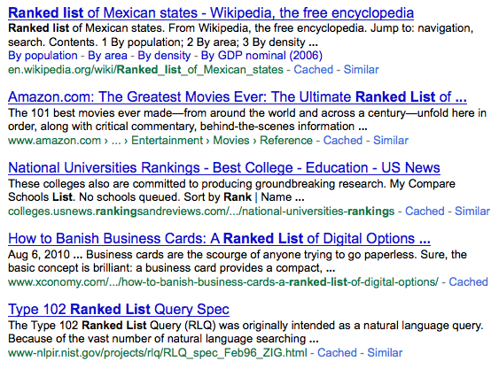
A typical IR System
Final
Results
Query
IR System
Query
Model
Scoring
Function
Results Set
Q*
M*
R*
Index
Collection

Slide 10
Outline
Task Definition
Evaluation
A Typical IR System
Retrieval Models
  Vector Space Models
  Probabilistic Language Models
  LSA and LDA
Web Search and Learning to Rank
  Features
  Learning to Rank Algorithms
    Pairwise ranking
  Query Modeling

Slide 11
Retrieval Models
A typical retrieval model includes:
Representation for queries and documents.
Scoring function that takes in a query Q and a document D and returns a score that reflects how relevant D is to Q.

Slide 12
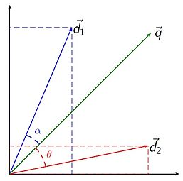
Vector Space Model:
Representation:
Documents and queries are represented as vectors in some space.
-- What are the dimensions?
-- How to map documents and queries to this space?
Scoring Function:
Rank documents by a measure of “closeness” of query and document vectors
  -- Distance, Cosine of the angle etc.
Image from: http://en.wikipedia.org/wiki/Vector_space_model

Slide 13
Vector Space Model: TF-IDF Model
Dimensions: Every word becomes a dimension.
Term Frequency:
A term that occurs many times in a document is important.
Inverse Document Frequency:
A term that occurs in many documents is unimportant.
TF-IDF:
Term-frequency weighted by inverse document frequency.
D = <x₁, x₂,…, x_{|V|}>

Slide 14
Vector Space Model:
A simple retrieval system
Term-at-a-time algorithm:
Input: Q = {q₁, q₂, … , q_{|Q|}} a query.
Initialize score[1..N] = 0 // An array holding scores for each doc.
For each query term q in Q:
Find D_{q} the subset that contains q.
For each D in D_{q}:
score[D] = score[D] + tf-idf(q, D) . tf-idf(q, Q)
For each D:
score[D] = score[D] / L2-norm(D)
return top-k scores
Many variants exist for tf-idf
Different choices made for D vs. Q

Slide 15
Vector Space Models: Enhancements
Efficient scoring
  Inverted indices – compression, skip lists, etc.
  Top-k documents without scoring all documents entirely.
Scoring methods
  Document length normalizations (e.g., pivoted)
  BM25 and various other heuristics
Dimensionality reduction
    Stemming, phrase representations etc.
  LSI

Slide 16
Outline
Task Definition
Evaluation
A Typical IR System
Retrieval Models
  Vector Space Models
  Probabilistic Language Models
  LSA and LDA
Web Search and Learning to Rank
  Features
  Learning to Rank Algorithms
    Pairwise ranking
  Query Modeling

Slide 17
Probabilistic Retrieval Models
Goal:
Obtain probabilistic formulations of the retrieval problem.
Approaches: Two prominent ones are:
Binary Independence Model [Robertson et al., 1976]
Language Models [Ponte and Croft, 1999]

Slide 18
Probabilistic Retrieval Models:
Language Modeling
Generative Assumption
P(w₁|θ_{D})
P(w₂|θ_{D})
…
P(w_{|V|}|θ_{D})
Assume that each document is generated by a probabilistic process specified by a multinomial distribution.
Document model
parameterized by θ
Query-likelihood Model
If a document D is relevant to a query, then the query should be a high probability sample from the document multinomial.

Slide 19
Probabilistic Retrieval Models:
Query-likelihood Model
Rank by the probability that the document model generated the query.
Query
model
Document
model

Slide 20
Probabilistic Retrieval Models:
Estimation
Estimate document model via maximum-likelihood
-- Assume document is a sample of the underlying distribution.
Zero probability issue!

Slide 21
Probabilistic Retrieval Models:
Smoothing
With a mixture model [Jelinek-Mercer Smoothing]
With a Dirichlet prior [Dirichlet Smoothing]
Posterior becomes:
m and λ estimated to maximize
retrieval performance on training.

Slide 22
Probabilistic Retrieval Models:
Enhancements
Independence Assumptions
  Markov-random Field Models to help with feature dependence.
  [Metzler and Croft, 2006]
Estimation
  Bigram models
  Smoothing techniques
Query models – Not all terms in a query are important
  Relevance Models
Document models
  Topic modeling to improve document representation.

Slide 23
Outline
Task Definition
Evaluation
A Typical IR System
Retrieval Models
  Vector Space Models
  Probabilistic Language Models
  LSA and LDA
Web Search and Learning to Rank
  Features
  Learning to Rank Algorithms
    Pairwise ranking
  Query Modeling

Slide 24
Document Representations
Idea: Words are surface realizations of (hidden) concepts
  Documents about “canine” and “dogs” are both on the same topic
Discover hidden concepts via corpus analysis
  Latent Semantic Analysis [Dumais et. al., CHI ‘88]
  Probabilistic Latent Semantic Analysis [Hoffman, SIGIR ‘99]
  Latent Dirichlet Allocation and extensions [Blei et al, ‘03]
  Deep-learned low-dimensional representations [Huang et al., CIKM 13]
Similarity is a measure of “closeness” in the latent space.

Slide 25
Latent Semantic Analysis
Premise
Using one-dimension per word is problematic.
Doesn’t scale.
(millions of words in large collections)
Doesn’t handle synonymy
(dog vs. canine)
Idea
Project documents and queries into a lower-dimensional space.
Instead of a |V| dimensional vector each word will be represented by a
k << |V| dimensional vector.

Slide 26
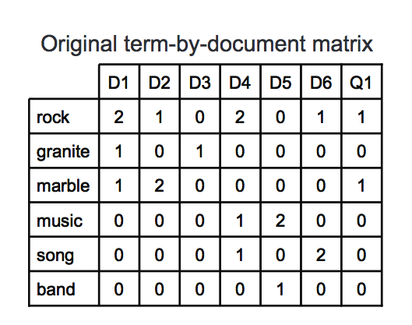
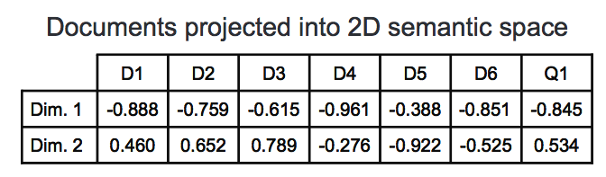
Latent Semantic Analysis
1) Represent co-occurrences as a term-document TD matrix (X).
2) Use singular-value decomposition to factorize TD.
3) Sigma is a diagonal matrix. Take the top k singular values.
4) Project query and documents using the top-k singular values.
5) Cosine similarity to score documents.
Figures stolen from: http://www.cs.cmu.edu/~nasmith/LS2/gimpel.06.pdf

Slide 27
Latent Semantic Analysis
Benefits
  Addresses synonymy
  Dimensionality reduction
Issues
  Efficient SVD implementations necessary.
    Many implementations available.
  New documents need to be handled in a special way.
  Disconnect w/ retrieval performance.
Extensions
  Probabilistic Latent Semantic Analysis (pre-cursor to LDA).
  Hierarchical (H-PLSA)

Slide 28
Topic Model
Premise
Probabilistic models that estimate word probabilities using MLE
suffer the same issues as the vector space model.
Idea
Formulate document models as a mixture model of topics.

Slide 29
Topic Models using LDA: A recap
T₁
T₂
T_{k}
Car
Ferrari
Wheels
…
election
vote
senate
…
nasdaq
rate
stocks
…
…
P(w₁|T₁)
P(w₂|T₁)
…
P(w_{|V|}|T₁)
P(w₁|T₂)
P(w₂|T₂)
…
P(w_{|V|}|T₂)
P(w₁|T_{k})
P(w₂|T_{k})
…
P(w_{|V|}|T_{k})
Documents
LDA
…
- - - - - - - - - - - - - - - - - -
- - - - - - - - - - - - - - - - - -
P(T₁|D₁)
P(T₂|D₁)
…
P(T_{k}|D₁)
D₁
Topics are distributions over words.
Documents are distributions over topics.
- - - - - - - - -
- - - - - - - - - - - - - - - - - -
- - - - - - - - -
P(T₁|D₂)
P(T₂|D₂)
…
P(T_{k}|D_{k})
D₂
…

Slide 30
Topic Models
Topic-based Retrieval Models [Yi and Allan, ECIR ’09]
Smoothed document model
Can also be used to smooth query model

Slide 31
Does it work?
[Yi and Allan, ECIR ’09]
Method | Mean Avg. precision
Query-likelihood | 0.2614
Topic-smoothed Document models | 0.2787
Relevance Query Model | 0.3006
Topic-based Query Model | 0.2947
Mixed results:
In general, it is hard to figure out what the granularity of the topics should be.

Slide 32
Outline
Task Definition
Evaluation
A Typical IR System
Retrieval Models
  Vector Space Models
  Probabilistic Language Models
  LSA and LDA
Web Search and Learning to Rank
  Features
  Learning to Rank Algorithms
    Pairwise ranking
  Query Modeling

Slide 33
Web Search and Learning to Rank
Web documents have many useful bits of information.
User interaction.
Structure discourse.
Hyperlink structure.
Machine learning to combine features.
ListNet, Gradient Boosted Decision Trees, Deep Learning
Search engines designed for scale.
Indexing and feature extraction are expensive.

Slide 34
Web Search Feature functions
Query words occur very frequently
-- matches synonyms
-- contains words related to the query words
Contain query words in close proximity
-- Phrases, concepts etc.
Contains query words in important sections
-- title
-- section heading
Is not a bogus document
-- Neither small nor too big
-- Not spam
Is an authority on the topic
-- many good websites point to it
-- users love for certain documents
Term Frequency TF
Co-occurrence Frequency
TF in selected fields
Spam/Ham score
Page Rank
Click features etc.
Several aspects of a document can determine relevance
Web search engines for use hundreds of features.

Slide 35
Learning to Rank: A Simple Formulation
Goal of “learning to rank” is to learn a function that assigns a score to (Q, D) pairs.
-- Relevant docs score higher than non-relevant docs.
A linear ranking function is simply a weighted sum of various feature functions.
Feature functions are defined over (Q,D) pairs.
Learning becomes the tasks of finding the weight vector w that provides the best retrieval performance.
Notes:
H

Slide 36
Logistic Regression: A Quick Recap
Represent items to be classified as a n-dimensional feature vector.
The classifier is the logistic function applied to a linear combination of X parameterized by W.
where,
We use the following rule to classify a new instance X:

Slide 37
Adapting Logistic Regression for Ranking
Changes
Feature vectors X are defined over (Q, D) pairs.
(Q,D) is assigned label 1 if D is relevant to Q, otherwise 0.
Train logistic regression to minimize labeling errors.
  Find W that minimizes errors on training data.
We set h to be the ranking function f(Q,D) to rank (Q, D) pairs.
  Document with higher h values are predicted to be more relevant.

Slide 38
Learning to Rank Using Logistic Regression: Training
Step 1:
Construct feature vectors from training data.
Query | Doc Id | Average Log Term Freq | TFIDF(Q,D) | Log-QL(Q,D) | Label
race car | 1 | 0.32 | 0.34 | -2.34 | 1
race car | 2 | 1 | 0.2 | -4.4 | 0
…
Boston | 1 | 0.1 | 0.1 | -5.6 | 0
Boston | 2 | 0.5 | 0.36 | -2.0 | 1
Step 2:
Use Logistic Regression to learn the w that provides the best classification accuracy.

Slide 39
Ranking Using Logistic Regression
Step 3:
For each document in the collection, construct the feature vector w.r.t the test query.
Query | Doc Id | Average Log Term Freq | TFIDF(Q,D) | Log-QL(Q,D)
bounty | 2 | 4 | 0.4 | -2.1
bounty | 3 | 3 | 0.2 | -3.3
bounty | 1 | 1 | 0.1 | -4.3
f(Q,D)
0.72
0.65
0.54
Step 4:
Score each instance (document) via the logistic regression classifier with weights w.

Slide 40
Learning to Rank: Types of Formulations
Point-wise
Classify each document as relevant or non-relevant.
Adjust w to reduce classification errors (Nallapati, 2004)
Pairwise ranking
Classify pairs of documents – D1 > D2? (Joachims, 2002)
Adjust w to reduce discordant pairs.
List-wise ranking
Score permutations -- Is {D1,D2,…} > {D1’,D2’,…} ?
Adjust w to directly maximize ranking measure of interest.

Slide 41
Formulation Issues
Point-wise and Pairwise: Disconnect between evaluation metric and learning objectives.
1. Lower classification error does not necessarily improve IR measure
2. All point-wise/pairwise errors are treated the same.
-- swapping docs (1,100) vs. (99,100)
-- Errors in the top of the list must cost more
3. Learning is dominated by queries with more relevant docs.
Approaches that directly learn W that maximizes average precision rather than classification errors.
Examples
Direct Co-ordinate Ascent.
Structured SVM^{Map}
n₁
n₂
r₃
r₂
r₁
AP
0.48
AP
1.0
f2
w₂
r₁
w₁
r₃
r₂
w₁
n₁
n₂
r₁
r₂
r₃
n₂
n₁
w₂
f1

Slide 42
Learning to Rank: Key issues
No single feature, ranking function works the best on all queries.
-- Different queries benefit from different features.
-- Informational vs. navigational queries
-- Tail queries vs. head queries
-- Long queries vs. short queries
Query-dependent approaches
-- Learning to select ranking functions
(Balasubramanian and Allan, 2010)
-- Query-dependent loss functions (Bian et al, 2010)
-- Ensemble approaches (LambdaMART, Groves of GBDTs).

Slide 43
ML for building Query Models
Query modeling
Query model can be viewed as a function that assigns weights to terms in the query.
Term importance
Term’s feature value

Slide 44
ML for building Query Models
Query reduction
-- Some words can lead the ranking function astray
Q = {give information on steps to manage control or protect
g(Q) = {steps control protect squirrels}
Query weighting
-- Some words are more important than others
Q = {civil war battle reenactments}
g(Q) = {0.3 war, 0.2 battle, 0.1 civil, 0.4 reenactments}
Query expansion
-- Some additional words can help improve the query
Q = {elected, officials}
g(Q) = {elected, officials, state senators, representatives, house,…}

Slide 45
Query Reduction: Overview
[Kumaran and Carvalho, SIGIR 2009, Balasubramanian et al. SIGIR 2010]
Premise: Long queries often contain extraneous terms
  Reduced versions obtained by removing extraneous terms can help.
Challenges:
  How to select a reduced version?
    Look at the results retrieved by each reduced version
    Predict the quality of the results automatically.
  When to select a reduced version?
    For some queries the original query is the best.
  In settings like web search, the whole process must be efficient.

Slide 46
Query-reduction: Learning to select queries
Final
Results
Query
Q = {q1, q2, q3,…}
R¹
IR System
Q
R⁰
Query
Dependent
Selection
Q-q1
Ranking function
R¹
Q-q2
R²
Query
Representations
Results
Sets

Slide 47
Query-reduction: Learning to select queries
Final
Results
R¹
Query
IR System
R⁰
R⁰
0.05
f11 | f12 | … | f1n
R¹
Regression
R¹
0.75
Selection
f21 | f22 | … | f2n
R²
R²
0.20
f31 | f32 | … | f3n
Features
Results
Sets
Query Dependent Selection

Slide 48
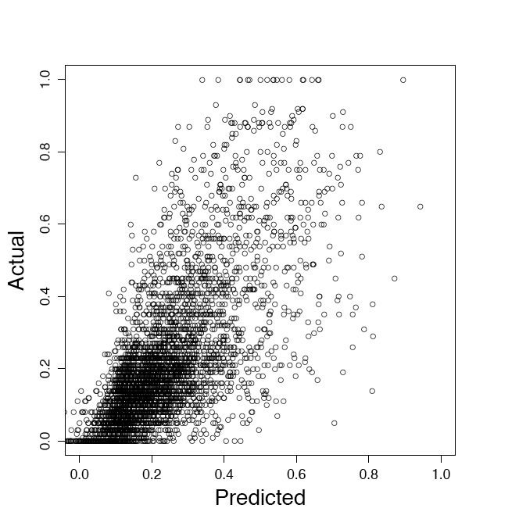
Query-reduction: Predicting Quality of Result Set
What features can indicate the quality of a result set?
Distribution of features used for ranking and the ranking scores themselves.
-- High ranker scores indicate good performance.
-- Large variance indicates bad performance.

Slide 49
Query-reduction: Learning Formulation
What learning formulation to use?
Model differences of reduced queries w.r.t to the original long query
-- Train a regression model that predicts for each reduced query, the difference in AP w.r.t to the original.
-- Select reduced version with highest positive difference
-- If no positive differences are predicted stick with original.

Slide 50
Query-reduction: Learning to select queries
Estimating differences in effectiveness is better.
Selection in general is a risky process: Helps some hurts some.
  Interleaving and thresholding mitigate selection risk.
An extension using a gated-learning solution [Sheldon et al,2010]
  Alternates between learning ranking function parameters and query-model parameters.

Slide 51
Other issues in Web Search
Combining multiple sources to build query models
  Reformulations, n-grams Wikipedia, click-logs.
Learning to produce diverse rankings and dynamic rankings
  What to do when user intent is unclear?
  Can we re-rank results based on user’s current behavior?
Incorporating IR advances in learning frameworks.
  How to perform relevance feedback ?
Adapt learning to specific types of queries
  Long queries, and Tail queries don’t have too many examples.
Creating evaluation data sets.
  To stay current, Web search engines periodically create data sets
  What queries to use ?
Ranking theory
  Convergence bounds, Generalization bounds etc.

Slide 52
Readings
Learning to Rank Algorithms
  RankSVM, AdaRank, ListNet
  Learning to Rank for Information Retrieval, A Tutorial in WWW 2009 by Tie-Yan Liu, Microsoft Research Asia.
  SIGIR 2009, 2008, 2007, Workshops on Learning to Rank.
ML for Query Modeling
  Bendersky et al., SIGIR ‘08, WSDM ’10, SIGIR ’11
  Balasubramanian et al., SIGIR ’10, Xue et al, CIKM 2010
Document Representations
  Dumais et al ‘88
  Hoffman, SIGIR ’99
  Blei et al, ‘03

