Slide 1
CSE 591: Energy-Efficient Computing Lecture 12 SLEEP: memory
Anshul Gandhi
347, CS building
anshul@cs.stonybrook.edu

Slide 2
commercial paper

Slide 3
Processor + memory architecture

Slide 4
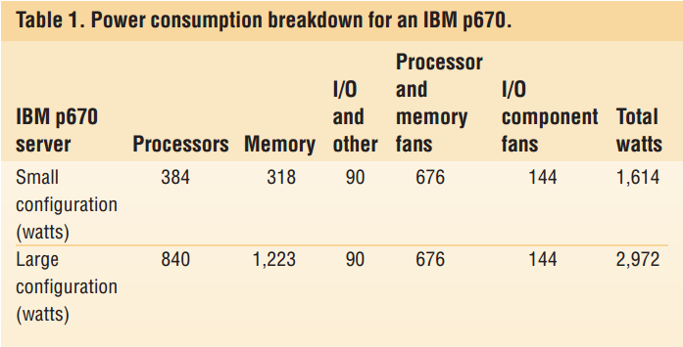
Power consumption breakdown
Notes:
1. What is missing here??
Disks not included – remote storage.
2. Authors claim idle and active power are similar – why? Servers are performance focused.

Slide 5
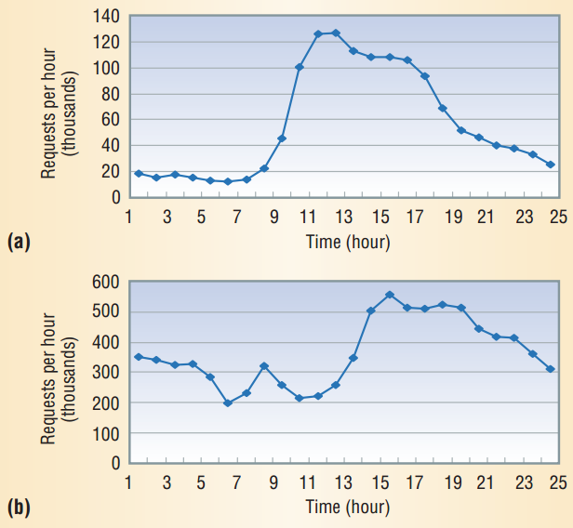
Transactional workloads
Notes:
Financial web site
98 Olympics web site

Slide 6
Multi-tier deployment
Notes:
Why multi-tier? Helps with performance and power.
Also, stateful + stateless = stateful!

Slide 7
Memory Power Management
Two low-power states: Self-refresh and power-down
Data placement (concentrate active data and new pages)
Memory address mapping (striping vs. single device)
Memory compression (can reduce memory capacity)

Slide 8
power_page paper

Slide 9
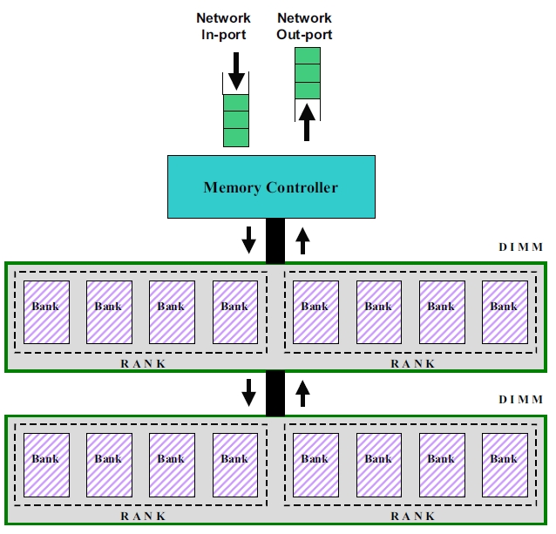
Memory Hierarchy
Notes:
<dimm,rank,bank>
Each controller owns some DIMMs.

Slide 10
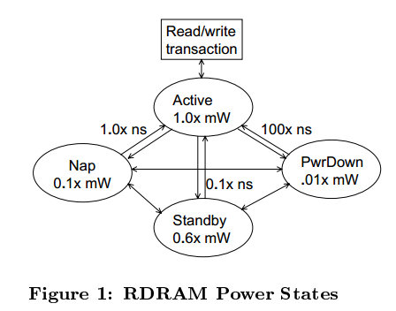
Power and latency

Slide 11
Static Policies
All chips active all the time (AlwaysOn)
All chips transition to a fixed low-power state when idle
standby
nap
powerdown
What is missing from these policies?
Notes:
twait

Slide 12
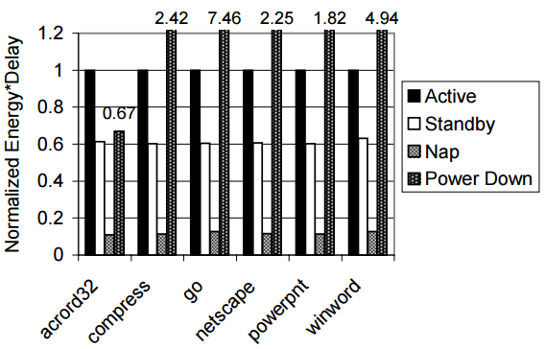
Static Policies: Evaluation: Random
Notes:
Acrord32 exception!

Slide 13
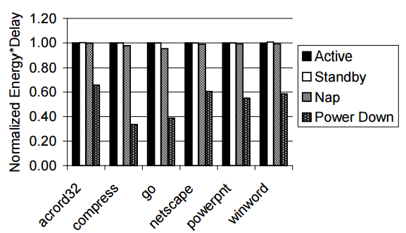
Static Policies: Evaluation: SFT
Notes:
Exception: powerdown

Slide 14
Dynamic Policies
Active when idle
Transition to next lower level if idle for threshold time
High threshold issues?
Low threshold issues?
Exploit locality of reference
Sequential first-touch
Notes:
Simple idea: keep some devices active, other idle, thus promoting sleep. Same as autoscale load unbalance and also MAID paper.

Slide 15
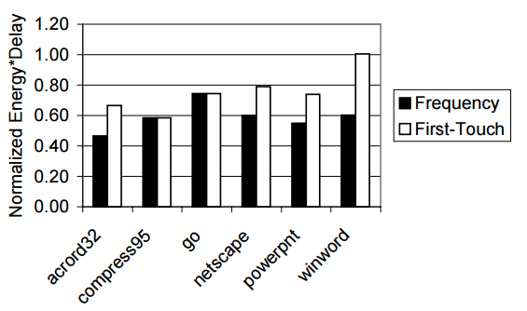
Dynamic Policies: SFT vs. Freq
Notes:
For a given set of thresholds

Slide 16
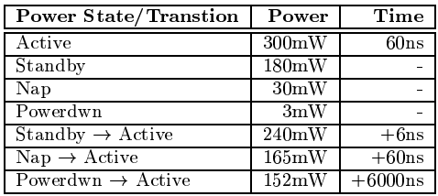
Power and latency

