Slide 1
CSE 591: Energy-Efficient Computing Lecture 10 SLEEP: network
Anshul Gandhi
347, CS building
anshul@cs.stonybrook.edu

Slide 2
PCs vs. servers
 | Servers (DC) | PCs
Number | 50 M | 1 B
Power/unit | 300W | 70W
Usage/day | 24 | 8
Annual cost | $9.2 B | $14.3 B
Notes:
Different from paper.

Slide 3
idle_net paper
Intel @ NSDI’09

Slide 4
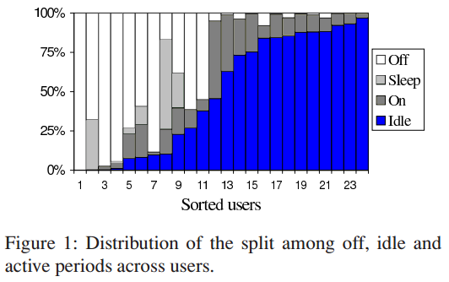
Idleness
Notes:
Note that PCs support sleep more readily than servers.
Note also that most users never use Sleep!

Slide 5
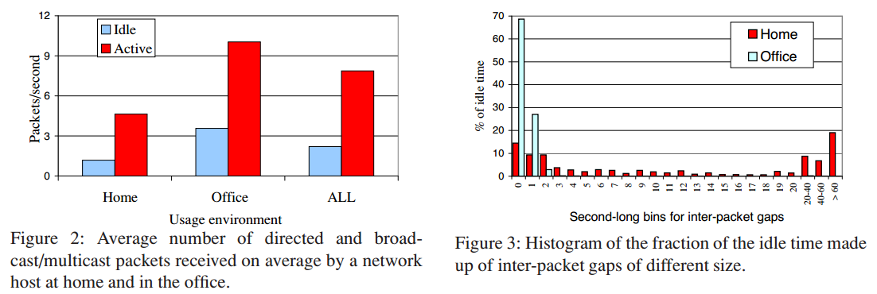
Idle time distribution
Notes:
Going to sleep + wakeup is at least 10 or more seconds. Thus, based on this data, can’t go to sleep. But note that this is all packets, not just important ones. Maybe some can be ignored.

Slide 6
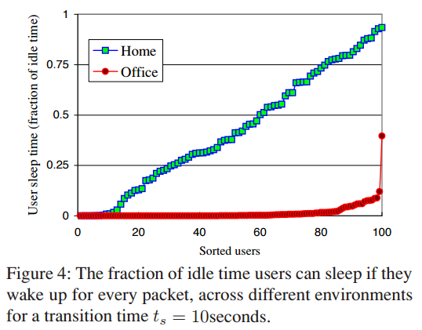
Potential for sleep
Notes:
Assumption: perfect predictions!

Slide 7
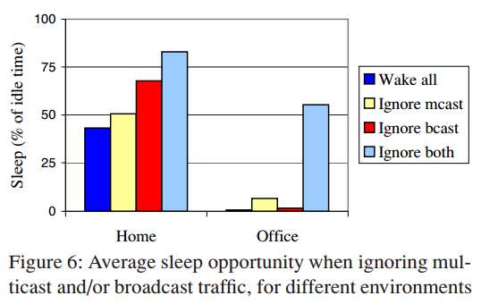
Sleep opportunity by proxying
Notes:
ARP can be handled by replying Yes/No to IP request.
Downloads? If embedded proc has some memory.

Slide 8
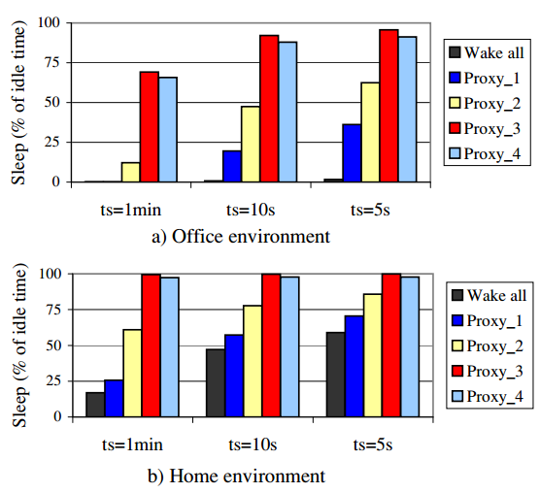
Proxy
Notes:
Assumes perfect future arrivals knowledge.

Slide 9
sleepless paper
Microsoft @ ATC’10

Slide 10
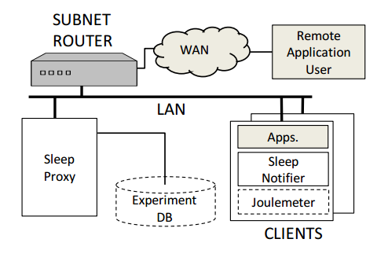
Architecture
Notes:
Difference: one proxy per subnet (as opposed to embedded proc for each PC).

Slide 11
somniloquy paper
Microsoft @ NSDI’09

Slide 12
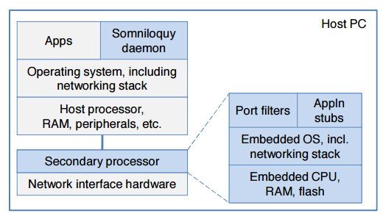
Architecture
Notes:
Embedded vs secondary proc.

Slide 13
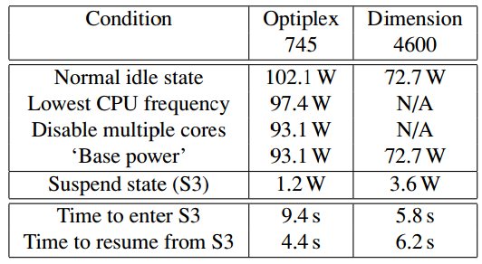
Desktop power/latency

Slide 14
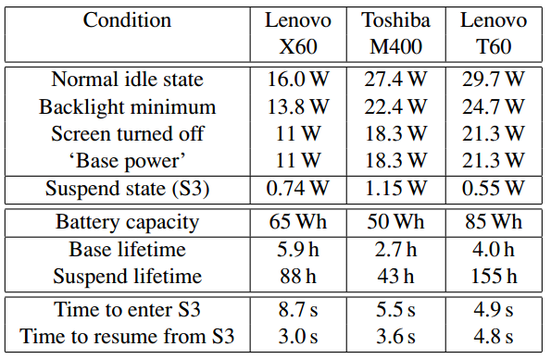
Laptop power/latency

Slide 15
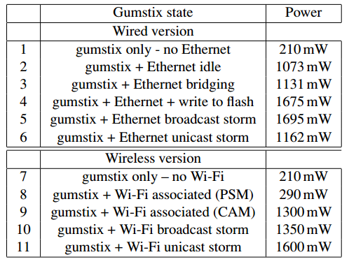
Somniloquy power/latency

Slide 16
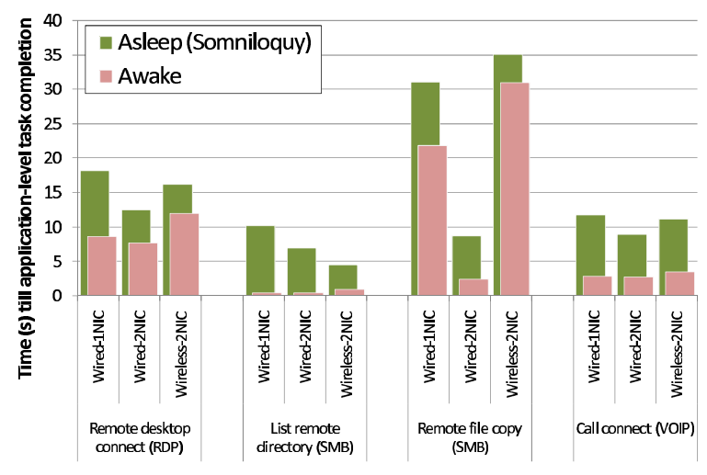
Delay
Notes:
These apps just required PC wakeup – no stubs.

Slide 17
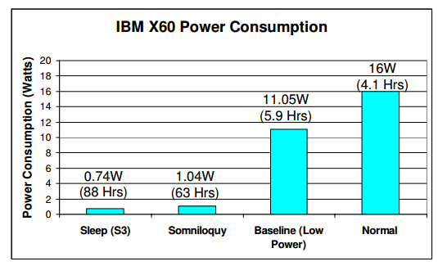
Energy savings
Notes:
These apps just required PC wakeup – no stubs.

