Slide 1
CSE 591: Energy-Efficient Computing Lecture 1: Intro and Logistics
Anshul Gandhi
347, New CS building
anshul@cs.stonybrook.edu
anshul.gandhi@stonybrook.edu

Slide 2
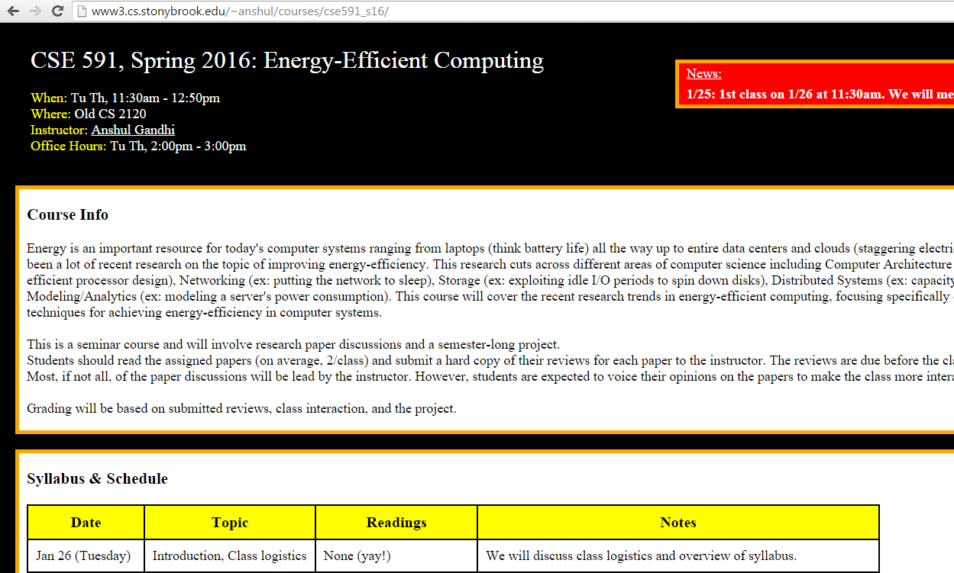
www3.cs.stonybrook.edu/~anshul/courses/cse591_s16

Slide 3
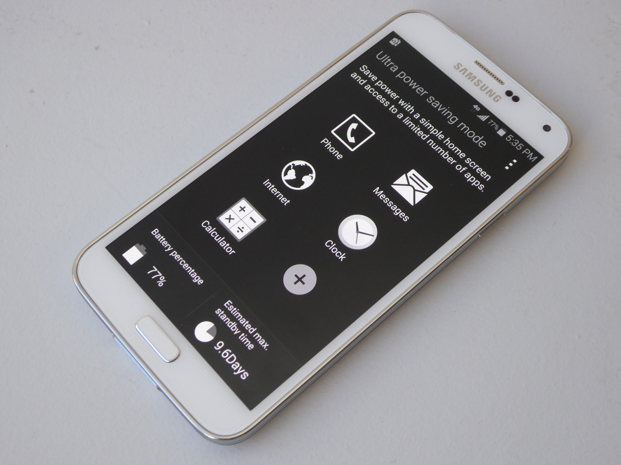

Slide 4
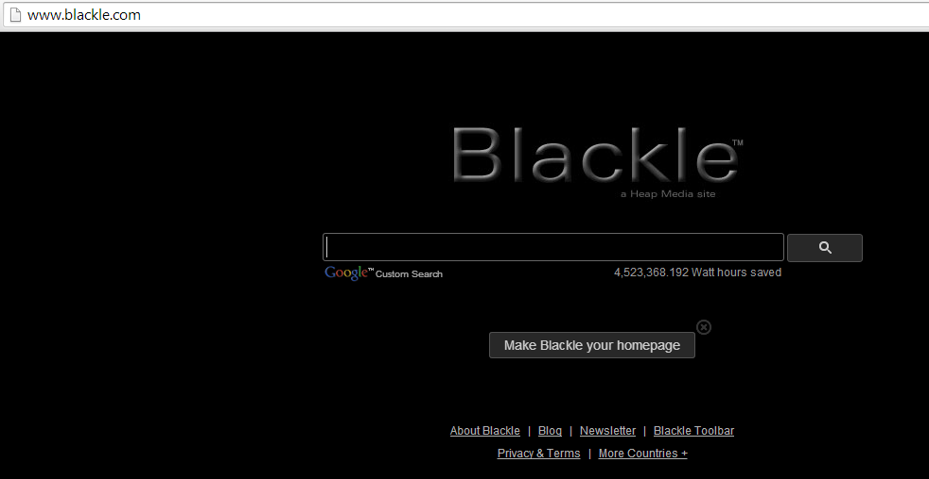
Blackle saves energy because the screen is predominantly black. "Image displayed is primarily a function of the user's color settings and desktop graphics, as well as the color and size of open application windows; a given monitor requires more power to display a white (or light) screen than a black (or dark) screen." Roberson et al, 2002

Slide 5
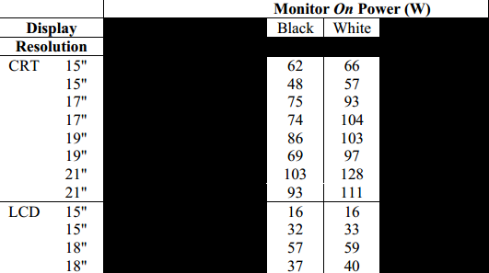
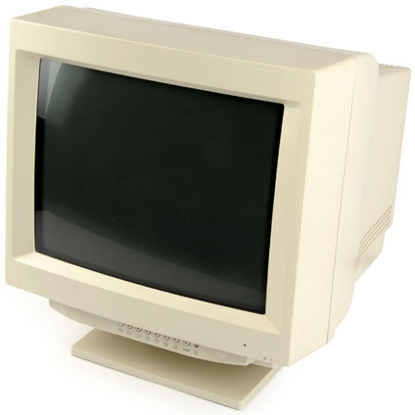
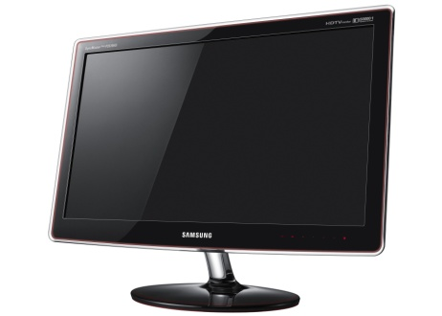
Blackle saves energy because the screen is predominantly black. "Image displayed is primarily a function of the user's color settings and desktop graphics, as well as the color and size of open application windows; a given monitor requires more power to display a white (or light) screen than a black (or dark) screen." Roberson et al, 2002

Slide 6
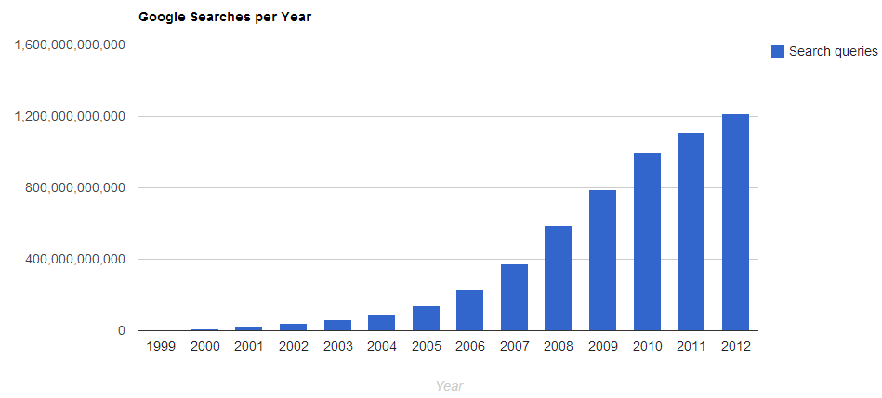
source: internetlivestats.com

Slide 7
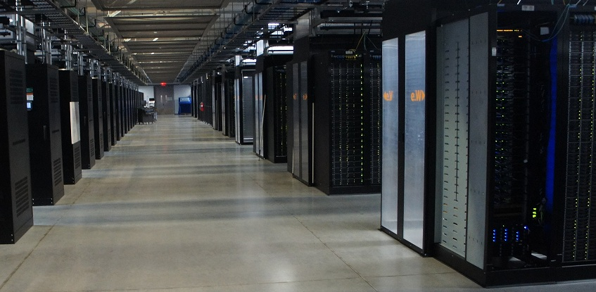
Data Centers

Slide 8
Data Centers: How many servers?
Google: 1M + (2013)
MS: approximately 1M (2013)
Amazon: approximately 1M (2013)
FB, Yahoo, etc: less than 1M
Baidu: more than 1M
50M servers in DCs worldwide
300 W per server

