Slide 1
CSE 544, Spring 2023 (in person) Probability and Statistics for Data Science Lecture 1: Intro and Logistics
Instructor: Anshul Gandhi
Department of Computer Science

Slide 2
CSE 544 Probability and Statistics for Data Science
What is Data Science?
Analysis of data (using several tools/techniques)
Statistics/Data Analysis + CS

Slide 3
CSE 544 Probability and Statistics for Data Science
Who is a Data Scientist
Statistics/Data Analysis + CS
Someone who is better at stats than the average CS person
and
someone who is better at CS than an average statistician.

Slide 4
Contact Info:
Anshul Gandhi
347, New CS building
anshul@cs.stonybrook.edu
anshul.gandhi@stonybrook.edu
PLEASE USE PIAZZA FOR ALL COMMUNICATION (more on this later)

Slide 5
Outline
Logistics
Course info
Lectures
Office hours
Course webpage + resources
Grading
Syllabus
Tentative schedule

Slide 6
Course Info
Probability theory
Probability review (basics, conditional prob, Bayes’ theorem)
Random variables (mean, variance, Geometric, Normal)
Stochastic processes (Markov chains, …)
Statistical inference
Non-parametric inference (empirical distribution, bootstrap, sample mean, bias, confidence intervals)
Parametric inference (method of moments, max. likelihood)
Hypothesis testing (truth table, various tests, p-values)
DS techniques
Bayesian inference (Bayesian reasoning, conjugate priors)
Regression analysis (linear regression, time series analysis)

Slide 7
Course Info
Prerequisites:
Probability and Statistics
Will greatly help!
Basic CS + programming background
We will use Python
This is NOT a systems course
More of a theory + algorithms course

Slide 8
Course Info
Required and recommended texts:
Software:
Available from DoIT

Slide 9
Example 1: Simple stats
X is a collection of 99 integers (positive and negative)
Mean(X) > 0
How many elements of X are > 0?
Same question but now Median(X) > 0?

Slide 10
Lectures
Tu Th: 9:45—11:05am
Engineering 145
5-min break at the halfway point
Live slides + annotations
Slides on website after class
No recordings (more on that later)
Occasionally some programming (Python)
Posted on website after class
May have cancellations due to weather or unavailability
Will post asap on piazza or via email

Slide 11
Lectures
Interactive (please): useful checkpoints, questions
Plan to take notes somewhere (book, tablet)
Attendance is not mandatory but strongly encouraged
All off-class communication (changes in deadlines, class cancelations, etc.) will be via piazza
Please sign-up and change communication mode to real-time

Slide 12
Lectures
Caveats:
Large class, need to engage everyone
In-class doubts and piazza
iPad + pencil: sometimes slow

Slide 13
Office hours (from today)
Tuesday 11am-12pm NCS 347
Friday 10am-11am Zoom
TA and TA OH: TBD
Will have a 1-hour TA OH every week, for assignment help
Piazza for assignment queries (do not give away answers)

Slide 14
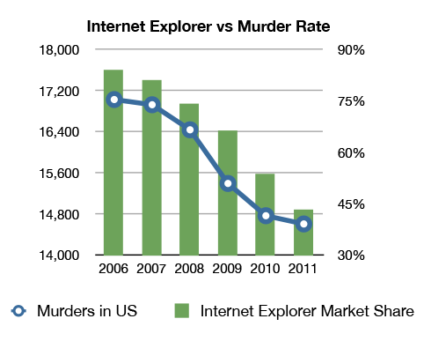
Example 2: Correlation v/s Causation
Q1: Are A and B correlated?
A
B

Slide 15
Example 2: Correlation v/s Causation
Q2: Which of the following is true (i) A causes B
(ii) B causes A
(iii) Either (i) or (ii)
(iv) None of the above
A
B

Slide 16
Example 2: Correlation v/s Causation
Q2: Which of the following is true (i) A causes B
(ii) B causes A
(iii) Either (i) or (ii)
(iv) None of the above
A
B

Slide 17
Example 2: Correlation v/s Causation

Slide 18
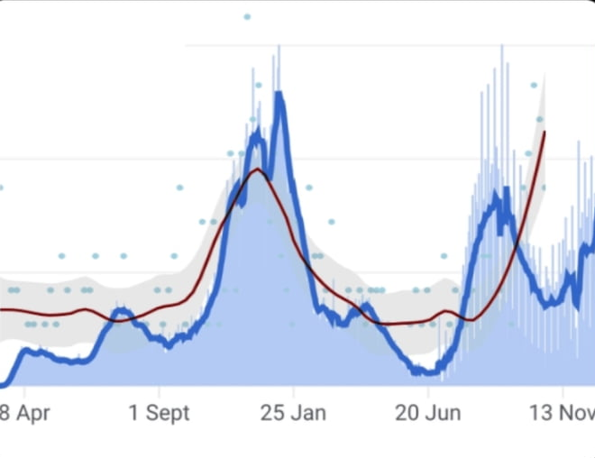
Example 3: Correlation v/s Causation
BLUE: # daily covid cases in US
RED: amazon reviews claiming no scent for Yankee candles
2021

Slide 19
Course webpage
www.cs.stonybrook.edu/~cse544 (will redirect)
Please bookmark this page
This is your best resource!
Will be regularly updated
Lecture slides
Assignment and exam dates
Assignment data files
Readings
Python scripts discussed in class

Slide 20
Course webpage
https://www3.cs.stonybrook.edu/~cse544

Slide 21
Other resources
Piazza (link on website)
Primary mode of communication, please sign up!
Helpful for posting lecture or assignment doubts
TAs will respond in a timely manner
Do NOT wait till the last moment
Announcements, class cancelations, etc.
Brightspace for assignments, solutions, grades
Assignment submission also via Brightspace
Zip all files (pdf of solution, py files, graphs, etc.)

Slide 22
Example 3: Inspection Paradox
Students at BSU complain about large class sizes. In an unbiased sample poll of students, the average reported class size was far beyond 100. However, BSU admin swears that the average class size is less than 50. Who is lying?
10 students
10 students
CSE 544, 180 students
10 students
10 students
Avg class size = (180 + 10 + 10 + 10 + 10)/5 = 220/5 = 44 < 50
Reported average = (180*180 + 4*10*10)/220 = 149 > 100

Slide 23
Grading
36% assignments
56% exams (in-class mid-terms)
8% group mini-project
0% attendance
Grading is on a curve

Slide 24
Grading - assignments
36% assignments
6 assignments (roughly once every 1.5 weeks)
6--7 problems per assignment
6% grade per assignment
Later assignments will have more programming
Qs based on lectures, but tougher on purpose
Collaboration is allowed (groups of at most 4)
One upload per group
Only use techniques taught in class
DO NOT COPY OR DISCUSS ACROSS GROUPS!
If a group member is inactive, let me know asap
You can change groups (check with me first)

Slide 25
Grading - assignments
Submit files (scanned pdf, py files) as one archive on Brightspace
Solutions can be typed or hand-written (legible)
Only one group member needs to submit, mention all names
Assignments due at 11:59pm on due-date
Due date posted on class website and in assignment pdf
Example: A1 due on Feb 8th (at 11:59pm)
Brightspace will mark submission after 11:59pm on Feb 8th as LATE, will not be graded if late
Please upload ahead of time, updates till 11:59pm allowed
NO LATE SUBMISSIONS, NO EXCEPTIONS
Not all questions will be addressable on release date

Slide 26
Grading - exams
56% exams
Mid-terms 1 and 2
23% mid-term 1 (probs & stats), mid-March
33% mid-term 2 (inference), early May
Non-overlapping
In-class exams (~75mins)
Easier than assignments, on-par with in-lecture questions
Entirely based on material covered in class
Closed-notes, closed-book (index card allowed)
No programming questions
No collaborations, obviously
Will release practice mid-term exam a week prior

Slide 27
Grading – group mini-project
8% group mini-project
Basically, assignment 7, due at end of semester
Data analysis project
Group size of max 4
Same as assignment group (can change if needed)
Mostly programming
2nd half of the semester
Will discuss details as we go along

Slide 28
Grading – attendance
0%
Attending class will be beneficial!
Exam questions centered around lecture material
Useful hints/questions posed in lectures
Practice questions in class will aid self-evaluation
Lectures not recorded to encourage attendance, though slides will be posted on website by end-of-day

Slide 29
Grading - recap
36% assignments (6 assignments, in groups of max 4)
56% exams (in-class exams)
8% group mini-project
0% attendance
Grading is on a curve
Will provide mid-sem grades (after M1)
For self-evaluation purposes only

Slide 30
Syllabus and Timeline
Probability Theory (7--8 lectures, 2 assignments)
Probability review (events, computing probability, conditional prob., Bayes’ thm.)
Random variables (Geometric, Exponential, Normal, expectation, moments, etc.)
Probability inequalities (Weak Law of Large Numbers, Central Limit thm., etc.)
Markov chains (stochastic processes, balance equations, etc.)
MID-TERM 1 (Early March, mostly March 9th)
Statistical Inference (~14 lectures, 3 assignments)
Non-parametric inference (empirical PDF, bootstrap, bias, plug-in estimator)
Confidence intervals (percentiles, Normal-based CIs)
Parametric inference (method of moments, max likelihood estimator)
Hypothesis testing (Wald’s test, t-test, KS test, p-values, permutation test)
Bayesian inference (Bayesian reasoning, inference, etc.)
Data Science Models (~3 lectures, 1 assignment)
Regression (simple LR, multiple LR, non-linear regression)
Time series analysis (moving average, EWMA, AR, ARMA, ARIMA)
MID-TERM 2 (Early May, mostly May 4th)
MINI-PROJECT (mid-May)

Slide 31
Key Takeaways
Very useful course for data scientist or quantitative analyst positions or ML/DS researchers
Math-heavy course
Exams have high weightage

Slide 32
Syllabus
www.cs.stonybrook.edu/~cse544

Slide 33
Next class
Probability review - 1
Basics: sample space, outcomes, probability
Events: mutually exclusive, independent
Calculating probability: sets, counting, tree diagram

Slide 34
Questions??

