Slide 1
CSE 544 (online) Probability and Statistics for Data Science Lecture 1: Intro and Logistics
Instructor: Anshul Gandhi
Department of Computer Science

Slide 2
CSE 544 (online) Probability and Statistics for Data Science
Online engagement:
Participants can decide video on/off
Keep participant audio on/off?
Participants can chat with host (please do)
Keep host audio on (obviously)
Host video on/off
Host will share slides throughout
Do not disturb/disrupt the lecture, please!

Slide 3
CSE 544 Probability and Statistics for Data Science
What is Data Science?
Analysis of data (using several tools/techniques)
Statistics/Data Analysis + CS

Slide 4
CSE 544 Probability and Statistics for Data Science
Who is a Data Scientist
Statistics/Data Analysis + CS
Someone who is better at stats than the average CS person
and
someone who is better at CS than an average statistician.

Slide 5
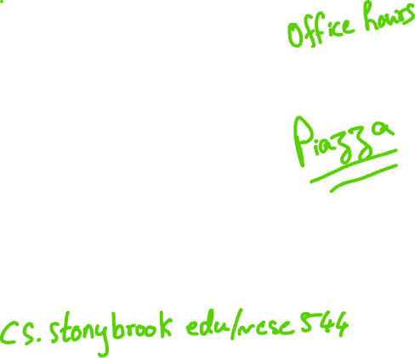
Contact Info:
Anshul Gandhi
347, New CS building
anshul@cs.stonybrook.edu
anshul.gandhi@stonybrook.edu

Slide 6
Outline
Logistics
Course info
Remote and hybrid instruction
Lectures
Office hours
Course webpage + resources
Grading
Syllabus
Tentative schedule

Slide 7
Course Info
Probability theory
Probability review (basics, conditional prob, Bayes’ theorem)
Random variables (mean, variance, Geometric, Normal)
Stochastic processes (Markov chains, …)
Statistical inference
Non-parametric inference (empirical distribution, sample mean, bias, confidence intervals)
Parametric inference (method of moments, max. likelihood)
Hypothesis testing (truth table, various tests, p-values)
DS techniques
Bayesian inference (Bayesian reasoning, conjugate priors)
Regression analysis (linear regression, time series analysis)

Slide 8
Course Info
Prerequisites:
Probability and Statistics
Will greatly help!
Basic CS + programming background
We will use Python
This is NOT a systems course
More of a theory + algorithms course

Slide 9
Course Info
Required and recommended texts:
Software:
Available from DoIT

Slide 10
Example 1: Simple stats
X is a collection of 99 integers (positive and negative)
Mean(X) > 0
How many elements of X are > 0?
Same question but now Median(X) > 0?

Slide 11
Remote Instruction
Unless specified otherwise, all lectures via Zoom
Same link as today (recurring meeting)
Almost all lectures synchronous (live)
I am anticipating some unavailability in early March
Switch to async lectures or TA lectures or cancelations
All components will be online via BB, including assignment release and submission, exams, office hours, TA office hours, etc.

Slide 12
Hybrid Instruction
For students in Section 02, an in-person component is needed for immigration/visa compliance purposes
Still being decided with the department
Most likely will require at least one trip to NCS 120 to attend a lecture and an in-person OH
More details by March
That is the only change expected for Section 02
Social distancing and masks will be needed, of course

Slide 13
Lectures
Tues Thurs: 1:15pm – 2:35pm
Via Zoom (link on BB)
5-min break at the halfway point
Live slides + annotations
Recordings will be on BB, slides on website
Occasionally some programming (Python)
Posted on website after class
May have cancellations due to weather or unavailability
Will be emailed and updated on website
Weather-related class cancelations decided by SBU

Slide 14
Lectures
Interactive (please): chat/audio
May have some ungraded quizzes for BB practice
Plan to take notes somewhere (book, tablet)
Attendance is not mandatory but strongly encouraged
All off-class communication (changes in deadlines, class cancelations, etc.) will be via piazza
Please sign-up and change communication mode to real-time

Slide 15
Office hours
Tue, Thurs 10-11am?
Will re-visit after add/drop date
Via Zoom, will create a link and share
Do not email me your Qs, wait for OH
Large class, easier to address Qs during OH
TA and TA Office hours: TBD
Will have a 1-hour TA OH every week, for assignment help
Piazza for assignment queries (do not give away answers)

Slide 16
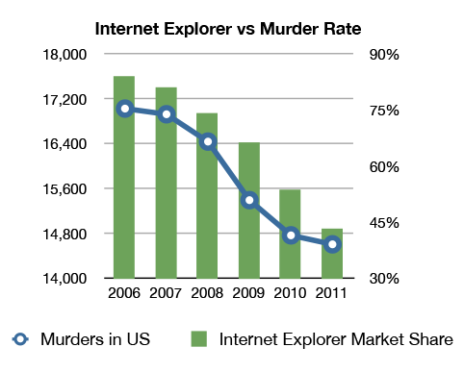
Example 2: Correlation v/s Causation
Q1: Are A and B correlated?
A
B

Slide 17
Example 2: Correlation v/s Causation
Q2: Which of the following is true (i) A causes B
(ii) B causes A
(iii) Either (i) or (ii)
(iv) None of the above
A
B

Slide 18
Example 2: Correlation v/s Causation
Q2: Which of the following is true (i) A causes B
(ii) B causes A
(iii) Either (i) or (ii)
(iv) None of the above
A
B

Slide 19
Example 2: Correlation v/s Causation

Slide 20
Course webpage
www.cs.stonybrook.edu/~cse544 (will redirect)
Please bookmark this page
This is your best resource!
Will be regularly updated
Lecture slides
Assignment and exam dates
Assignment data files
Readings
Python scripts discussed in class

Slide 21
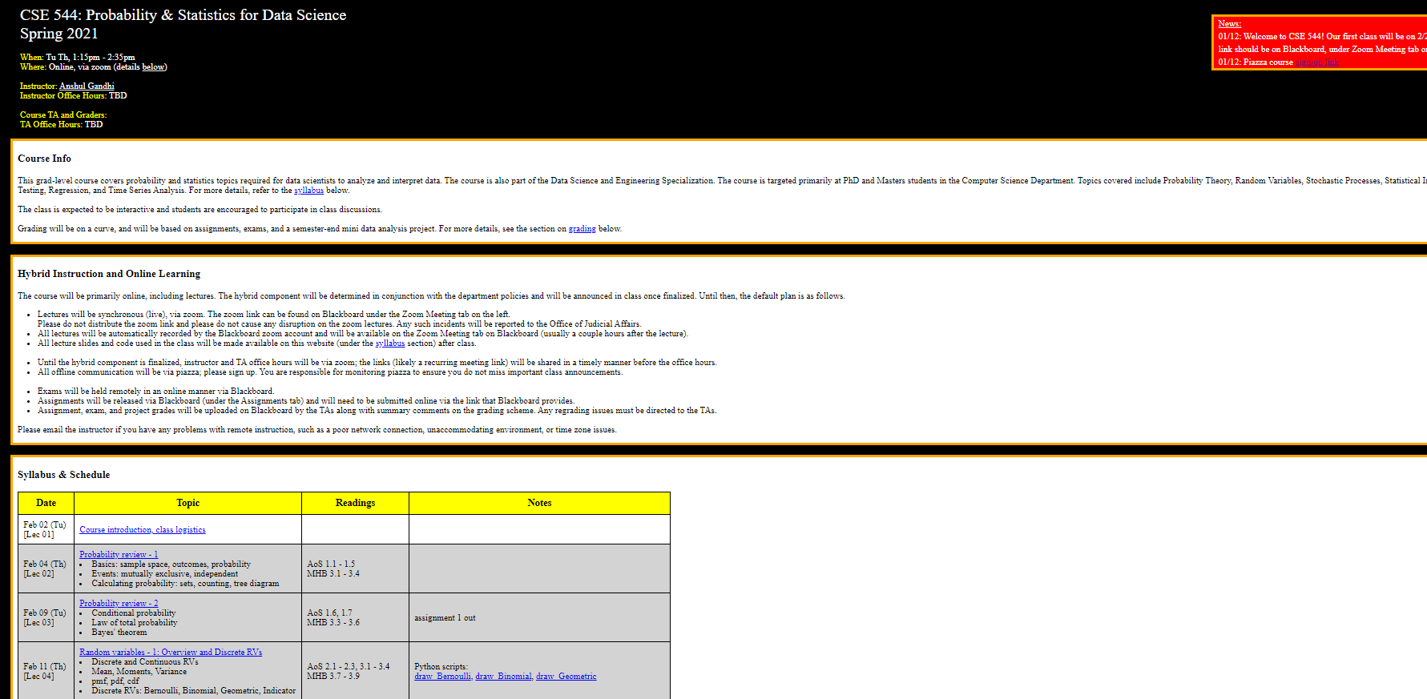
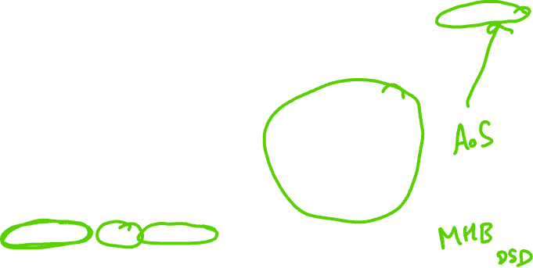
Course webpage
www.cs.stonybrook.edu/~cse544

Slide 22
Other resources
Piazza (link on website)
Primary mode of communication, please sign up!
Helpful for posting lecture or assignment doubts
TAs will respond in a timely manner
Do NOT wait till the last moment
Announcements, abundance of caution, etc.
Blackboard for assignments, exams, solutions, grades
Assignment submission also via BB
Zip all files (pdf of solution, py files, graphs, etc.)
BB for in-class quizzes

Slide 23
Example 3: Inspection Paradox
On average, an SBU shuttle arrives at the SAC loop every 20mins. If you show up at the SAC loop at some random time, let W be the #mins you end up waiting for a shuttle.
What is E[W]?
W
t=0
t=20

Slide 24
Example 3: Inspection Paradox
On average, an SBU shuttle arrives at the SAC loop every 20mins. If you show up at the SAC loop at some random time, let W be the #mins you end up waiting for a shuttle.
Can E[W] > 10mins?
W
t=0
t=40

Slide 25
Example 3: Inspection Paradox
On average, an SBU shuttle arrives at the SAC loop every 20mins. If you show up at the SAC loop at some random time, let W be the #mins you end up waiting for a shuttle.
Can E[W] > 20mins?
W
t=0
t=60

Slide 26
Example 3: Inspection Paradox
Students at BSU complain about large class sizes. In an unbiased sample poll of students, the average reported class size was far beyond 100. However, BSU admin swears that the average class size is less than 50. Who is lying?
10 students
10 students
CSE 544, 180 students
10 students
10 students
Avg class size = (180 + 10 + 10 + 10 + 10)/5 = 220/5 = 44 < 50
Reported average = (180*180 + 4*10*10)/220 = 149 > 100

Slide 27
Grading
45% assignments
45% exams (in-class mid-terms)
10% group mini-project
Some parts are tentative!

Slide 28
Grading - assignments
45% assignments
6 assignments (roughly once every 1.5 weeks)
6-8 problems per assignment
Later assignments will have more programming
Qs based on lectures, but tougher on purpose
Collaboration is allowed (groups of at most 4)
One write-up/upload per group
Discuss among group
DO NOT COPY OR DISCUSS ACROSS GROUPS!
If a group member is inactive, let me know asap
You can change groups (check with me first)

Slide 29
Grading - assignments
Submit all files (scanned pdf, py files) as one archive on BB
Solutions can be types of hand-written (legible)
Only one group member needs to submit, mention all names
Assignments due at the beginning of class
Due date posted on class website and in assignment pdf
Example: A1 due on Feb 18th
BB submission site will mark submission after 1:15pm on Feb 18th as LATE, will not be graded if late
NO LATE SUBMISSIONS, NO UPDATES, NO EXCEPTIONS

Slide 30
Grading - exams
45% exams
Mid-terms 1 and 2
20% mid-term 1 (probs & stats), mid-March
25% mid-term 2 (inference), early May
Non-overlapping
Exams administered via BlackBoard
Open-book, open-notes exams
MCQ + fill in the blanks
Randomized Qs and As, tightly timed, to discourage cheating
No programming questions
Somewhat easier than assignments, but will test concepts
No collaborations, obviously

Slide 31
Grading – quizzes
0%
Roughly once a week or so
Very simple, 1 Q, via BB (for practicing BB exams)
Purpose: self-evaluation
Best to do this yourself
This is in response to student requests from prior sems

Slide 32
Grading – group mini-project
10% group mini-project
Basically, assignment 7, due at end of semester
Data analysis project
Programming involved
Same as assignment group (can change if needed)
2nd half of the semester
Will discuss details as we go along

Slide 33
Grading - recap
45% assignments (6 assignments, in groups of max 4)
45% exams (timed, BB exams)
10% group mini-project
0% quizzes
Some parts are tentative!
Will provide mid-sem grades (after M1)
For self-evaluation purposes only

Slide 34
Syllabus
Probability Theory (8 lectures, 2 assignments)
Probability review (events, computing probability, conditional prob., Bayes’ thm.)
Random variables (Geometric, Exponential, Normal, expectation, moments, etc.)
Probability inequalities (Weak Law of Large Numbers, Central Limit thm., etc.)
Markov chains (stochastic processes, balance equations, etc.)
MID-TERM 1 (Early March)
Statistical Inference (~12 lectures, 3 assignments)
Non-parametric inference (empirical PDF, bias, kernel density, plug-in estimator)
Confidence intervals (percentiles, Normal-based CIs)
Parametric inference (method of moments, max likelihood estimator)
Hypothesis testing (Wald’s test, t-test, KS test, p-values, permutation test)
Bayesian inference (Bayesian reasoning, inference, etc.)
Data Science Models (2-3 lectures, 1 assignment)
Regression (simple LR, multiple LR, non-linear regression)
Time series analysis (moving average, EWMA, AR, ARMA, ARIMA)
MID-TERM 2 (Early May)
MINI-PROJECT (Early May)

Slide 35
Syllabus
www.cs.stonybrook.edu/~cse544

Slide 36
Next class
Probability review - 1
Basics: sample space, outcomes, probability
Events: mutually exclusive, independent
Calculating probability: sets, counting, tree diagram

