Slide 1
CSE 591: Energy-Efficient Computing Lecture 4 SLEEP: full-system
Anshul Gandhi
347, CS building
anshul@cs.stonybrook.edu

Slide 2
power_nap paper

Slide 3
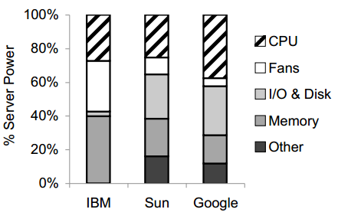

Slide 4
US data centers: 100 billion kWh by 2011
?? $$
Server utilization: <30%
Idle server power: 60% of peak
Idle periods: ~seconds
why important?

Slide 5
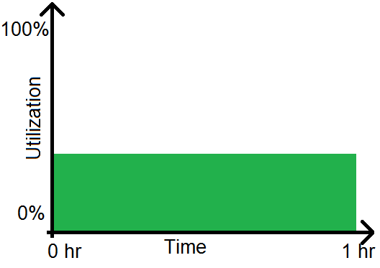
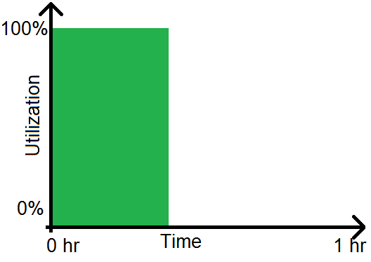
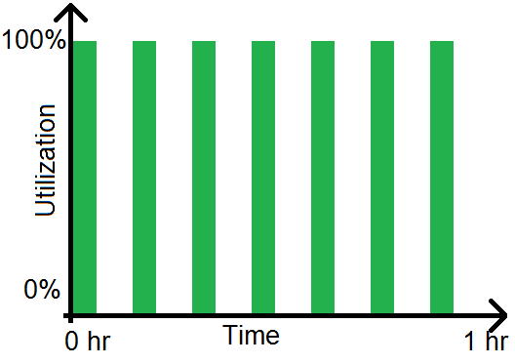
What does 30% utilization mean?

Slide 6
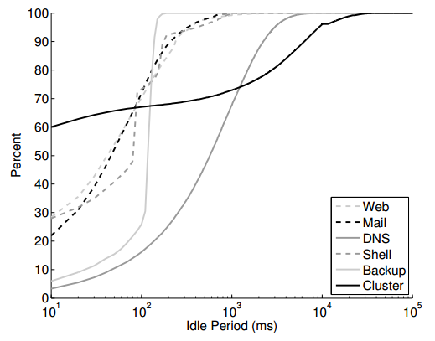
Utilization data

Slide 7
Existing techniques
Consolidation
Sleep states
Throttling (DVFS)

Slide 8
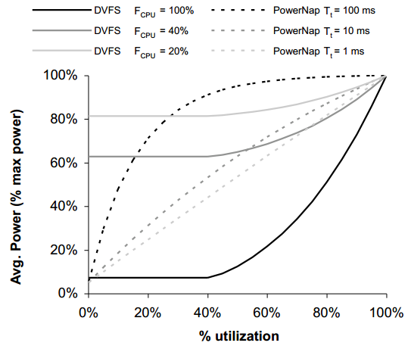
PowerNap
Simple idea (only 2 states)
Minimize power draw in sleep
Fast transitions
Model (power and response time)
PowerNap vs DVFS
RAILS
Notes:
Why the weird plateauing at low utilization for DVFS? Assumed that fmin is 2.4 lower than fmax.
FCPU is %power contribution of CPU.

Slide 9
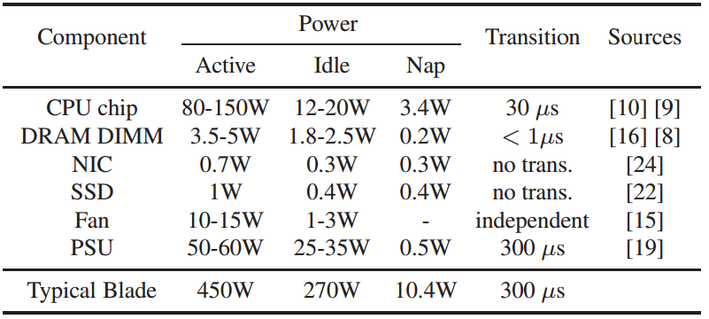
(Potential) Implementation
Notes:
Why the weird plateauing at low utilization for DVFS? Assumed that fmin is 2.4 lower than fmax.
FCPU is %power contribution of CPU.

Slide 10
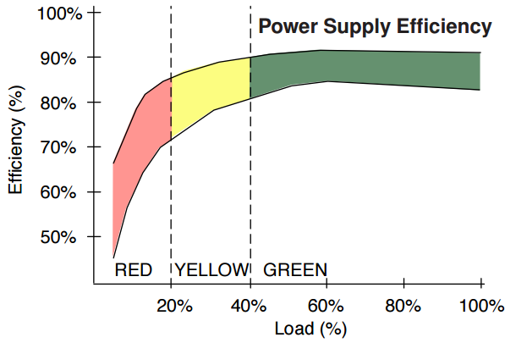
RAILS
Notes:
Why low load? 1. Rated for max power draw. 2. Redundant power supply.

Slide 11
agile paper

Slide 12
agile
PowerNap was NOT implemented agile took first REAL step towards that
Static consolidation vs Dynamic consolidation
How to minimize latency penalties of dynamic consolidation? 3 ideas.
agile: dynamic virtualization +
PowerNap implementation
Notes:
Workload scheduling
Workload forecasting
Extra servers

Slide 13
agile: main problem

Slide 14
agile: low-power states
 |  |  | Turbo
 |  | C0 | P states | T states
 |  | C1
 |  | C1E
 |  | C2
 |  | C3
 | S0 | C6
 | S1
 | S2
 | S3
G0 | S4
G2 | S5
G3

Slide 15
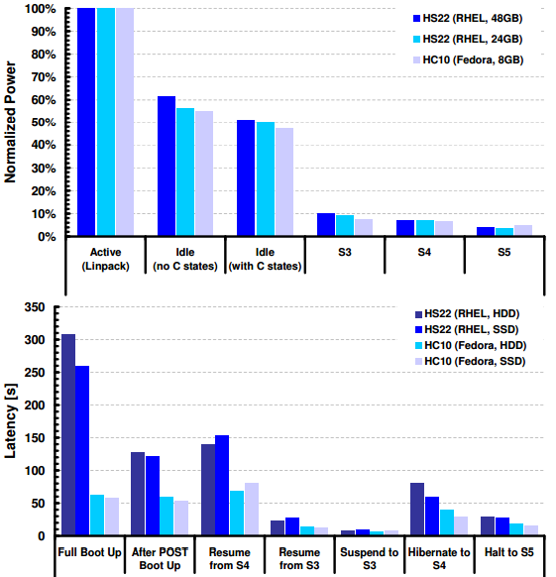
agile: power vs. latency
Notes:
Blade vs rack server.

Slide 16
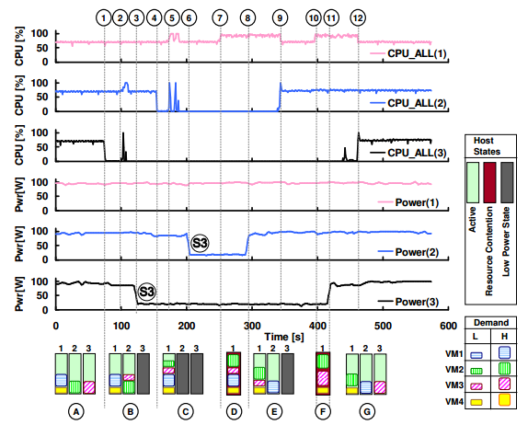
agile: dynamic consolidation
Host power-up
VM migration
Host power-down

