Slide 1
CSE 591: Energy-Efficient Computing Lecture 19 SPEED: memory
Anshul Gandhi
347, CS building
anshul@cs.stonybrook.edu

Slide 2
memscale paper

Slide 3
Memory subsystem

Slide 4
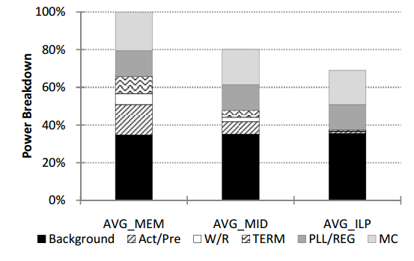
Memory power breakdown
MEM MIX CPU

Slide 5
Remarks on memory DVFS
DVFS lowers power, but effect on energy is not obvious as response time might increase
Some memory access stages get delayed, not necessarily end-to-end latencies

Slide 6
Performance monitoring
top
sar
collectl
perf stat

Slide 7
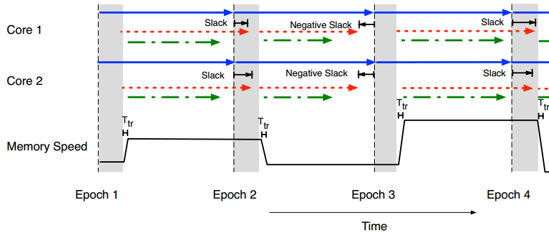
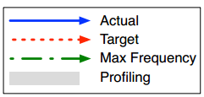
Energy management policy
300 microsecs
| 5 millisecs |

Slide 8
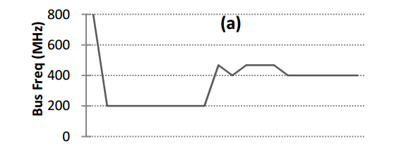
Controller

Slide 9
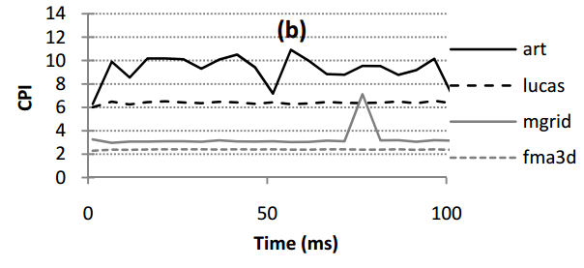
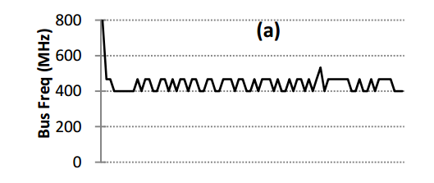
Controller
Oscillations?

Slide 10
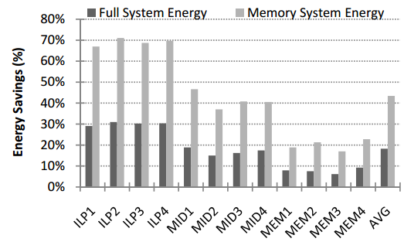
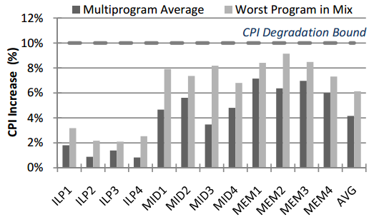
Evaluation

Slide 11
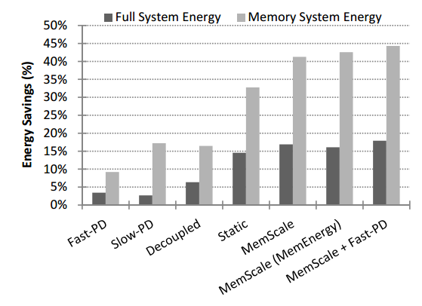
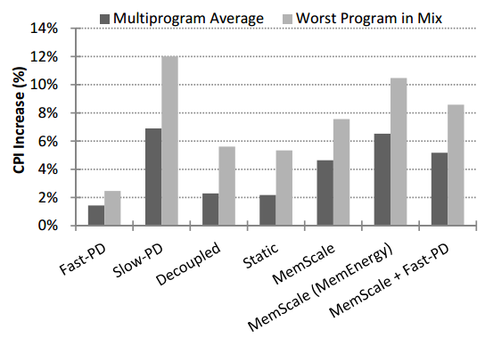
Comparisons

Slide 12
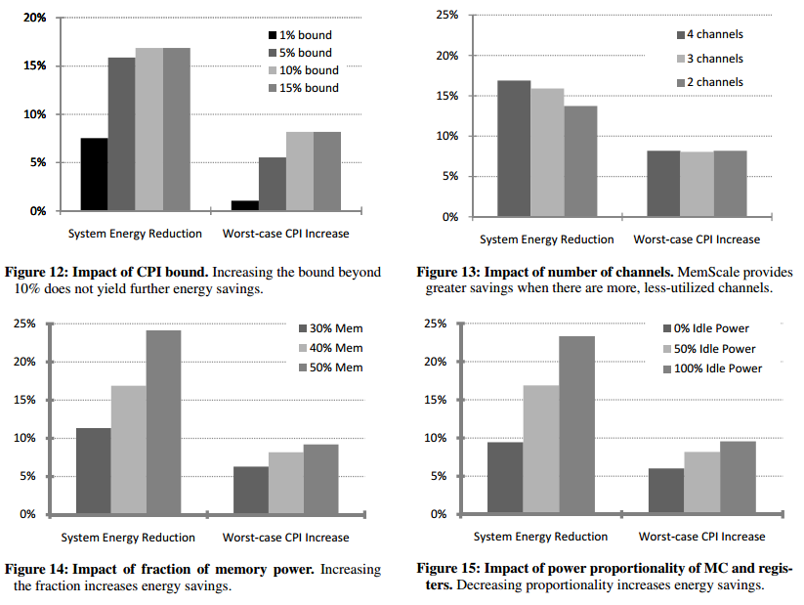
Sensitivity analysis
Notes:
Similar to? DreamWeaver

Slide 13
memory_dvfs paper

Slide 14
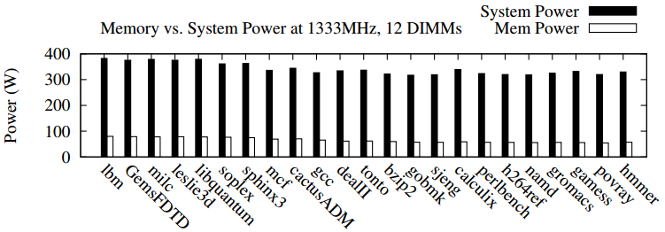
Memory power %

Slide 15
Active energy

Slide 16
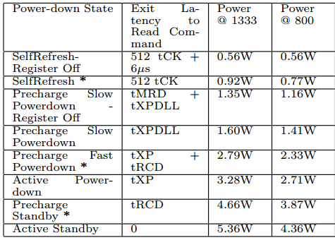
Background power

Slide 17
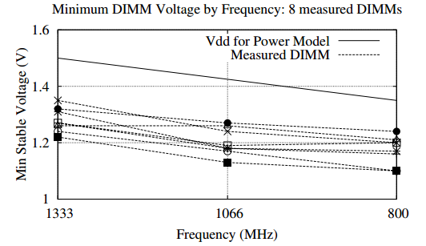
VF scaling

Slide 18
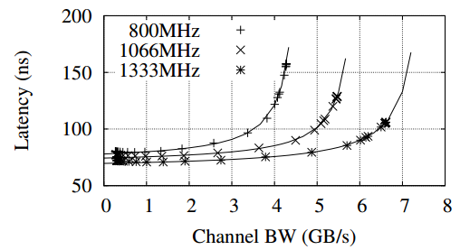
Latency vs. B/W
Notes:
Similar to what queueing theory suggests.

Slide 19
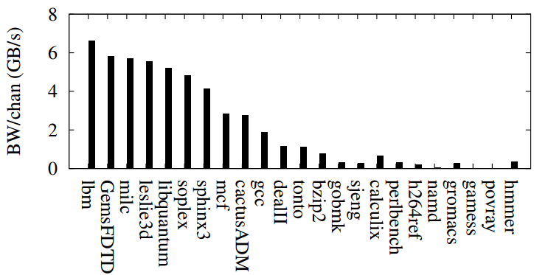
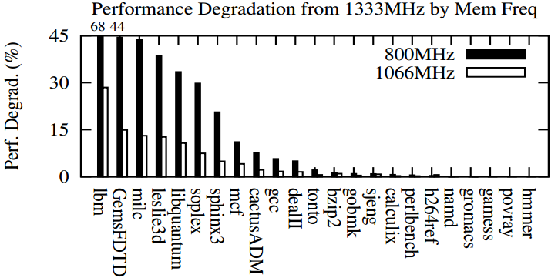
B/W vs. savings
Notes:
Compared to 1333 MHz.

Slide 20
Algo in action
Notes:
Measure bandwidth in previous epoch and find frequency for next epoch based on observed latency vs bandwidth graph.

