Slide 1
CSE 591: Energy-Efficient Computing Lecture 18 SPEED: power
Anshul Gandhi
347, CS building
anshul@cs.stonybrook.edu

Slide 2
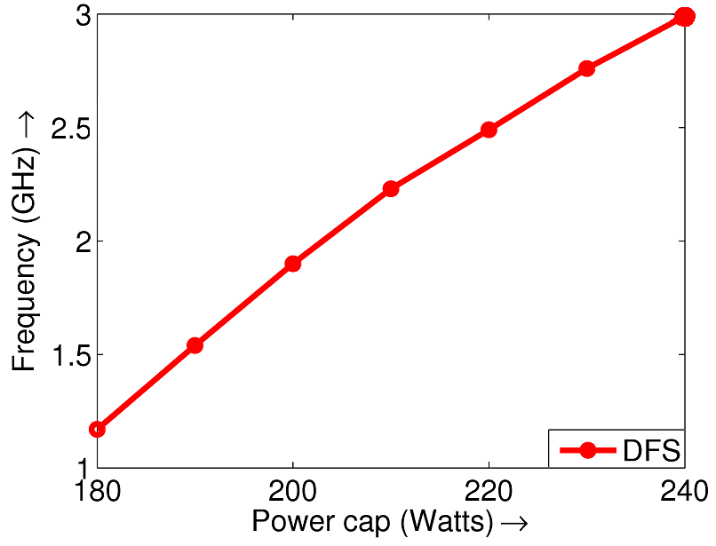
Recap
DFS: Dynamic Frequency Scaling
Frequency (GHz)
(server speed)
DFS
“linear”
P = system power
NOT processor power
Power (Watts)

Slide 3
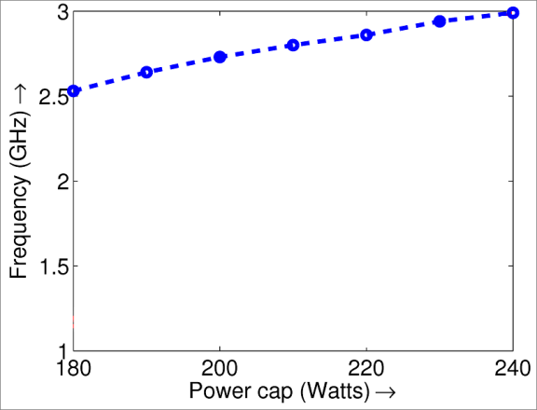
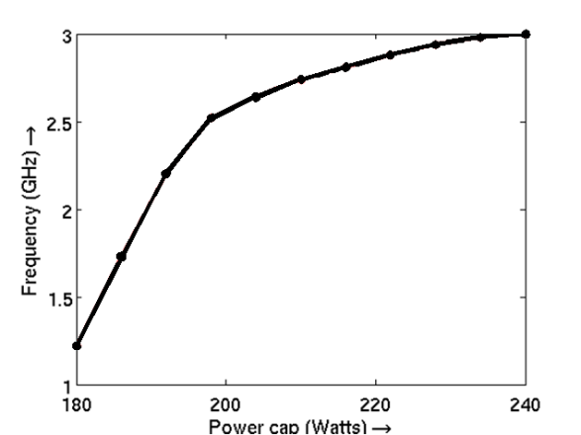
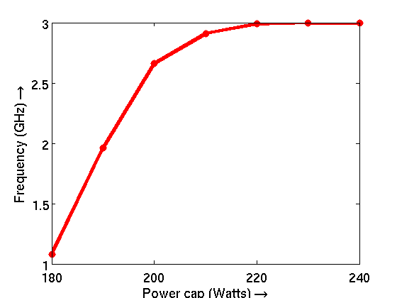
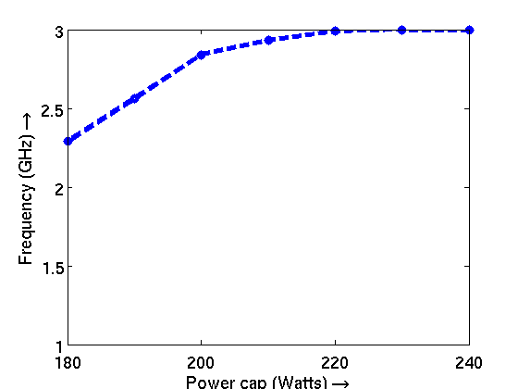
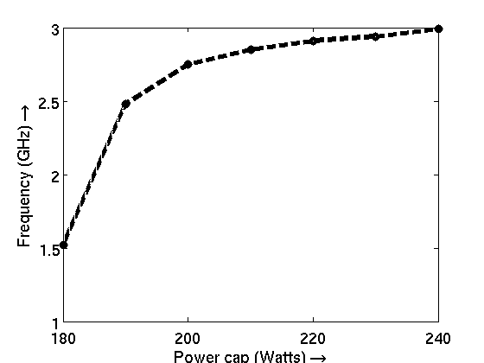
Recap
How power affects server speed for a single server
DVFS
Frequency (GHz)
DVFS
+DFS
“LINPACK”
CPU BOUND
DFS
Frequency (GHz)
Frequency (GHz)
Power (Watts)
Power (Watts)
Power (Watts)
DVFS
DVFS
+DFS
Frequency (GHz)
DFS
“STREAM”
MEM BOUND
Frequency (GHz)
Frequency (GHz)
Power (Watts)
Power (Watts)
Power (Watts)

Slide 4
power_capping paper

Slide 5
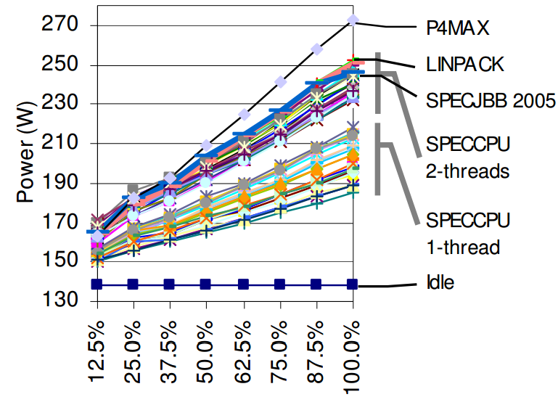
Power vs. Performance
Label power = 308W

Slide 6
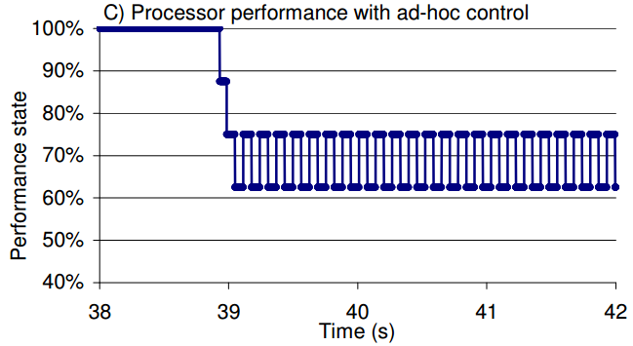
Ad-hoc controller

Slide 7
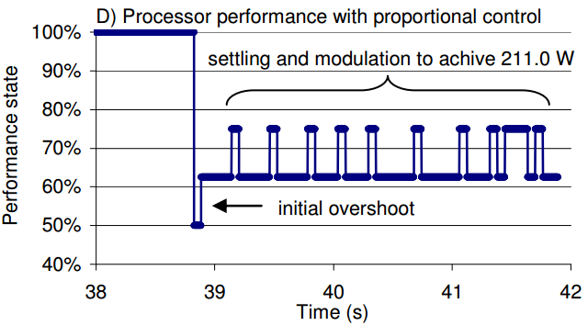
Proposed controller

Slide 8
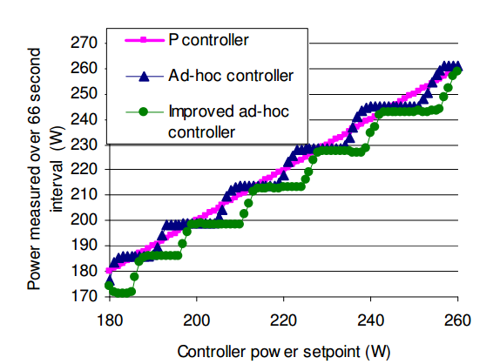
Stable results

Slide 9
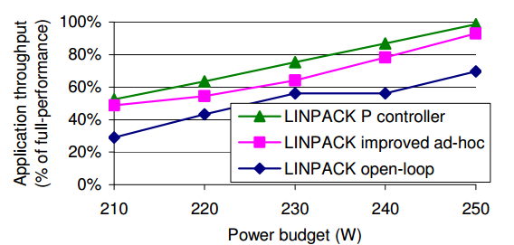
Performance impact
Notes:
Open loop: statically select a P state that ensures power budget
Ad hoc: too much fluctuations, so xput is low
P controller: stable, less fluctuations, so more useful work time

Slide 10
Power shifting
Allowing even 1W of extra budget to server can improve performance
For rack power budget, power budget can be “stolen” from low priority servers to give additional power budget to high priority servers
Power shifting

Slide 11
power_modeling paper

Slide 12
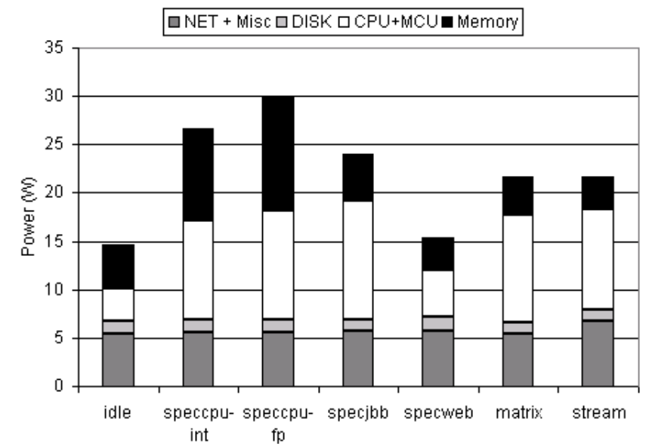
Power breakdown

Slide 13
Power measurement
Directly from hardware or sensors
Via simulations
Via power modeling
Model should be able to provide component-level power consumption

Slide 14
Power model

Slide 15
Power model

Slide 16
Power model

Slide 17
Applications of power models
Server-specific power profiles
Resource bottleneck identification
Selective fan cooling
Temperature proxy
Electricity cost proxy

