Slide 1
CSE 591: Energy-Efficient Computing Lecture 17 SCALING: survey
Anshul Gandhi
347, CS building
anshul@cs.stonybrook.edu

Slide 2
autoscaling_survey paper

Slide 3
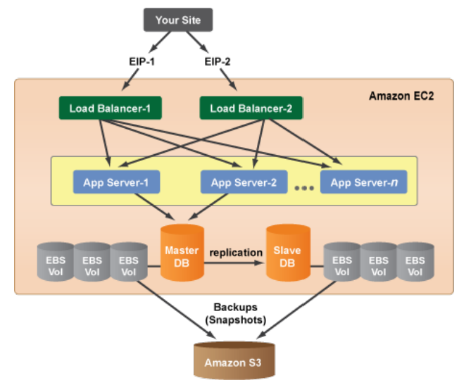
3-tier architecture

Slide 4
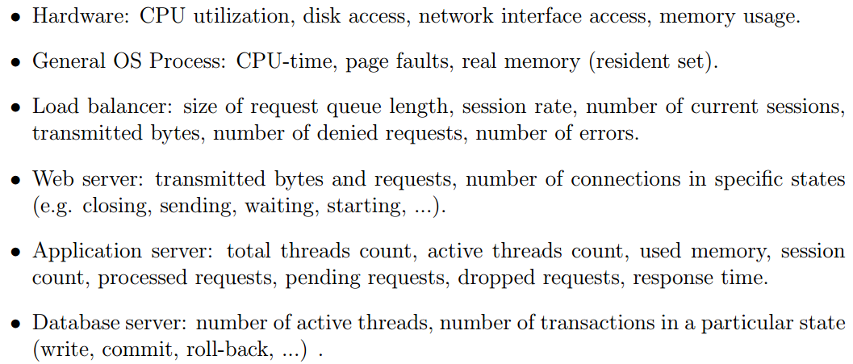
Metrics

Slide 5
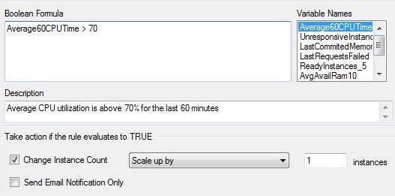
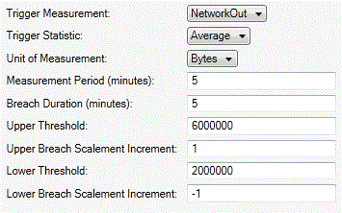
Cloud scenario
Businesses have started moving to the cloud for their IT needs
reduces capital cost of buying servers
allows for elastic resizing of applications that have dynamic workload demand
Cloud Service Providers (CSPs) offer monitoring and rule-based triggers to enable dynamic scaling of applications
Microsoft Azure Watch
Amazon auto scaling
Demand
Time

Slide 6
Challenges
The values have to be determined by the user
requires expert knowledge of application (CPU, memory, n/w thresholds)
requires performance modeling expertise (when and how to scale)
How to set these values ??
Microsoft Azure Watch
Amazon auto scaling

Slide 7
Challenges
The values have to be determined by the user
requires expert knowledge of application (CPU, memory, n/w thresholds)
requires performance modeling expertise (when and how to scale)
Offline benchmarking
Trial-and-error
Expert application knowledge
95% Resp. time (ms)
400 ms
Not possible for CSPs !
arrival rate (req/s)
60 req/s

