Slide 1
CSE 591: Energy-Efficient Computing Lecture 14 SCALING: setup time
Anshul Gandhi
347, CS building
anshul@cs.stonybrook.edu

Slide 2
napsac paper

Slide 3
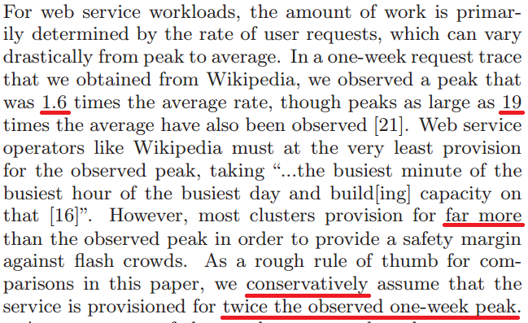
Web workloads

Slide 4
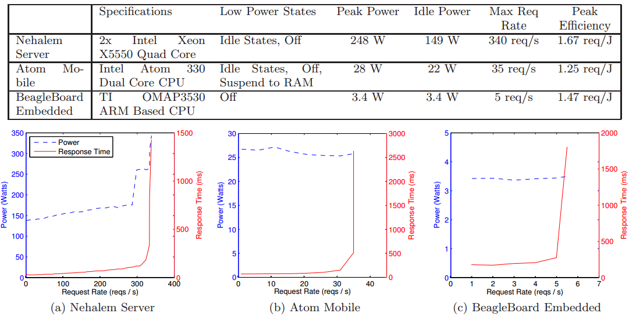
Heterogeneous machines
Notes:
Beagle board use? For static content during setup time. Kind of like embedded. Or SoftScale.
1/(1-x) shape.

Slide 5
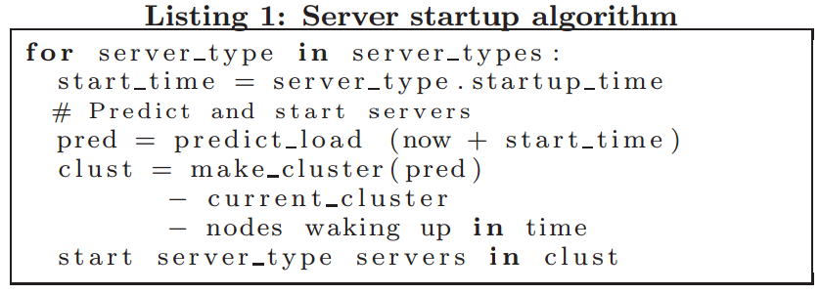
NapSac algorithm
Notes:
Sorted by efficiency. Note that might want to wake up quick servers, even if inefficient, if predictions are wrong.
Make_cluster is knapsack.

Slide 6
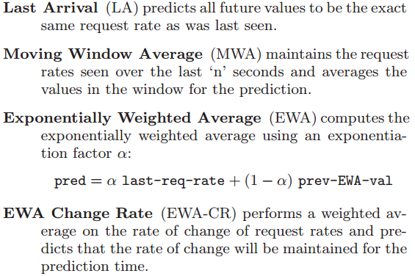
Algorithms

Slide 7
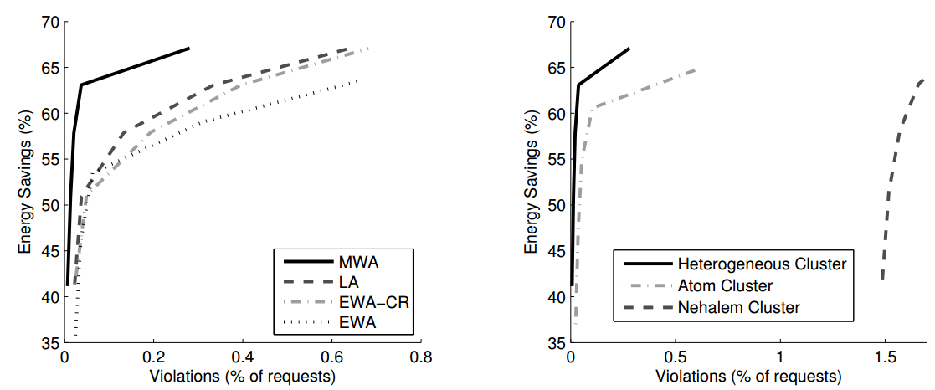
Results
Notes:
Note the range of results for each algo instead of a single point – strength.

Slide 8
vmsetuptime paper

Slide 9
Startup time definition
From “issuing VM acquisition request” to …

Slide 10
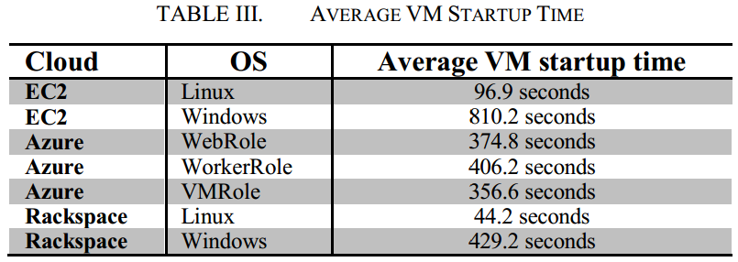
VM startup time
Notes:
OS makes a big difference. Possibly due to image size and preloaded software and/or checks.

Slide 11
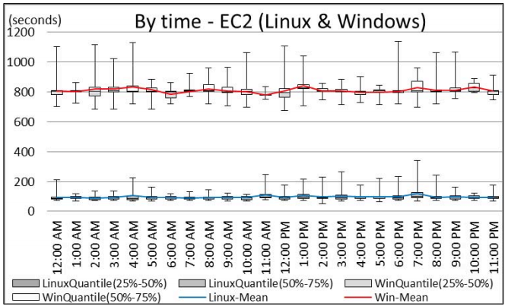
Time-of-day effects
Notes:
Not much effect.

Slide 12
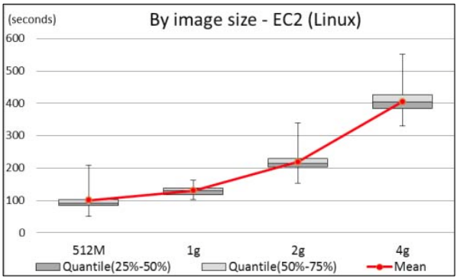
OS image size
Notes:
Linear dependence.

Slide 13
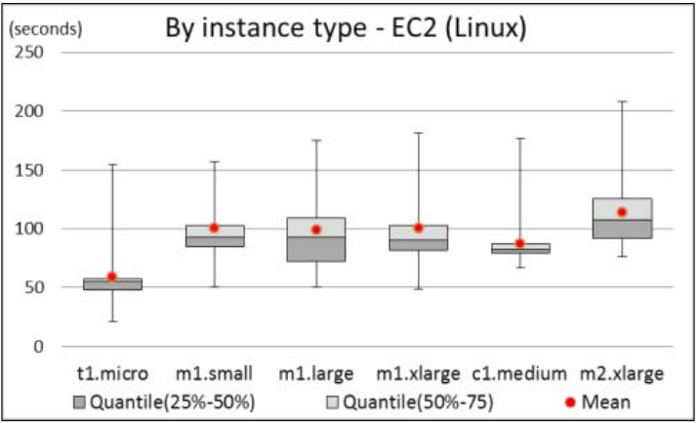
Instance type
Notes:
Makes sense that larger will have more setup time as need time to find host that has that much free capacity.

Slide 14
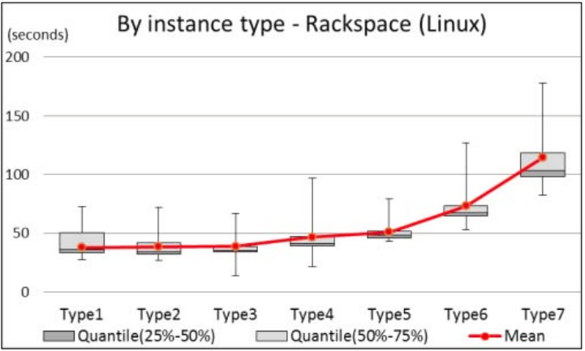
Instance type

Slide 15
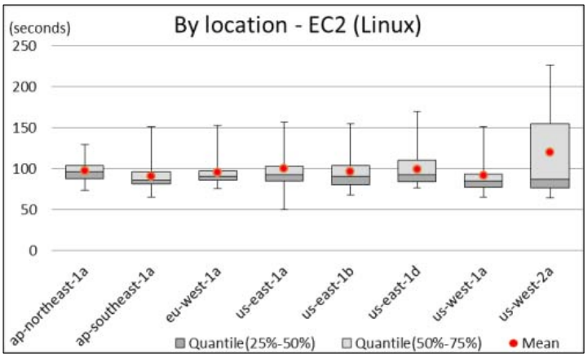
Location
Notes:
Last one is new DC location, so maybe still running checks, etc.

Slide 16
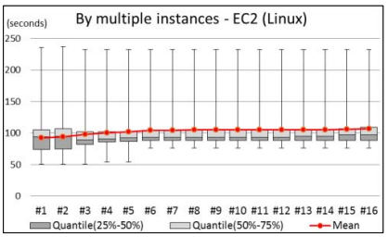
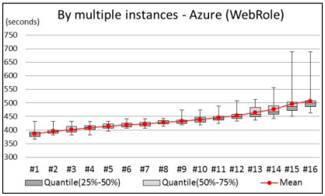
Group request
Notes:
Last ones take longer to setup, possibly because of straggler effect.

Slide 17
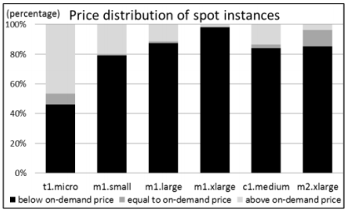
Spot Instances

Slide 18
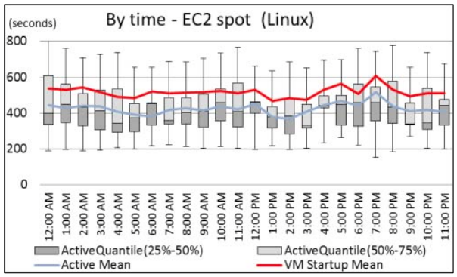
Spot Instances
Notes:
Ignore active vs startup.
No difference by time.

Slide 19
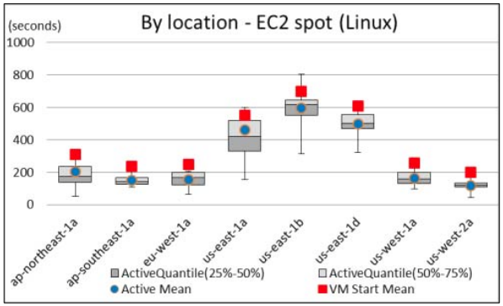
Spot Instances - Location
Notes:
East is probably busier, so harder to schedule these as they are low priority? East has high turnover?

Slide 20
VM Create - success rate

