Slide 1
CSE 591: Energy-Efficient Computing Lecture 13 SLEEP: sensors
Anshul Gandhi
347, CS building
anshul@cs.stonybrook.edu

Slide 2
sensor_power paper

Slide 3
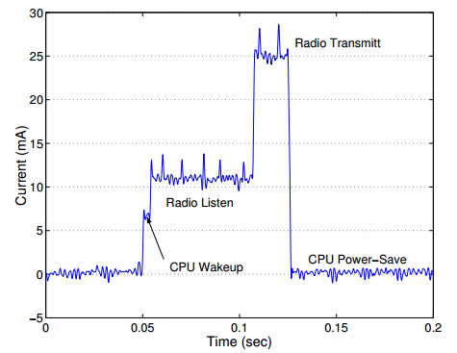
Power consumption

Slide 4
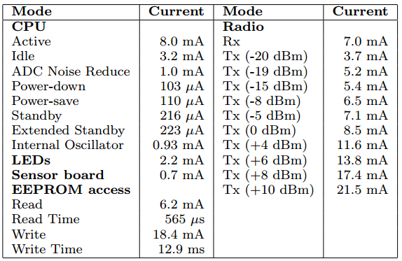
Power consumption
Notes:
Stress each component to create power model for that component.

Slide 5
Power estimation approach
Only consider idle and busy times per CPU state
Ignore difference in per-instruction power (why?)
Power per instruction is almost constant
Block execution count X cycles/block (documented)
5-10% estimation error

Slide 6
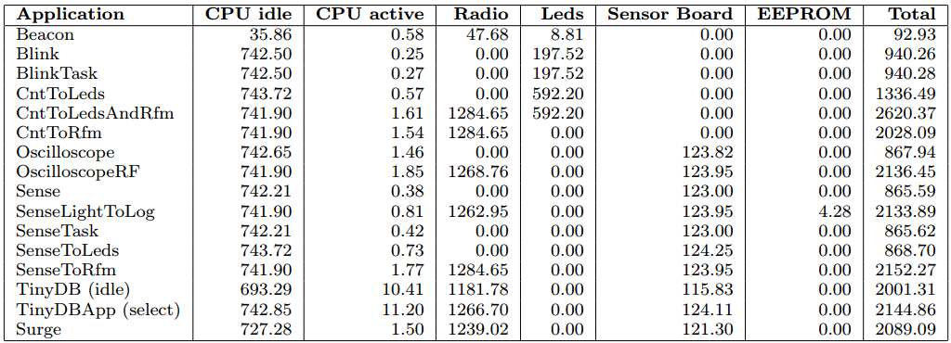
Energy breakdown
Notes:
Use LEDs only for debugging (e.g., low battery)

Slide 7
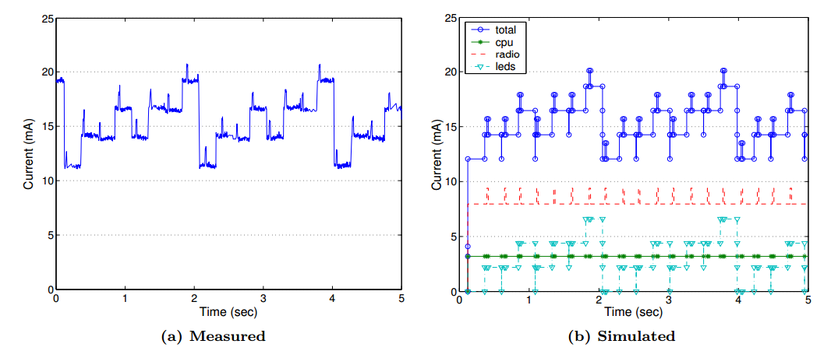
Accuracy
Notes:
Useful to see power by individual components.

Slide 8
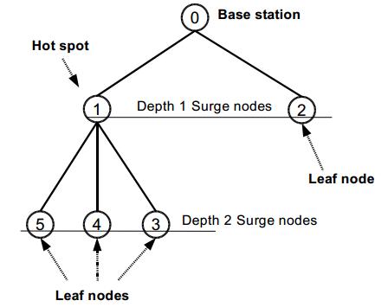
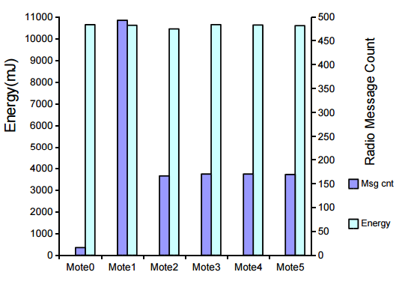
Sensor network

Slide 9
solar_embedded paper

Slide 10
Energy harvesting

Slide 11
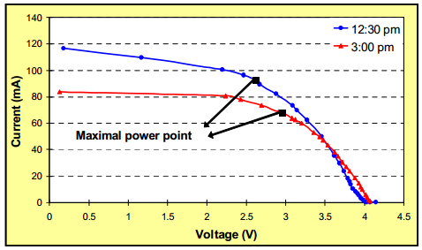
Solar cells
Energy is stored by battery (to be released later).

Slide 12
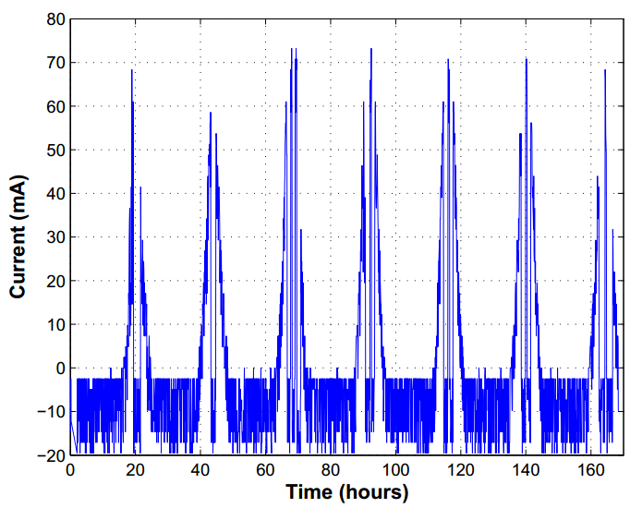
Battery charging

Slide 13
sensor_detect paper

Slide 14
Motivation
Data Collection | Event Detection
Periodic wake-up | AlwaysOn detection
Frequent reporting | Only on detection
Detect rare, yet random, events that last for a short time while consuming low energy
Passive (low power/detect) + active (high power/detect)
Similar to?

Slide 15
Detection
Suggested detection strategy?

