Slide 1
CSE 544- Fall’18
Assignment 6

Slide 2
Overview:
Three datasets: Choose one of them
Traffic violations. Link: https://www.kaggle.com/felix4guti/traffic-violations-in-usa
Craiglist car and trucks data. Link: https://www.kaggle.com/austinreese/craigslist-carstrucks-data
P2P lending data. Link: https://www.kaggle.com/skihikingkevin/online-p2p-lending
Test 5 hypotheses of which 3 are provided.
Techniques to employ for remaining 2 hypotheses: Bayesian Learning, Regression, Time Series Analysis.

Slide 3
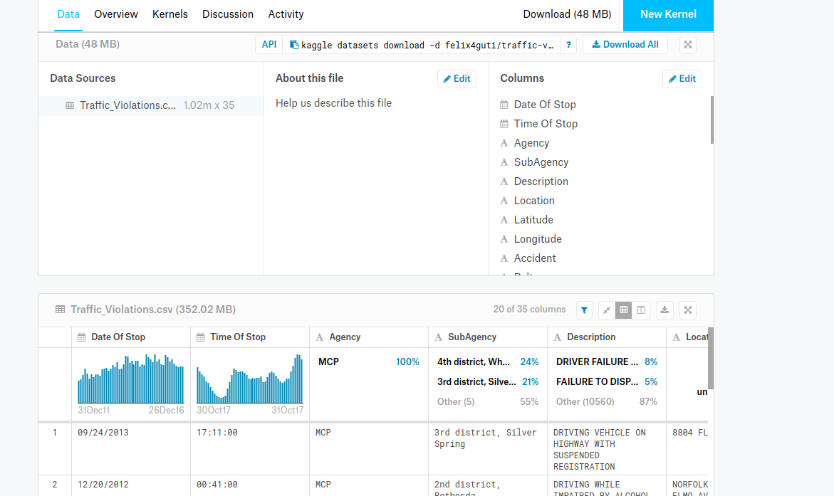
Traffic violations data
Notes:
Date Of Stop, Time Of Stop, Agency, SubAgency
Description, Location, Latitude, Longitude
Accident, Belts, Personal Injury , Property Damage, Fatal
Commercial License, HAZMAT, Commercial Vehicle
Alcohol, Work Zone, State, VehicleType, Year,
Make, Model, Color, Violation Type, Charge, Article
Contributed To Accident, Race, Gender,
Driver City, Driver State, DL State, Arrest Type, Geolocation

Slide 4
Traffic violations data
Time of violations is a uniform distribution (0, 24 hours). Use KS test to check this hypothesis. Also check this for the subset of data with Male and Female drivers.
Compare means: Honda and Toyota cars have same amount of chances of getting citation and warning. Use 2-sample Wald’s test to compare the means.
Distribution of number of citations as a function of time (0, 24 hours) is the same for Wheaton and Silver Spring districts. Check this hypothesis via Permutation test with # random samples = 100 and 10,000. Repeat for number of warnings data.

Slide 5
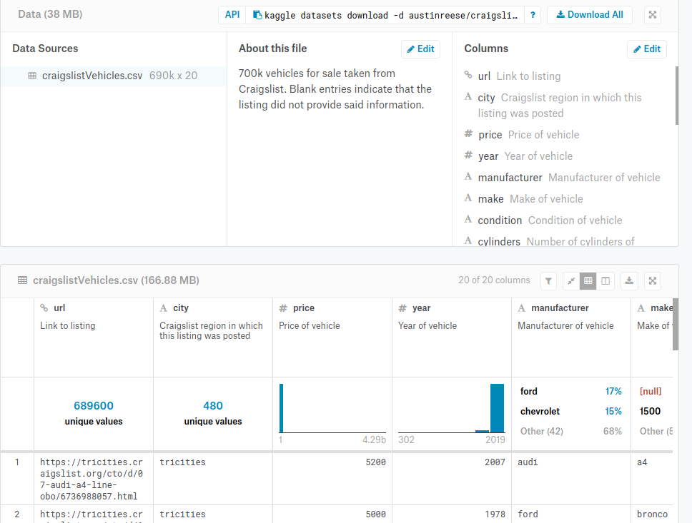
Craiglist car and trucks data

Slide 6
Craiglist car and trucks data
The age of cars available in Craigslist follows normal distribution. Use KS test to compare distributions N(10,3), N(10,5), N(12,5) where mean and standard deviations are in years.
Black color cars are more valuable than blue color cars. Use Wald’s 2-sample test to compare means.
Distribution of age of automatic transmissions sold is the same as that of manual transmissions sold. Check via Permutation test with # random samples = 100 and 10,000.
Notes:
Url, city, price
Year, manufacturer, make, condition
Cylinders, fuel, Odometer, title_status
Transmission, VIN, drive, size
Type, paint_color, image_url, lat, long

Slide 7
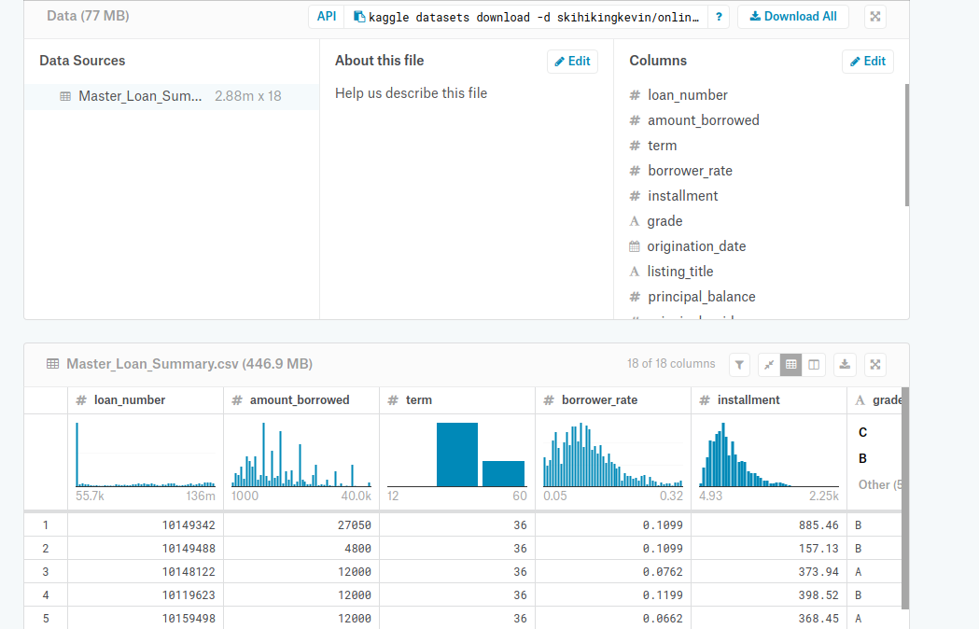
P2P lending data

Slide 8
P2P lending data
Principal paid is exponential distribution. Use KS test to compare principal paid with exponential distribution with mean = 500, 1K, 2K.
Interest paid and principal paid are drawn from same distribution. Use Permutation test with # random samples = 100 and 10,000.
Borrower interest rate is higher for #installments less than 300. Compare mean interest rate for #installments using Wald’s 2-sample test.
Notes:
Loan_number,
Amount_borrowed, term, borrower_rat, installment, grade
Origination_date, listing_title, principal_balance,
Principal_paid, interest_paid, late_fees_paid, debt_sale_proceeds_received
Last_payment_date, next_payment_due_date, days_past_due, loan_status_description, data_source

